Slide 1
Defining Metrics that Matter:
How to Amplify Resident Engagement & Overall Wellbeing

Slide 2
Introduction
Brittany discovered her love for senior care while obtaining her BS in Business Administration with a Certificate of Gerontology. As a student, she began her career as a C.N.A. and life enrichment assistant. She simultaneously assisted the Director of Aging Partners for her practicum which sparked an interest in advocacy as well.
Over the past 12 years she has had the opportunity of serving in different capacities at four senior healthcare organizations in Nebraska and Colorado. The last 8 years were spent in leadership roles focused on dementia care at Garden Terrace Alzheimer’s Center (Aurora, CO), Tabitha Adult Day Services, and The Woodlands at Hillcrest (both Lincoln, NE). Absorbing wisdom from lived experience and developing family-like relationships with clients and their loved ones were most valuable to her. For the past two years she has been a Customer Success Specialist and provides value by assisting client teams across the country.

Slide 3
02
Agenda
PART 1
Why Using Metrics is Important
PART 2
How Metrics Provide Meaningful Insight
PART 3
Where & When Metrics Set Your Team Up for Success

Slide 4
PART 1
Why Using Metrics Is Important

Slide 5
PART 1
Using Metrics Is Important..
...to Understand Your Starting Point
Currently measuring what's most important?
Accurate picture of your culture?
...to Understand Preferences...
Is admission information accessible, searchable, or adaptable?
Do staff have a voice to share their preferences?
Do families know your avenue and frequency for communication?

Slide 6
Based on lessons from COVID, we may need to look at new metrics to define success
Important Notes
Different success metrics might be needed based on different levels of care
The metrics you think are important might not be important to other communities, and that is okay!

Slide 7
When residents preference data is stored electronically, staff are:
Using Metrics Is Important..
2
x
more
likely
to create individual plans for each resident
...to Assess Communication and Care Plans
...to Assess Resident Well-Being
...to Assess Staff Efficiency
133
%
more
likely
to build community and groups
When using electronic engagement platforms, staff are:
162
%
more
likely
to report knowing if residents are engaged in programs in real-time
183
%
more
likely
to report they know if programs match resident preferences
Source: Linked Senior

Slide 8
PART 2
How Using Metrics provides Meaningful Insight

Slide 9
Use metrics to empower your leaders, drive greater accountability, and make it easier to understand the needs and desires of your residents.

Slide 10
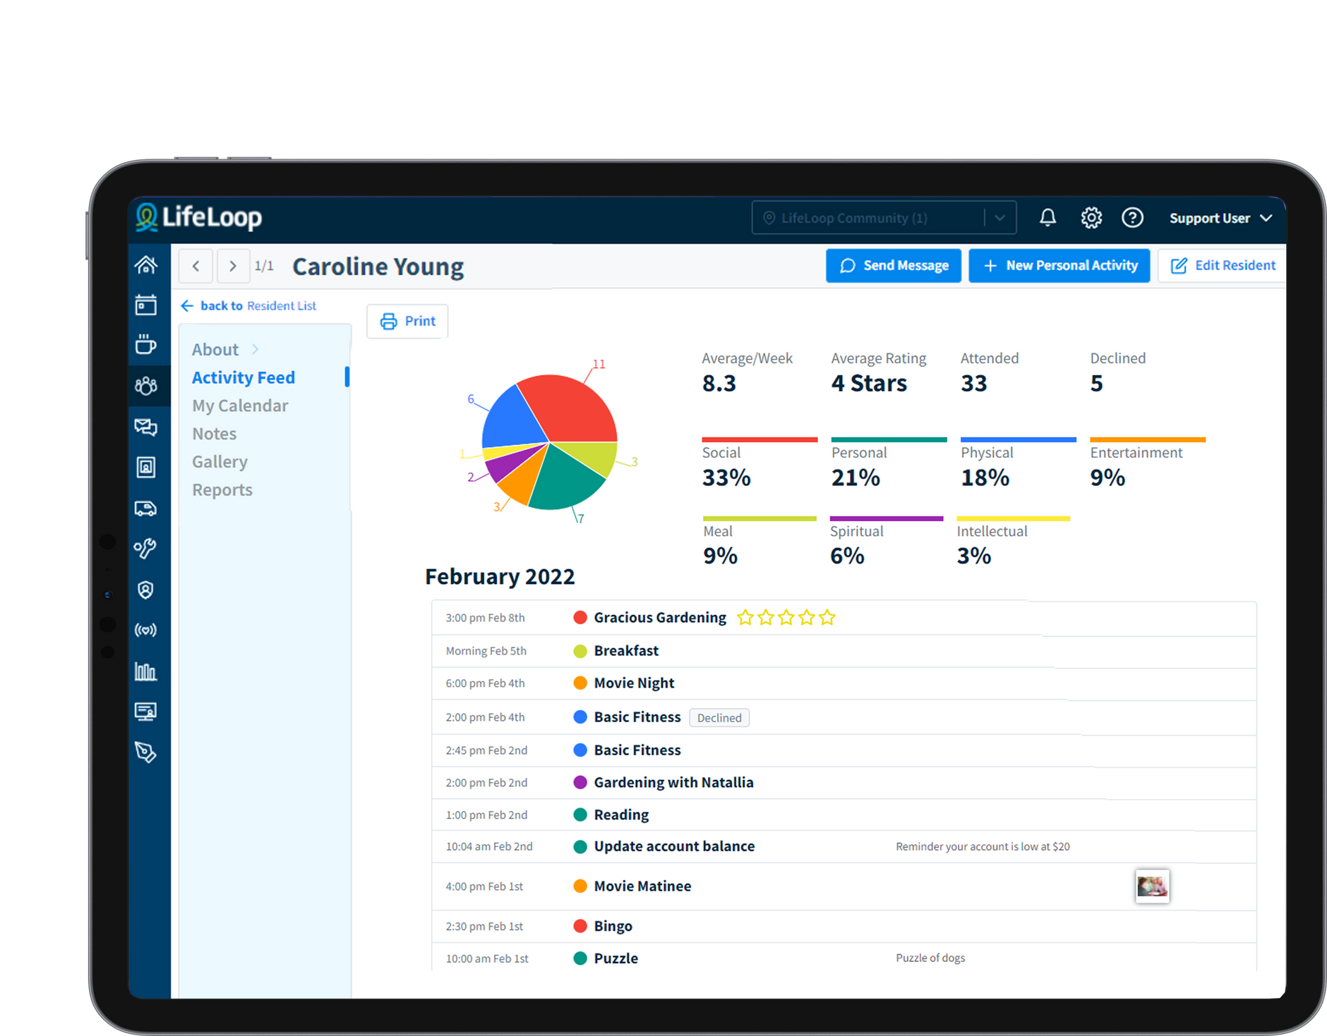
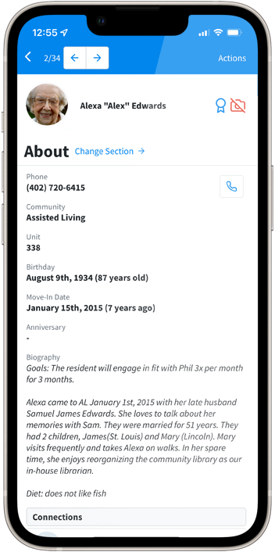
Ensure Easy to Understand Data

Slide 11
Use Data for Department Evaluation
Use data to: drive what you need from management
Use data to: see what is working and what is not working
Use data to: understand the trends of your residents
Use Data to Improve Family & Community Relationships
Ends the mystery of what they "think" is happening
Helps practice empathy
Helps care with a united front

Slide 12
PART 2
Use Data to Capture & Share ALL Types of Engagement
The pandemic helped bring to light that engagement is more than simply attending group activities—engagement is purpose and connection, which also happens on an individual level.
Residents may be highly engaged with personal acvities or small groups of friends, but not care for large group activities. Is this distinguished or measured in your community?

Slide 13
Social Connection
66%
Tailored Connection
75%
two-thirds of residents report being social is "very important" or absoluley essential"
to their well-being
Three quarters of residents say activities tailored to interests are "absolutley essential" or "very important" to well-being
Use personal interest data to connect seniors. Both interests and socialization are ranked as key drivers of happiness and wellbeing .
Source: Linked Senior

Slide 14
96% of residents felt joy 'all' or 'most of the time' after interacting with personalized content and activities
96%
Source: Linked Senior

Slide 15
Older adults who use video chat have a 50% lower risk of developing depression
50%
Source: Linked Senior

Slide 16
PART 3
Where & When Metrics Set Your Team Up for Success

Slide 17
When Social Connection Drives Satisfaction!
Communities must go beyond checking the box of providing activities, to implementing resident-led solutions for preventing loneliness and facilitating friendships.
99%
98%
Resident families say that having friends impacts a resident’s well-being
Agree that having friends impacts
a resident's families satisfaction
Source:iN2L

Slide 18
One of the biggest lessons the senior living industry learned during the pandemic is how vital technology-enabled social connection is.
Residents must have a way to connect with each other and maintain friendships, and engagement technology can help facilitate all kinds of interactions.
Technology solutions empower residents to connect with each other over shared interests.

Slide 19
Top 3 reasons a family member would not recommend a community:
1
No opportunities for my loved ones to socialize with other residents
2
No opportunities for engagement activties that interest my loved one
3
No opportunities for my loved ones to socialize with family or friends living outside the community
Source: iN2L

Slide 20
It is traditional to think of technology as replacing human labor and expertise. Although true in some areas, in caring for seniors, technology can have the opposite effect.

Slide 21
PART 3
By increasing efficiency, community management solutions can actually free up staff members to spend more time with residents and provide higher-quality care.
Often the most common complaint in senior living communities: 'feeling rushed when being assisted by staff'.

Slide 22
When technology doesn’t prevent human interaction, but deepens it.
Ultimately, this produces positive business results and tremendous ROI, but that’s a secondary benefit. Better care and more rewarding relationships are the top priorities for staff who use the system, and for residents and their families.
Efficiency and wellness can change the landscape for senior care overall, increase the desire for people to work in the industry, and eliminate negative stigmas.

Slide 23
Questions?

Slide 24
THANK YOU!
Brittany Tran
Brittany.Tran@ourlifeloop.com

