Slide 1
Modern Cyber Risks Focusing Your Risk Mitigation Strategies
May 2024

Slide 3
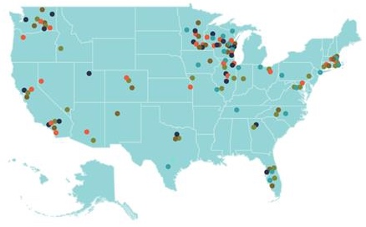
CLA – A Professional Services Firm
A professional services firm with five distinct business lines
Audit
Tax
Outsourcing
Wealth Advisory
Digital
More than 8,500 professionals
Offices coast to coast
Investment advisory services are offered through CliftonLarsonAllen Wealth Advisors, LLC.

Slide 4
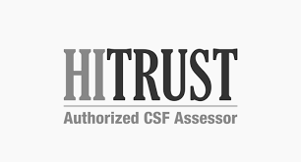
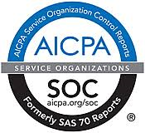
Cyber Security Services at CLA
Information Security offered as specialized service offering for over 25 years
Penetration Testing and Vulnerability Assessment
Black Box, Red Team, and Collaborative Assessments
IT/Cyber security risk assessments
IT audit and compliance (HIPAA, GLBA/FFIEC, NIST, CMMC, CIS, etc.)
PCI-DSS Readiness and Compliance Assessments (PCI-DSS)
Outsourced Information Security Advisory
Incident response and forensics
Independent security consulting
Remediation assistance
Internal audit support
*Callahan and Associates 2021 Guide to Credit Union CPA Auditors.

Slide 5
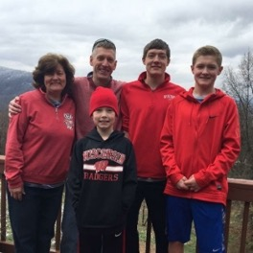
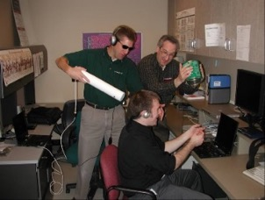
C:\whoami > m0th_man
“Professional Student”
Science Teacher / Self Taught Computer Guy
IT Consultant - Project Manager → IT Staff/Help Desk → Hacker
Assistant Scout Master (Boy Scouts)
Boys Scouts Motto: Be Prepared

Slide 6
Sun Tzu: “Know Your Enemy” The Current Threat Landscape

Slide 7
Raise Your Hand if You Work for a Tech Company
Security Cameras
Motion Sensors
Logistics/GPS Tracking
Print Vendors
Smart TV Displays
HVAC
Digital Assistance
Cloud Applications & Analytics
Bio-Medical Care & Monitoring
“Presence”
Security cameras
Garage door
Home thermostat
Cable TV remote
Smart TV
Sleep number bed
Roomba
“Hey Siri, what’s my balance?”
Apple Watch or FitBit
“Presence”
Are You Prepared?
7

Slide 8
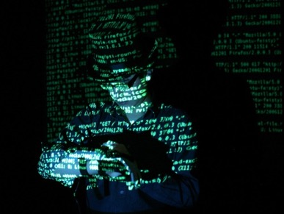
Cybercrime and Black-Market Economies
Black market economy to support cyber fraud
Business models and specialization
Underground Marketplace (The Dark Web)
Most common cyber fraud scenarios we see affecting our clients
Theft of information
Log-in Credentials
ePHI, PII, PFI, account profiles, etc.
Credit card information
Ransomware and interference w/ operations
Monetization of access…
To the Hackers, we all look the same…
They will hit you with any or all of the following:
Email Spear Phishing Attacks
Password Guessing and Business Email Account Takeovers
Payment and Funds Disbursement Transfer Fraud
Data exfiltration
Ransomware
Extortion to avoid breach disclosure
8

Slide 9
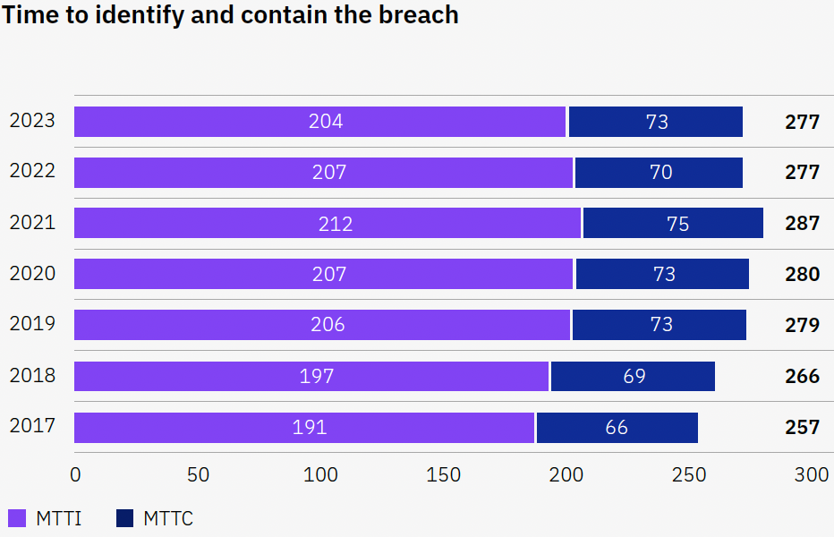
Average Days to Identify and Contain a Data Breach
Global average is
277 days
204 days to identify a breach
73 days to contain the attack
What are the bad guys doing for 204 days?
Source: IBM Security Cost of a Data Breach Report 2023
Notes:
What are they doing while they are inside???
Create numerous back doors
Learn everything about your institution
Find your crown jewels and take them
Disable backups and security systems
Monetize their access for as long as they can…

Slide 10
Email Spear Phishing The Root Cause For More Than 85% of Breaches

Slide 11
Microsoft 2022 Digital Defense Report: Attackers are Targeting Businesses
Microsoft 365 credentials remain one of the most highly sought after account types for attackers
Once compromised attackers can log in to corporate-tied computer systems
1hr 12 m - The median time is takes for an attacker to access your private data if you fall victim to a phishing email
1hr 42 m - The median time for an attacker to begin moving laterally within your corporate network once a device is compromised
Business Email Compromise (BEC) is attack of choice for higher payouts
Notes:
Credential phishing schemes are on the rise and remain a substantial threat to users everywhere because they indiscriminately target all inboxes. Among the threats our researchers track and protect against, the volume of phishing attacks is orders of magnitude greater than all other threats.
Using data from Defender for Office, we see malicious email and compromised identity activity. Azure Active Directory Identity Protection provides still more information through compromised identity event alerts.

Slide 12
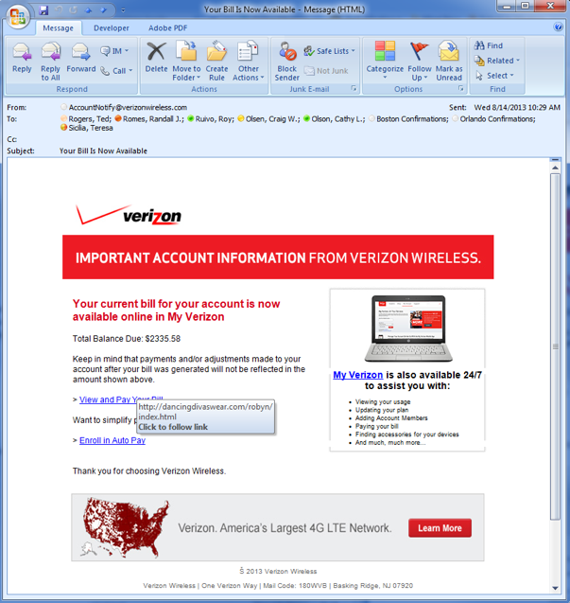
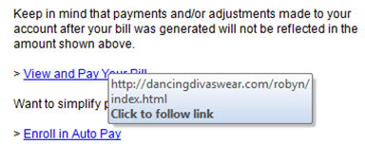
Spear Phishing

Slide 13
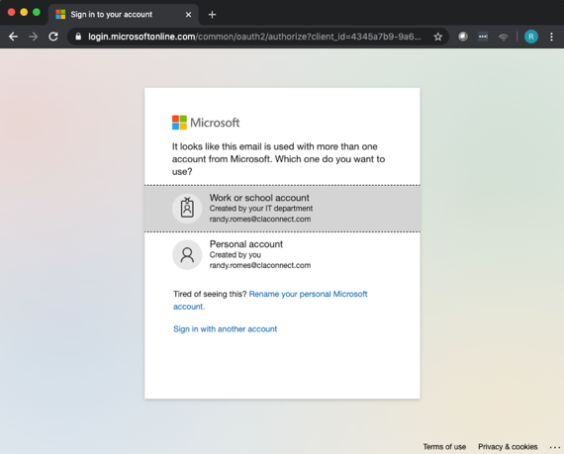
Credential Harvesting and Password Guessing:
Attacks on Office365
Password guessing attacks
Phishing that harvests credentials

Slide 14
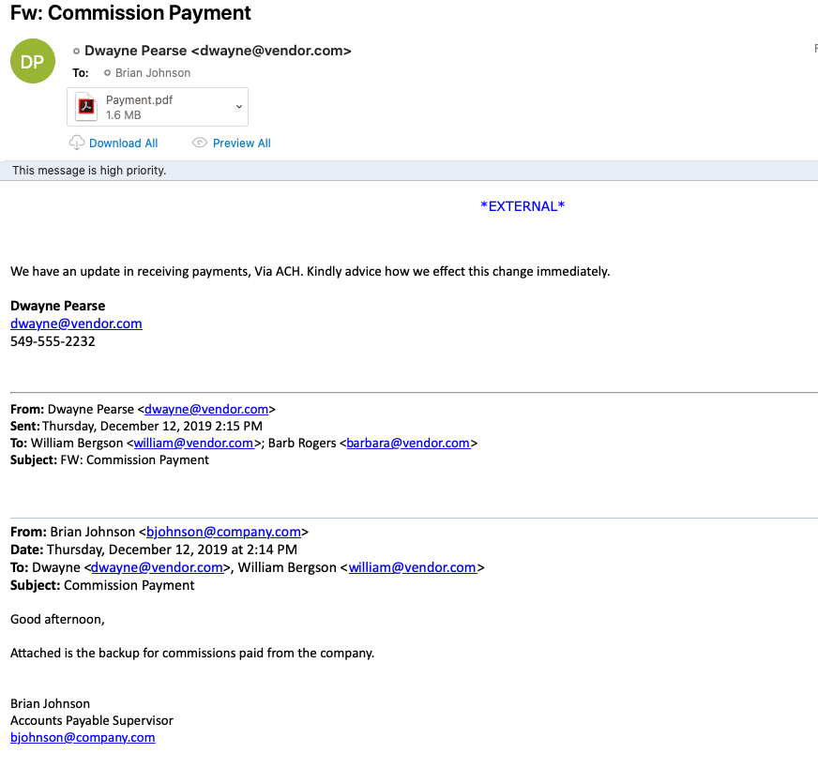
Business Email Compromise
Finance person’s email account is compromised.…
Finance person phished
…buy a bunch of gift cards…
IT staff “investigated…” / IT staff “shut it down”
Governances asks: We are good (right?)
Issues
Retention time and data storage limits
Email hardening controls not implemented
IT is not equipped to perform incident response
Notes:
87,000 CC #
51,000 SSNs

Slide 15
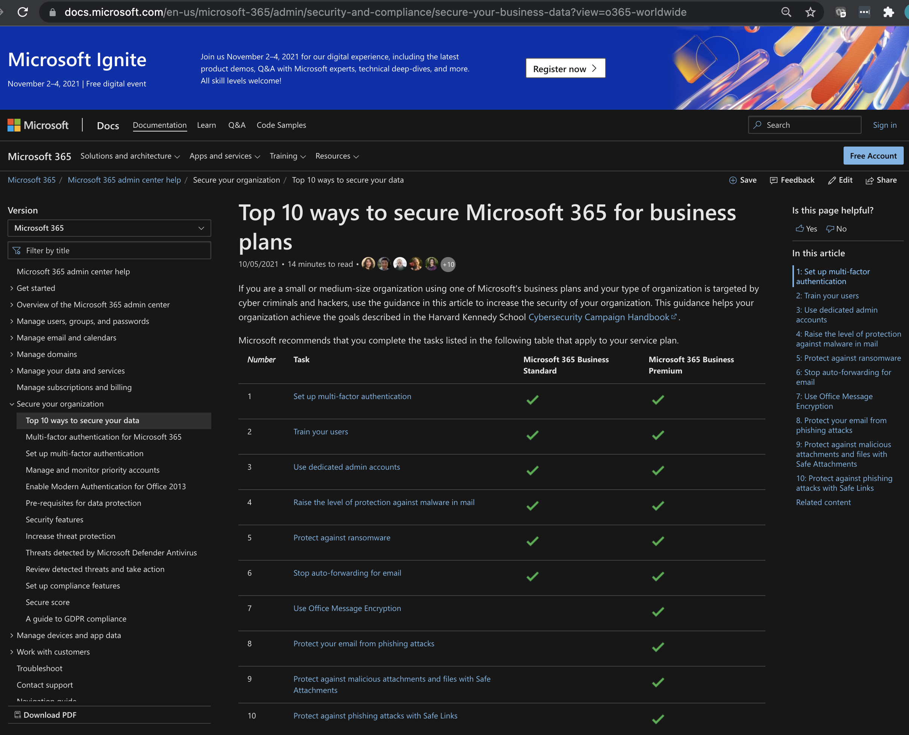
Secure Office 365
NOT fully secure by default
Enable/Turn On security features
Harden (email) security
Fine tune logging, monitoring and alerting
Enforce retention periods
Security configurations need to be periodically assessed
Logging is based on license level
Notes:
Conditional Access – like old AD GPO issues: overlaps, conflicts, exclusions, exceptions…
3rd Party Spam Filter? Need Transport Rules to block MS
Azure AD Device Join – can bypass MFA and Conditional Access
Global Admins in Azure…. What do they sync to locally
Autofowarding

Slide 16
Does Your Organization Already Use a Phishing Service?
“We already use _______”
“IT tests our people every ___”
”Click through rate is ___”
“Failures are required to take training…”
“We report results to the board quarterly…”
These are important…
These services are best categorized as training and training effectiveness measurement tools.
They are NOT penetration testing…
There is a “so what factor” that you may be missing…

Slide 17
Attacking the Supply Chain:

Slide 18
Software Vendor/Supply Chain Risk Management
All software products have bugs/vulnerabilities
Key questions:
Do we have accurate system and data inventory?
What does this software application have access to?
What user account/privileges are given to it?
What do we need to do for our due diligence?
What impact does this software have on the institution…
If it is hacked/breached?
If it is down for… 2 hours? 2 days? 2 weeks? 2 months?
Pick your hosted software vendor:
MoveIT
Kronos
Solarwinds
MS Exchange
_________

Slide 19
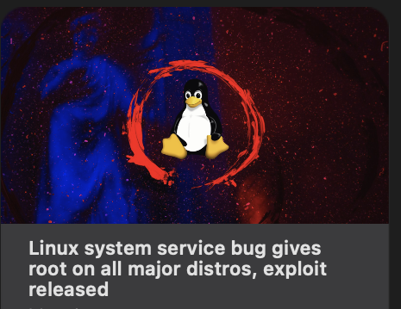
Software Vendor/Supply Chain Risk Management
Imbedded Software:
Common software components with exploitable vulnerabilities.
Recent examples include
“Log4j” Java vulnerabilities…
Pkexec - CVE-2021-4034 (PwnKit)
Python – CVE-2007-4559
September 2022
15-Year-Old Python Flaw Slithers into software worldwide
An unpatched flaw in more than 350,000 unique open source repositories leaves software applications vulnerable to exploit.
Google:
Log4j vulnerabilities

Slide 20
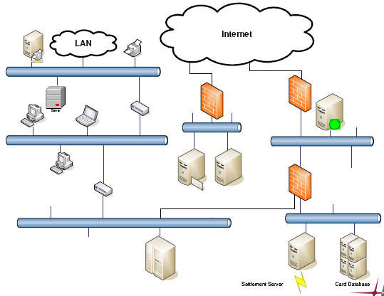
Java Software and Log4j
Java in Firewall(s)
Java in
Multifunction device
Java in
Printer
Linux appliance
Where else?
Java in web server

Slide 21
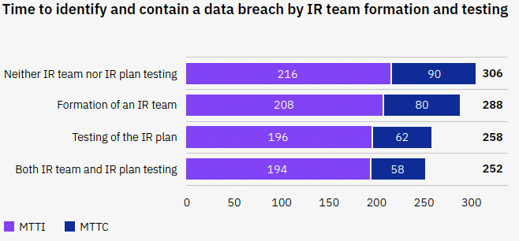
Take-Aways and To-Dos (i.e., IR)
Have a plan
Incident Response Play Book(s)
Disaster Recovery Plan and Procedures
Business Continuity Plan supported by Business Impact Analysis
Know how the vendors fit into and support the plan
Service provider responsibility matrix
Practice the plan
Tabletop exercises
Red Team Penetration Tests
Regularly review and update the Plan(s)
Having/practicing plan improves…
Source: IBM Security Cost of a Data Breach Report 2023

Slide 22
Interference With Operations and Extortion
Ransomware is not going away…

Slide 23
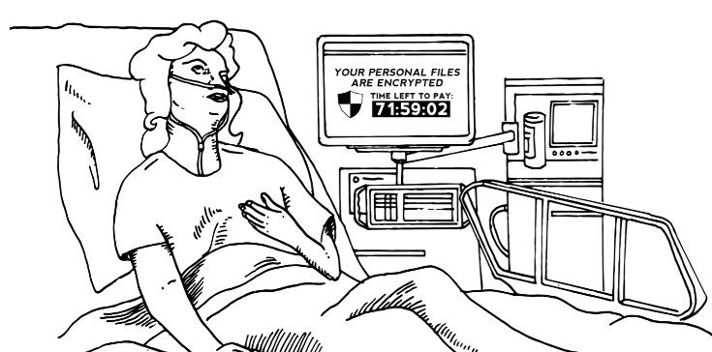
Ransomware
Ransomware bursts on the scene more than eight years ago…
Notes:
Describe Imperial County.
- Ransomware demand of $1.2M
Estimate to recover on own and fix was over $3M
WOULD NEED TO DO THIS ANYWAY…
Did NOT pay
More than 8 months later… still not done fixing and cost has soared past $3M

Slide 24
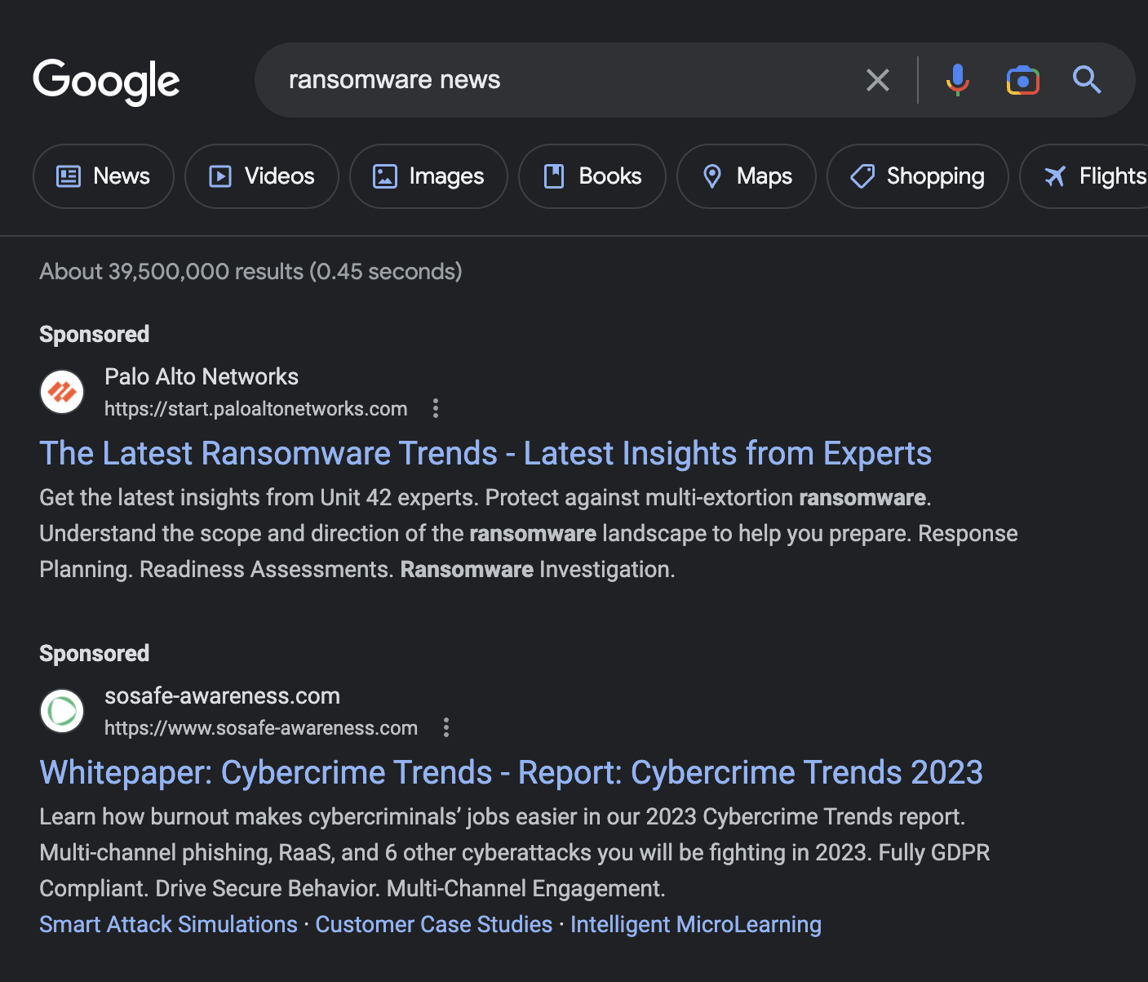
Ransomware
Interfere with operational up time
This costs $
Extortion:
Pay to release data
Pay to avoid exposure
Threaten those whose data has been stolen

Slide 25
Ransomware Attacks Continue to Evolve
Earliest versions attack consumer availability
2nd generation attacked business availability & confidentiality
Latest versions
Successful against all operating systems
Search for and encrypt back ups first
FINISH with threat of data disclosure (DR is not enough…)
If you have not tested your susceptibility to Ransomware…???
If you have not tested your recovery capabilities, from bare metal up…???
Are you confident your hosted vendor is prepared???
Change Health Care?
Ransomware

Slide 26
Standards Based Operations “People, Rules, and Tools”

Slide 27
Peace of Mind - It Starts with Policies and Standards
Security is not a product
People, Rules and Tools
What do we expect to occur?
How do we conduct business?
Who is responsible for what?
Standards based operations from a governance or compliance framework:
HIPAA, GLBA, State Laws ----- Regulatory
PCI – DSS, CMMC ----- Contractual
CIS Critical Controls, NIST ----- Operational standards

Slide 28
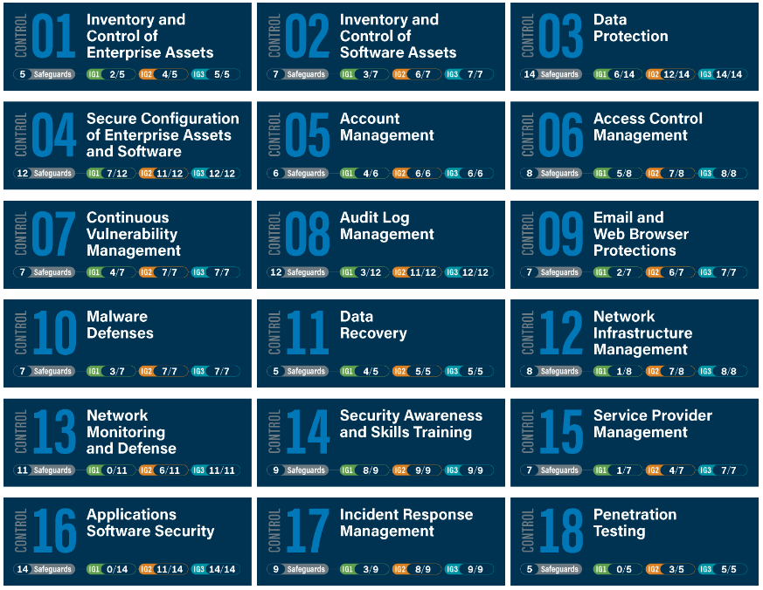
Standards Based IT and Cyber Operations
https://www.cisecurity.org/controls/
Notes:
New version has more focus and emphasis on internet based/cloud based systems and processes…
Implementation groups

Slide 29
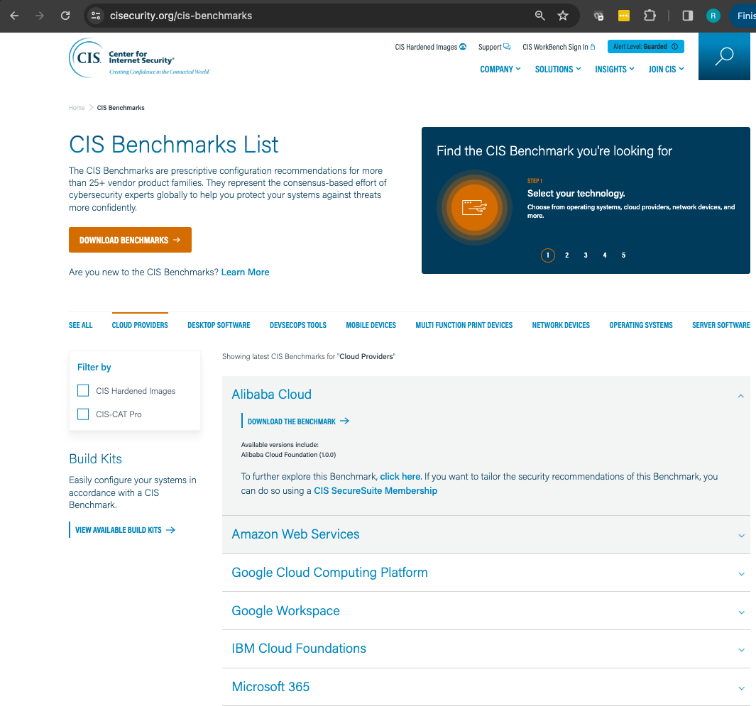
CIS Benchmarks & Hardening Guides
CIS Benchmarks
Checklists and How-to guides for just about everything
Cloud
Desktops Software
Mobile Devices
Multi-function Devices
Network Devices
Operating Systems
Server Software
Etc.

Slide 30
Operational Discipline
Stick to the standards
Disciplined change management
Consistent exception control and documentation
Should include risk evaluation and acceptance of risk
Risk mitigation strategies
Expiration and re-analysis of risk acceptance
Stick to the update and testing schedule

Slide 31
Independent Security Testing
Independent security testing is core tenant of most frameworks
CIS Control 18
NIST NIST 800-115
PCI Requirement 11
CMMC Level 4 Maturity - “Proactive” hygiene
HIPPA Periodic technical validation testing: Evaluation (§ 164.308(a)(8))
What is the difference?
Vulnerability Scanning
Penetration Testing

Slide 32
Disaster Recovery & Business Continuity
Inventory of assets and results of risk assessment are crucial
Hardware and software inventory
Critical data elements (“the crown jewels”) inventory
Data Retention policies and standards
Where is the data (if we know where it is, we know where to apply controls)
Critical business processes
Business impact analysis with definition of recovery point objectives
This is another name for a specialized type of risk assessment
Defines criticality and priority for restoration
Disaster Recovery is periodically practiced
Need to make sure it works the way you expect
IT needs to PRACTICE – prove they can restore in the heat of the moment

Slide 33
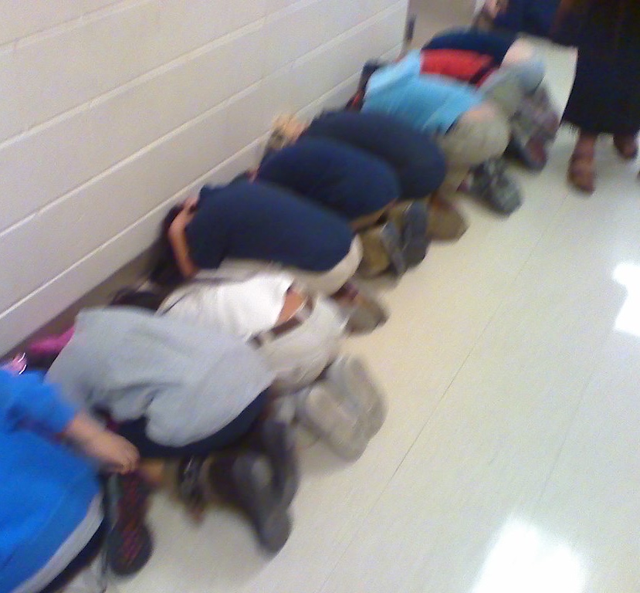
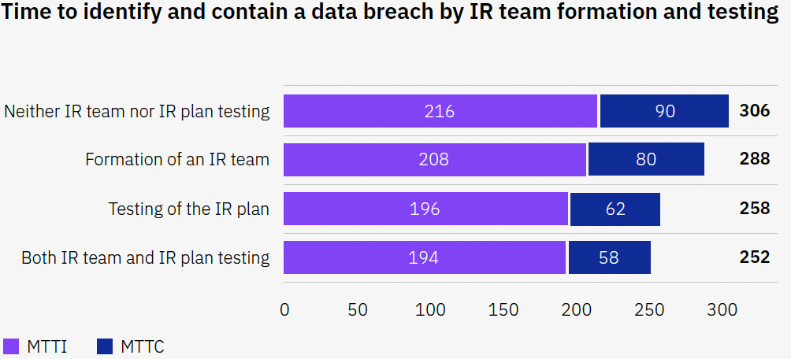
Practice the Plan
Tabletop exercises- simulations where participants walk through the incident and response procedures
Two types of tabletop exercises
Technical
Management
Both types should be conducted annually
Spear phishing tests and other social engineering tests
Red team penetration testing
Source: IBM Security Cost of a Data Breach Report 2023
Notes:
Like all emergency procedures, they need to be practiced

Slide 34
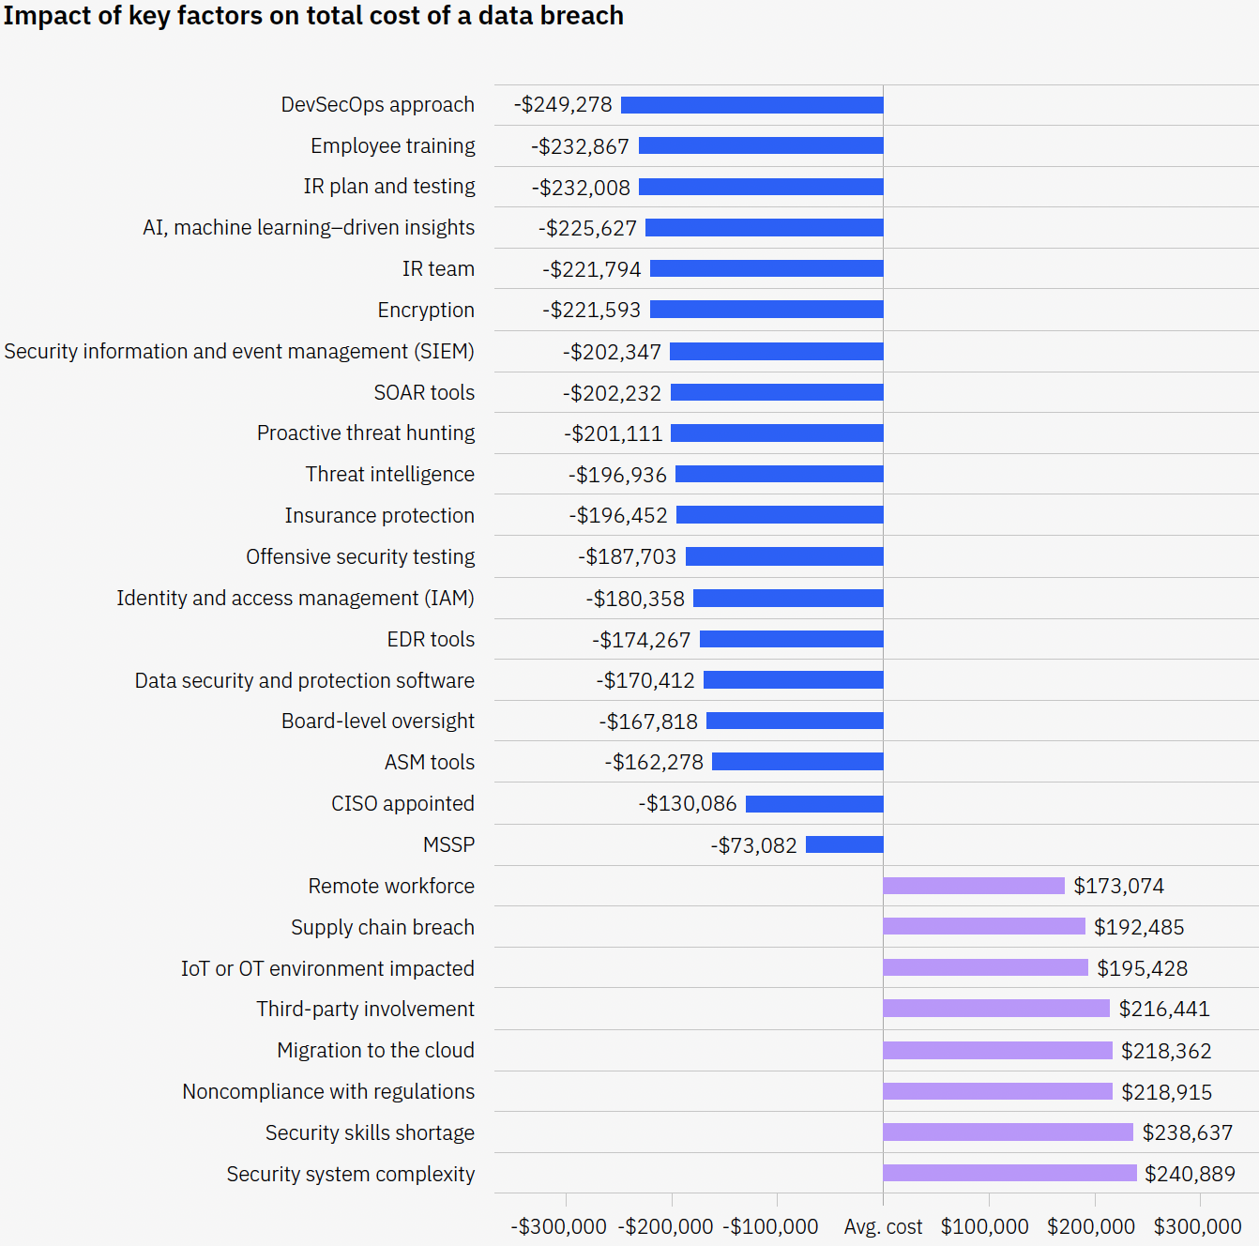
Incident Preparedness Cost Savings
Global Average cost is $4.45M
The impact of 27 factors on the average cost of a data breach
Source: IBM Security Cost of a Data Breach Report 2023

Slide 35
Boy Scouts Motto: Be Prepared…
Prepare
Operate
Test
Standards Based Operations and Exception Management
Daily Operational DNA
Regular/periodic risk assessment:
Daily Business as Usual
Monitor and fine tune:
Continuous improvement
Practice and Test
Audit your operations controls (against a framework)
Review Office 365 (O365) security (periodically)
Schedule IR Tabletop and Disaster Recovery exercises
Test new systems and after significant change
Test and prove your cyber hygiene and resilience
Governance - PROVE IT
35

Slide 36
Thank you!
Randy Romes CISSP, CRISC, CISA, MCP, PCI-QSA
Principal – Cybersecurity
612.397.3114
randy.romes@CLAconnect.com

