Slide 1

How to Create a Strategic &
Innovative Technology Roadmap
for Your Community

Slide 2

Amber Bardon
Founded Parasol Alliance based on a vision to transform senior living technology culture.
Possesses over a decade of experience in senior living technology and strategic planning.
Built a 100% virtual company with a multi-state workforce and client-base.
Contributing member & presenter for Leading Age National, VA, MD, DC, MO, IN, TN, WI, IL, Mennonite Health Assembly & Channel Futures MSP 501.

Slide 3
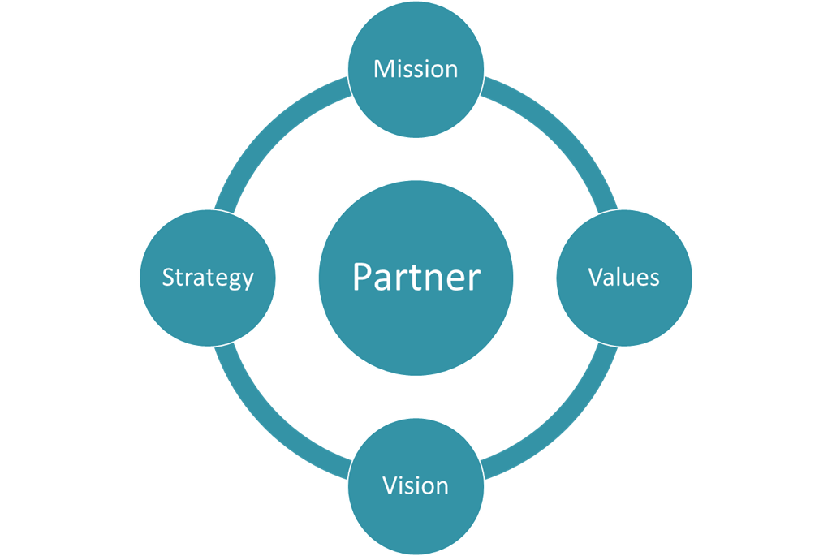

Senior Living Expertise
What is Parasol Alliance?
We specialize in strategic planning, project management and IT operations to help our clients effectively leverage technology and achieve their long-range goals.
Serving more than 40 communities
Decades of senior living expertise on
our team
Executed more than 70 strategic plans
Completed over 500 projects
Supporting over 10,000 end users
Our Vision: Transform Technology Culture in Senior Living
Notes:
Other secret: client happiness
Client focused business
BOD has wealth of experience in governance
Staff have been hired from clients
Expertise in strategic roadmaps
Share best practices

Slide 4
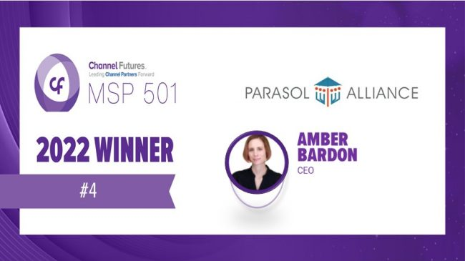


20 Workplace Awards
& #4 MSP in the World
Notes:
Work from home
Unlimited PTO
Reimbursements for health clubs + certification
Mentorship program, Parasol Academy
Committees opportunity to give back

Slide 5
Communication
Sustainability
Why & How
Execution
Now more than
ever before,
having a comprehensive technology
strategic plan is essential.

Slide 6
Defining “IT” vs. Technology Culture
Innovation
Business Systems
Infrastructure & Operations
Culture
Technology
Pyramid

Slide 7

What does Technology Mean?
Infrastructure, Systems, Operations
Defining “IT” vs. Technology Culture
Infrastructure, Systems & Operations
Change & Solutions
Culture
Innovation
Governance
Low Voltage & Telecom

Slide 8
Senior Housing 2022 Technology Survey
Only 16% of Senior Living leaders believe their organization was fully prepared from a technology standpoint to address the challenges of COVID.
78% of respondents reported an increase
in technology spending in 2021.
70% stated they are increasing their technology budgets in 2022.
Outcomes
of
2022
Notes:
Findings from the Senior Housing 2022 Technology Survey of 247 senior living providers:
Only 16% of respondents believe their organization was fully-prepared from a technology standpoint to address the unique challenges of COVID-19.
Seventy-eight percent of respondents reported their technology spending increased during 2021.
Technology spending is a priority among survey participants, with 70% planning to increase their technology budget relative to 2021.

Slide 9
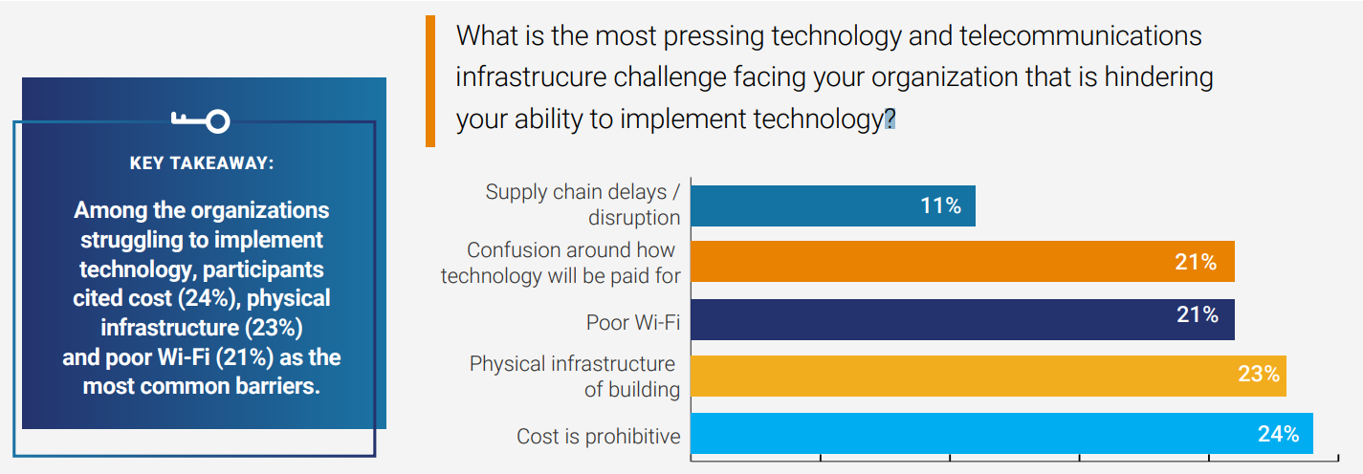
Senior Housing 2022 Technology Survey

Slide 10




IT Strategy
The Importance and Components of
a Strategic Technology Plan
Assessment
Scorecard
Roadmap
Execution

Slide 11
Assessment
The Importance and Components of
a Strategic Technology Plan
Long-range community objectives
Current + Future Technology Culture
Interviews/Staff input
Current infrastructure, operations and business systems
Notes:
When you create your long-range technology plan, consider:
Consider long-range business objectives
What will future residents expect
What is your current technology culture and where do you need to be
Deployment for residents & employees

Slide 12
Scorecard
The Importance and Components of
a Strategic Technology Plan
Best practices
End of life hardware
Configuration
Standards

Slide 13
Roadmap
The Importance and Components of
a Strategic Technology Plan
Comprehensive
Organized by budget year
Costs
Agreed upon and accepted

Slide 14
The Importance and Components of
a Strategic Technology Plan
  Steering Committee
  Project Management
  Champions
  Technology/business partnership
  Technology culture
  SME Groups
  Regular check-ins
Execution

Slide 15
The Importance and Components of
a Strategic Technology Plan
Project Plan Includes:
Business objectives and strategic goals
Problems we’re solving
Background
Scope and schedule
Deliverables
Constraints
Stakeholders
Communication plan
Assumptions and risk
Project
Management

Slide 16
The Importance and Components of
a Strategic Technology Plan
3 years:
Assessment & Roadmap
Annual:
Budget
Quarterly:
Steering Committee & Projects
Notes:
Where to start

Slide 17
The Tech Team
Systems Engineers
Project Managers
Business Analysts
Onsite Technical Support
Client Service Managers
Support team
Infrastructure design and strategy
Manage the implementation of the roadmap and client relations
Technical resources & day-to-day support
Network & Security Engineers
Notes:
Consider the full technology expertise needed to execute the roadmap

Slide 18

The Importance and Components of
a Strategic Technology Plan
Residents
Resident Technology Plan
Engagement Systems
Personal Support
Smart homes and beyond

Slide 19

Innovation

Slide 20

Innovation Technology Solutions
to Differentiate Your Community
Virtual Reality
Staff
Residents

Slide 21

Resident Engagement Applications
Communication
Daily living and lifestyle
Activities
Dining
Work orders
Family

Slide 22


Smart Homes
Innovation Technology Solutions
to Differentiate Your Community
Notes:
Smart Home technology is becoming more innovative and more affordable. A SmartHub switch can be installed in an apartment that can service up to 250 iOT devices. Examples of iOT devices include thermostats, lighting control, active monitoring of movement in the apartment, electronic locking, lighting up a path to the bathroom at night, smart pill dispensers, medic alert tech, and robotic cleaners, to name a few. Smart Home technology can also be used for wellness check-ins as well as falls monitoring. Most Smart Home technology integrates with voice recognition software such as Alexa.

Slide 23

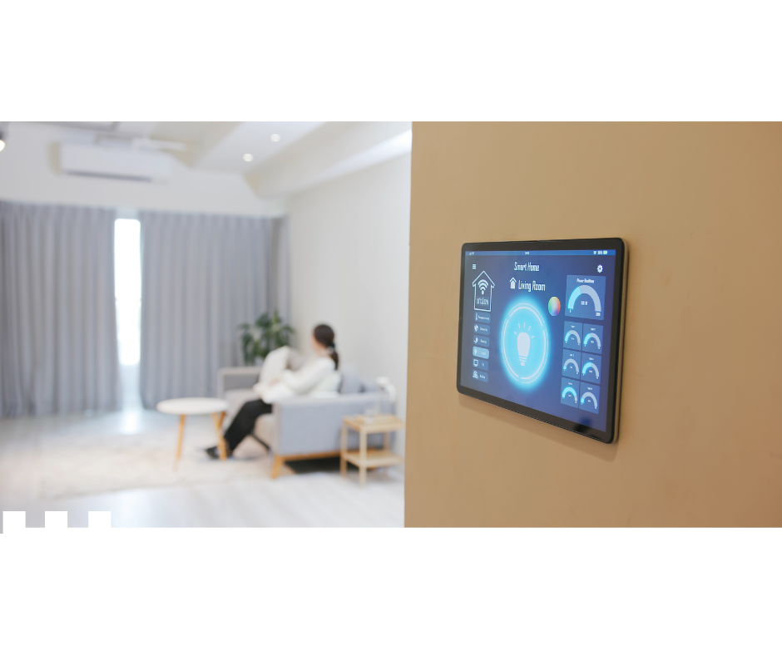
Falls Technology
Innovation Technology Solutions
to Differentiate Your Community
Ai
AI devices
Cameras
Active monitoring
Smart lamps / toilets
Wearables

Slide 24



New Construction Technology
“A Day in the Life”
Raising Tech Podcast
Season 1, Episode 9

Slide 25

Robotics and Artificial Intelligence (AI)
Innovation Technology Solutions
to Differentiate Your Community
Robots
Robot devices
Telehealth
Medication dispersion
Pets
Cleaning
Companionship

Slide 26


Telehealth
Innovation Technology Solutions
to Differentiate Your Community
Notes:
Telehealth saw wider adoption with the Covid19 pandemic. The biggest hurdle, reimbursement, was somewhat addressed with shifting pandemic rules. Telehealth can be most useful for specialty visits, such as psychiatry, or in rural areas. Use of telehealth visits can reduce hospital admissions.

Slide 27

Video Storytelling
Innovation Technology Solutions
to Differentiate Your Community
Accelerated by the onset of the pandemic, video app storytelling helped communities effectively leverage the power of video to generate and convert leads, as well as engage residents and family members.
These video apps allow you to quickly create and send branded, personalized videos via email, text, and more.
Notes:
Customized to your community’s branding. Big during Covid. Instead of emailing or calling, sending personalized video. Videos generate more views than a phone call or email.
Videos are being sent to prospects by staff.

Slide 28

Innovation Technology Solutions
to Differentiate Your Community
Website Engagement & Conversion Tools:
  Live Chat
  Automated Chatbots
  Decision Science Assessments

Slide 29

Business Intelligence/
Data Analytics
Notes:
Customized to your community’s branding. Big during Covid. Instead of emailing or calling, sending personalized video. Videos generate more views than a phone call or email.
Videos are being sent to prospects by staff.

Slide 30

Staffing
Innovation Technology Solutions
to Differentiate Your Community

Slide 31



Online at: www.ParasolAlliance.com
Email: amber.bardon@parasolalliance.com

