Slide 1
Making it Happen: Lessons in Change Leadership
Jill Vitale-Aussem, President & CEO
Christian Living Communities
Notes:
I’ve got a pretty rebellious spirit and I’ve always known that elders deserve better than what our current systems provide. So I’ve been trying to create change in the communities I’ve worked in for about 15 years. It’s only in the past 3-4 years that I have gotten good at it. What I am going to share with you are some of the things that I wish I had known years ago. Things that will help you understand how change affects individuals, and organizations.

Slide 2
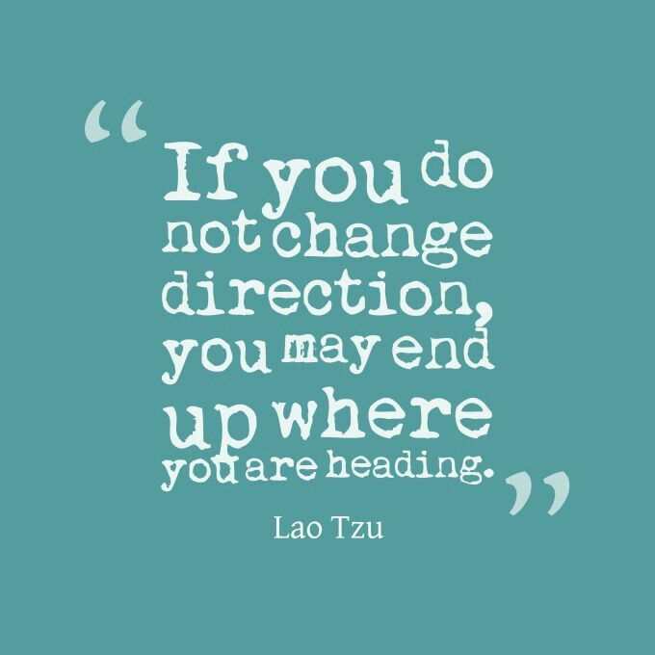

Slide 3
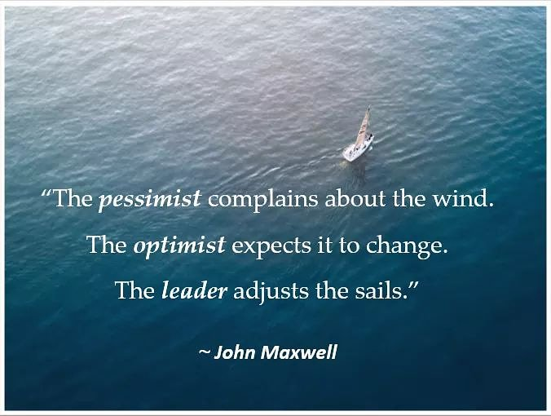
To be a leader you must be able to create positive change.

Slide 4
Expect resistance!
Diagnosing a situation
Getting people on board with change
Change leadership practices
Being our best in times of stress
Getting out of our own way

Slide 5
Resistance is the first step to change
-Louise Hay

Slide 6
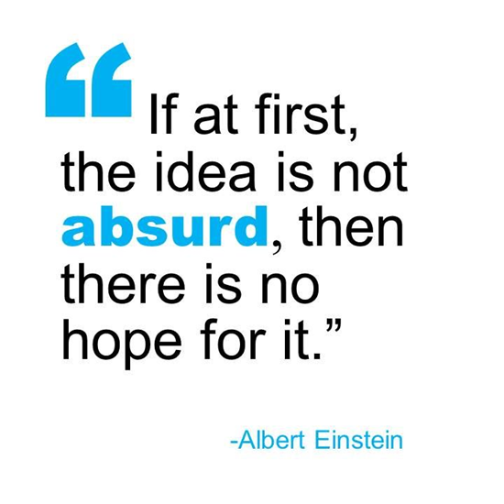
Handwashing
Light bulbs
Personal Computers
Bicycles
“Talking” Pictures

Slide 7
Technical Problem
or
Adaptive Challenge?
Notes:
I strongly believe that many culture change initiatives in health care fail because we fail to see the difference between a technical problem and an adaptive challenge. Ronald Heifetz pioneered this theory and it makes a lot of sense.

Slide 8
Technical Problems | Adaptive Challenges
Easy to identify | Difficult to identify (easy to deny)
Quick & easy solutions, improve existing practices | Require changes in values, beliefs, roles, relationships & approaches to work.
Can be solved by authority or expert, knowledge and skills readily available | People with the problem do the work of solving it, solution is not readily available
Change required in only one or two places | Change required in many places, throughout organization
People usually receptive to technical solutions | People will resist
Solutions implemented quickly by edict, policies, procedures | Require much experimentation and discovery over a long period of time
Adapted from Heifetz, R.A. (1994). Leadership without easy answers. Cambridge, MA: Belknap Press.
Notes:
We are really good at technical problems in our field. We’re great at implementing new checklists.
We need to get really good at identifying technical challenge or adaptive challenge.
Building a new building.
Calling a unit a neighborhood
Getting dogs and cats and plants
People using cell phones
guardian angel program,
If you throw all the technical fixes you can at the problem and the problem persists, it’s a pretty clear signal that an underlying adaptive challenge still needs to be met.
Adaptive challenges are often harder to pin down, and less clearly visible, than technical ones, and certainly tougher to work on.”

Slide 9
Change Resistance =
The loss you are asking people to incur outweighs the perceived purpose
Notes:
Adaptive change stimulates resistance because it challenges people’s habits, beliefs, and values. It asks them to take a loss, experience uncertainty, and even express disloyalty to people and cultures. Because adaptive change asks people to question and perhaps refine aspects of their identity, it also challenges their sense of competence.
Years ago, I was the administrator of a large nursing home in colorado. I knew things were broken in our system and that the community was very institutional. Our ombudsman kept telling me I needed to go to Certified Eden Associate training. I was very interested but still a bit resistant. Looking back, I now understand that by going to this class I would be admitting that many of the things I had been doing all of these years weren’t the right way to do things. And I was pretty good at doing things in the institutional model – I had a lot invested in becoming a good administrator in the traditional setting. So it was scary to think about learning things that would make me feel incompetent.
Loss, disloyalty, and feeling incompetent. That’s a lot to ask. No wonder people resist. It wasn’t until I went to the class. And susan black, the instructor and an experienced admistrator talked about the normal feelings of incompetence that come with it that I was able to relax a bit, open up and move ahead.
Think about the people in your organization who are the most resistant to change….many times it’s the people who have worked there the longest and who have the most time invested in their careers. They have the most to lose.

Slide 10
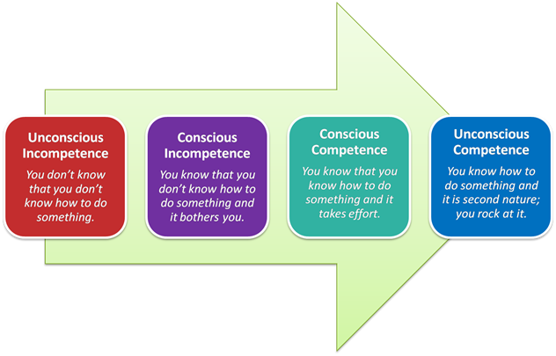
Reframing Incompetence

Slide 11
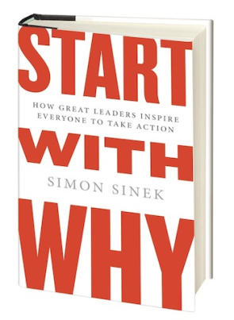
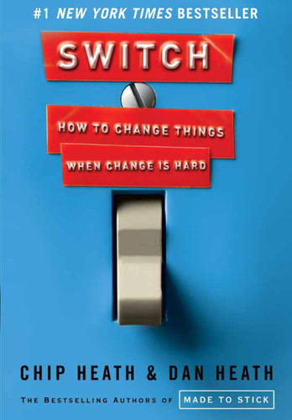
Notes:
Here are some ways to do that….And these methods come from three books really impacted me as I started to educate myself about effective change leadership. Start with Why, Switch and Leadership without easy answers (really great principles but a tough read – suggest finding summaries or articles on line – much easier to digest.
Acknowledge the loss – like Susan black did
Appeal to emotion – this goes back to the elephant and the rider that nancy talked about. We have to get that elephant – the emotional side of things. People have to understand in their gut and in their hearts that culture change is worth it. Perfect example – made my boss cry.
Appeal to intellect - the rider – steps to get things moving in the right direction. Next steps.
Eden alternative – open people’s hearts before you can open their minds.
Give the work back to the people – the people who are living with the problem need to be the ones working on the solution. Bringing decision making to elders or those closest to them.
Huge mistake years ago – people sleep in, open dining. Managers got together and worked on this. I came in early and residents were up sleeping in the hallway. We hadn’t involved the team members in solving the problem. Once we did that, it stuck.

Slide 12
Notes:
People get paralyzed. Don’t know where to start. It’s ambiguous and scary.

Slide 13
The Dance Floor & Balcony

Slide 14
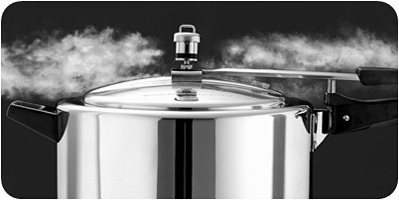
Manage the Pressure Cooker

Slide 15
“It shouldn’t be lonely
at the top.”
Suellen Beatty
Sherbrooke Community Centre

Slide 16
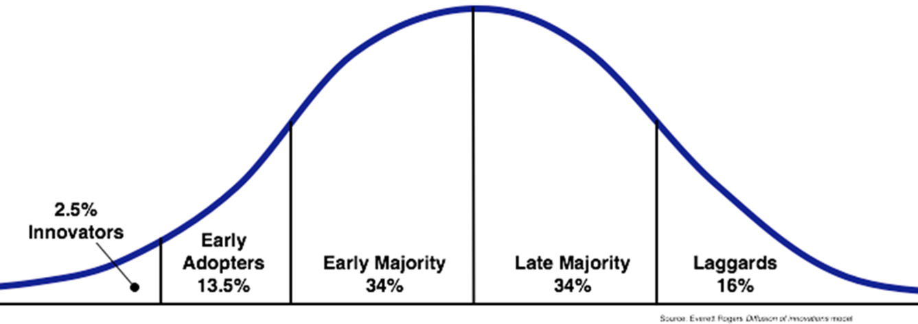
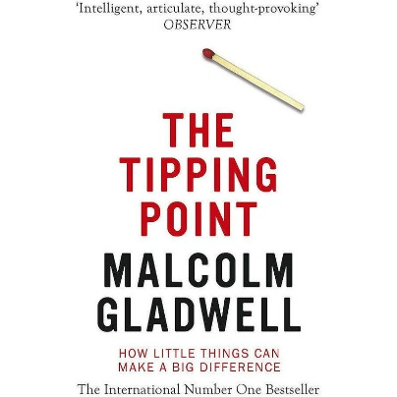
Theory of Diffusion of Innovation
The tipping point

Slide 18
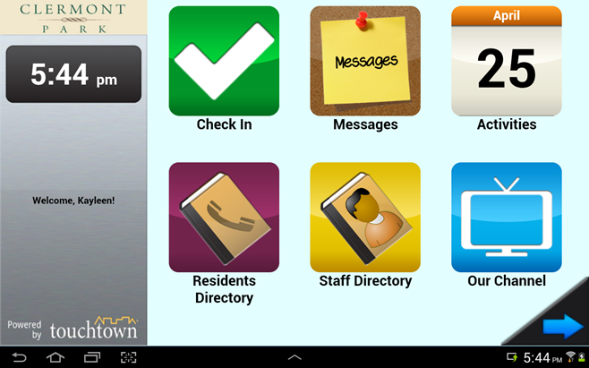

Slide 19
Theory of Diffusion of Innovation
The tipping point

Slide 20
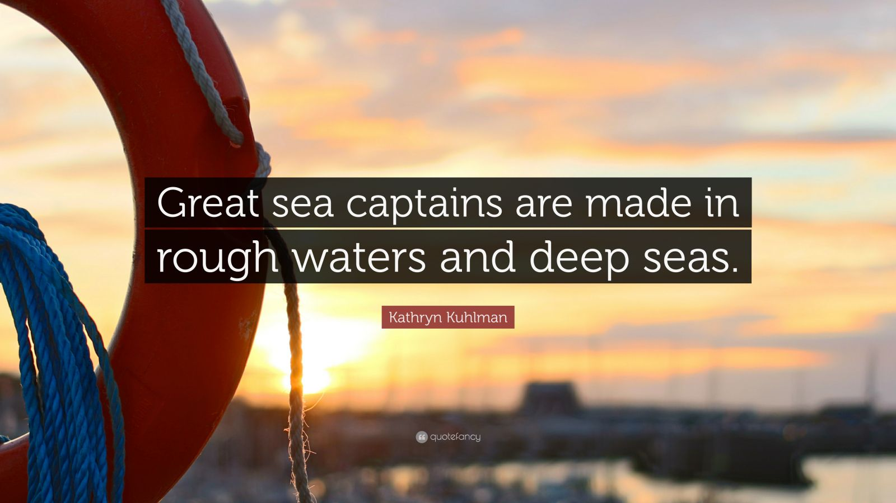

Slide 21
A Leader’s Role in Times of Change

Slide 22
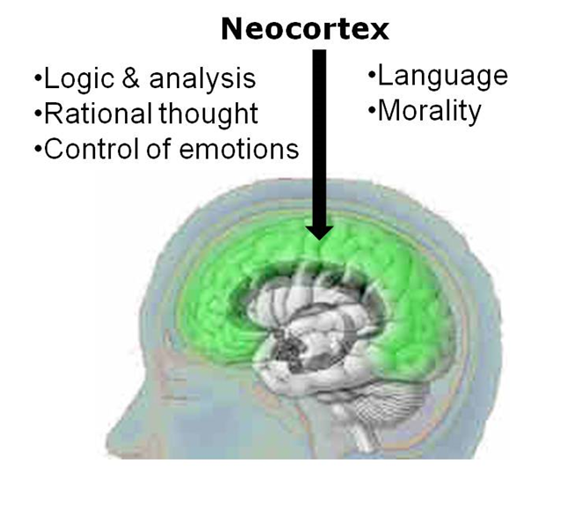
Cognitive System-Neocortex
Planning, perspective, consequences
Working memory
Decision making
Strategizing
Prioritizing
Impulse management
Notes:
.

Slide 23
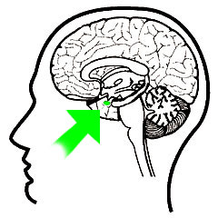
Limbic System-Amygdala
Fight or flight
Emotional learning
100 times faster

Slide 25
STATUS
Success/Title
Pay
Reputation
Competence
SAFETY
Physical
Emotional
Environment
Predictability
Certainty
VALUED
Appreciated
Significant
Recognized
Praised
Heard
ACCEPTED
Included
Liked
Needed
Paid attention to
AUTONOMY
Sense of control
Choice
Power
Has a say
Able to act
RESPECTED
Understood
Treated fairly
Dignity

Slide 27
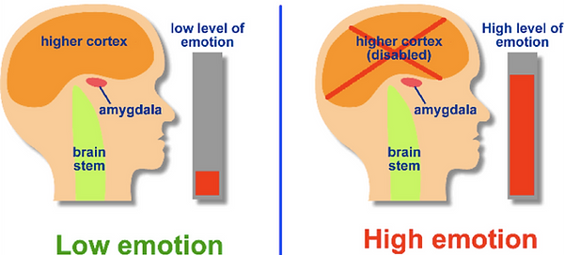
What happens in the brain?

Slide 28
Notes:
Constantly scanning for things that may hurt us or scare us.. Thinking power disrupted.

Slide 30
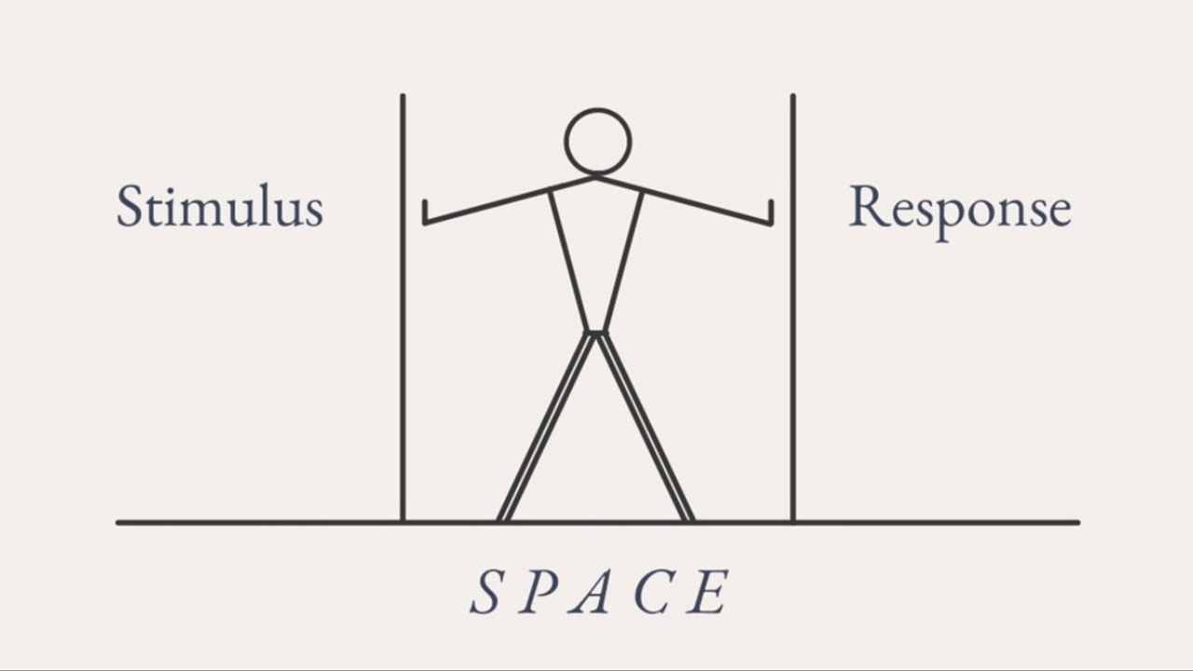

Slide 31
Competence
Certainty
Sense of Control
Reputation
Respect

Slide 32
Embracing Boredom

Slide 33
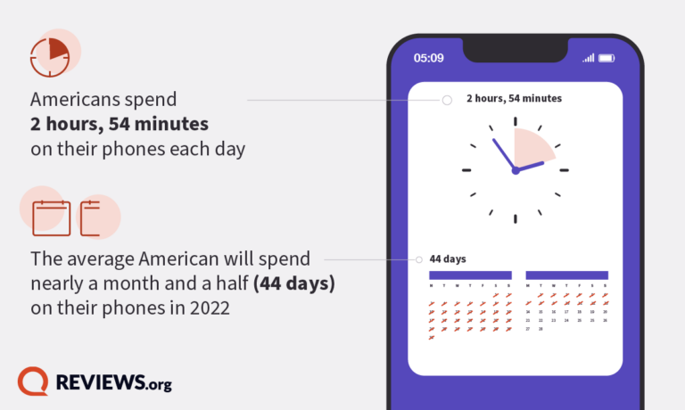
Notes:
On a typical day (or day off from work for those who are employed), 65 percent of American adults say they often or constantly check personal email, 52 percent and 44 percent say the same about texts and social media, respectively, and 28 percent (of those employed) report the same about their work email. For some, constant checking itself can be a stressful act. Constant checkers are more likely to say that constantly checking devices is a stressful aspect of technology, compared to non-constant checkers (29 percent vs. 24 percent, respectively). For employed Americans who check their work email constantly on non-work days, this jumps to 41 percent.

Slide 34
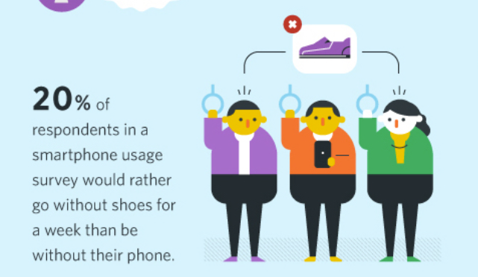

Slide 35
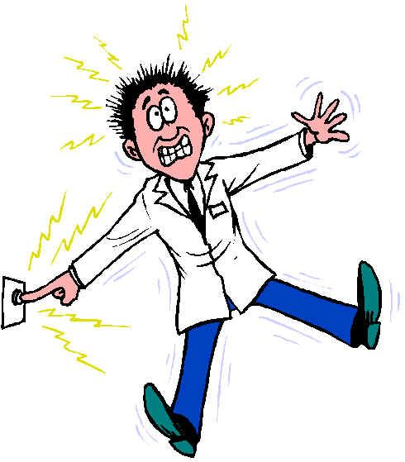
We’ll do anything to avoid boredom…
11 studies
6-15 minutes
67% of men
25% of women

Slide 36
The Shower Effect

Slide 37
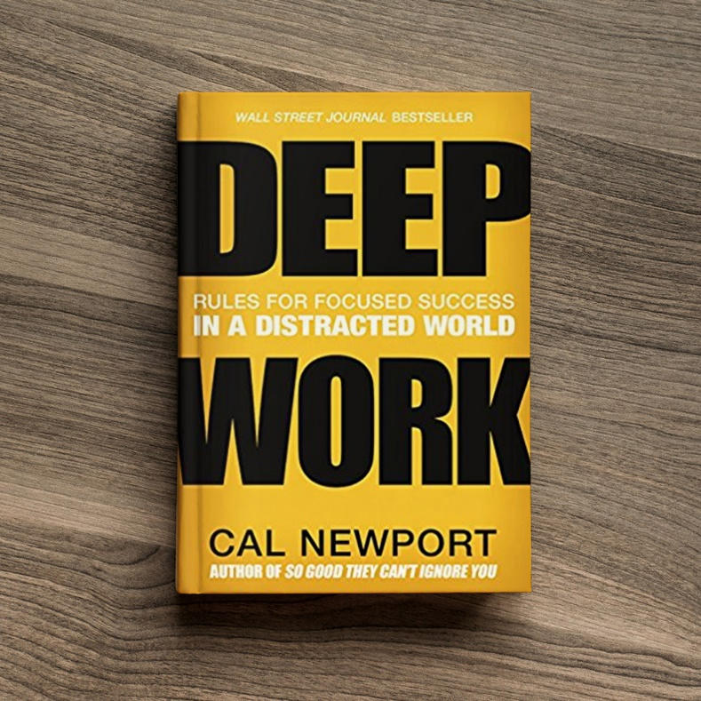
Practice deep work
Embrace boredom
Daily journaling practice
Meditation
Creative endeavors

Slide 38
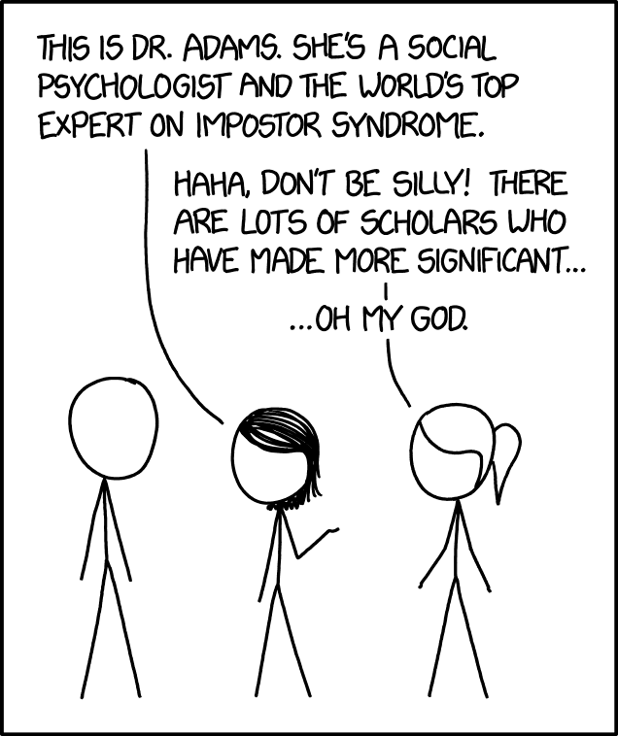
IMPOSTER SYNDROME
“It’s not who you are that holds you back, it’s who you think you are not.”
Denis Waitley

Slide 39
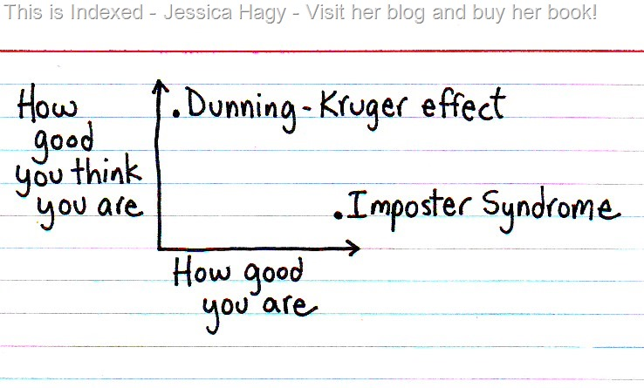

Slide 42
“The people who are crazy enough to think they can change the world are the ones who do.”
Steve Jobs

