Slide 1

Navigating the Assisted Living Process: Avoiding Costly Pitfalls
Presentation By
Sara Wright

Slide 2

Purpose of Surveys
The Colorado Department of Health and Environment, the department, conducts routine license inspections, also known as surveys, to evaluate resident care and services compliance with licensing rules.
Ensuring compliance with licensing rules and addressing deficiencies promptly is essential to maintaining a safe and healthy environment for assisted living residents.

Slide 3
CDPHE ALF/ALR Survey Process
Complaint Investigation
Initial Licensure
General Inspection
Re-Visit of ANY of the Previous Surveys
Renewal Licensure
Licensed
IC Focused
CHOW (Change of Ownership)
Focused Vaccination or Focused QMP Survey

Slide 4
Citing Deficiencies
Sections 3.11 and 3.12 of the Chapter 7 regulations distinguish different levels of deficiencies based on the number of affected residents and the level of harm.
When deficiencies are cited, the department outlines how the residence is not in compliant with licensing rules. This information is obtained by surveyors and is based on:
    Observations
    Interviews
    Record Reviews

Slide 5
Levels of Deficiencies
The levels are categorized as follows:
Level A - Isolated potential for harm for one or more residents.
Level B - A pattern of potential for harm for one or more residents.
Level C - Isolated actual harm affecting one or more residents.
Level D - A pattern of actual harm affecting one or more residents.
Level E (Immediate Jeopardy) - Actual or potential for serious injury or harm for one or more residents

Slide 6
Citations and Deficiencies
Preliminary Findings Summary
- Presented to Administrator upon Exit Date
- Indicates any initial findings and deficiencies including:
- Rule / Section No.
- Brief Description of Requirement
- Area of Non-Compliance
*Note if Level E (Immediate Jeopardy “IJ”) – describes actual or potential serious injury or harm for one or more residents is cited during the survey process, the community will be required to immediately remove the cause of the immediate jeopardy risk and provide the Department with written evidence that the risk has been removed.

Slide 7
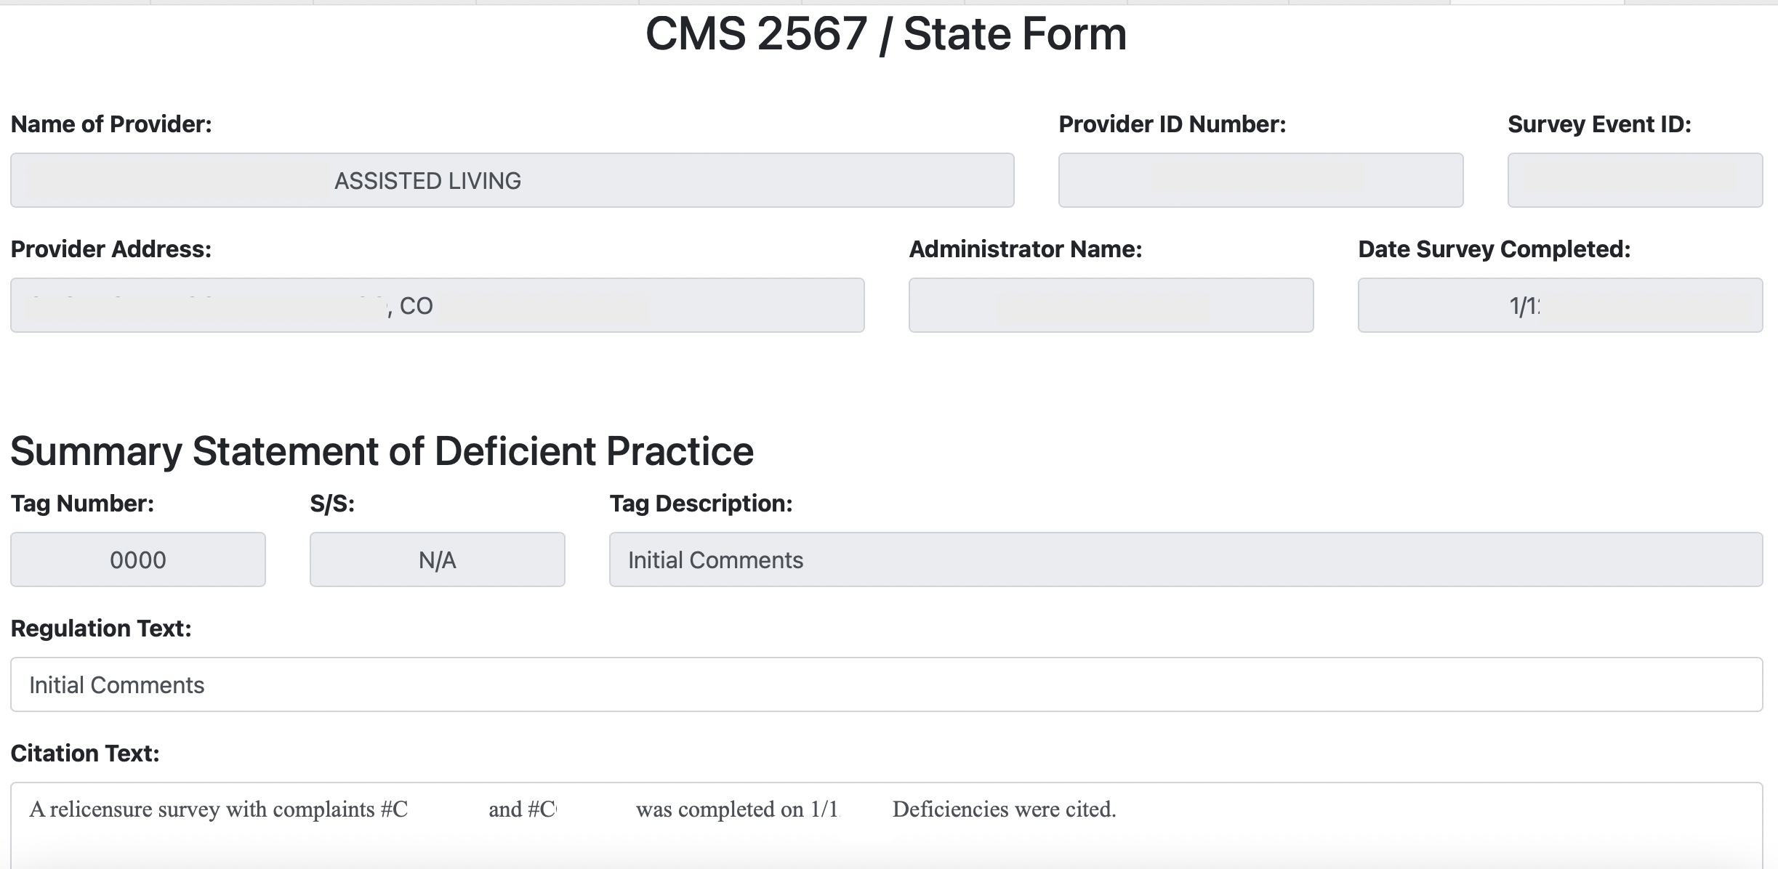
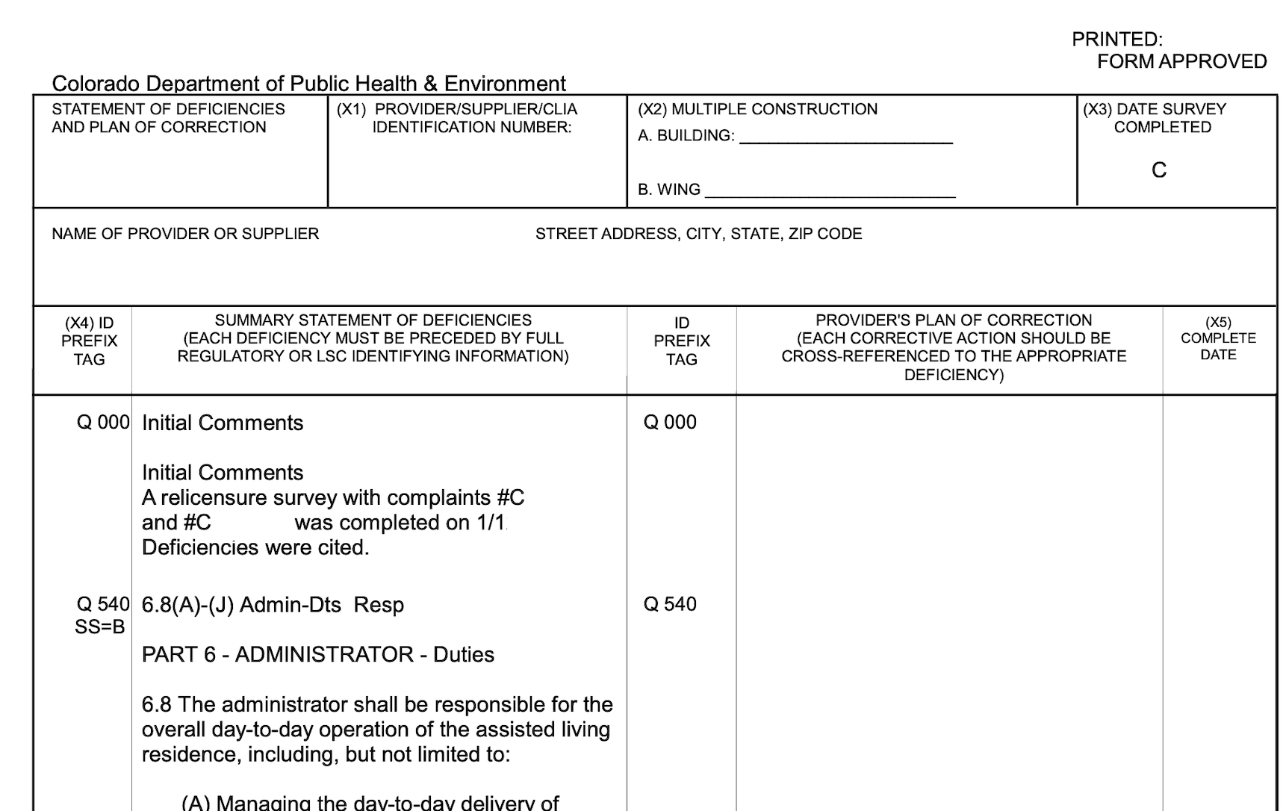
Citations and Deficiencies
After your survey, the Department may request a plan of correction from a licensee or require a licensee’s compliance with a Department directed plan of correction (POC).
Form CMS-2567
- Official Documentation of the survey results
- Detects non-compliance with regulations
- Records of compliance/noncompliance on those affected
- Accessible to the general public upon request
- Utilized by the facility to draft the Plan of Correction (POC)

Slide 8
Components to YOUR Survey Results
COHFI Email Notification
Dear Provider,
You have a new message regarding the 1 survey that exited on 1/1/2023 for Facility: ABC AL, FacID: ABCDEF.
Write and Submit Your POC(s)
Ensure ALL 3 required elements
are included indoor POC
Survey Tracking Workbench
Surveys with Messages
Surveys in Progress
Surveys Completed
Review ALL Documents
Review Survey Results (Details)
ALR Packet
ABC AL DL A12B12 (Deficiency List)
ABC AL ESL A12B12 (Staff Sample List)
ABC AL SL A12B12 (Resident Sample List)
ABC AL LTC A12B12 (Letter with indicated Intermediate Conditions and Required POC)
Review and Print 2567
  All Tag #’s will be listed here

Slide 9
Elements for a PLAN OF CORRECTION (POC)
#1
#2
#3
A description of how the licensee will correct each identified deficiency
A description of how the licensee will monitor the corrective action to ensure each deficiency is remedied and will not reoccur
A completion date
Reference Chap 02 Part 2.10.4(B)
Notes:
(1) The plan of correction shall be in the format prescribed by the Department and included, but not be limited to, the following:
(a) A description of how the licensee will correct each identified deficiency,
(b) A description of how the licensee will monitor the corrective action to ensure each deficiency is remedied and will not reoccur, and
(c) A completion date that shall be no longer than thirty (30) calendar days from the issuance of the deficiency list, unless otherwise required or approved by the Department. The completion date is the date that the entity deems it can achieve compliance.
THE POC WILL NOT BE ACCEPTED IF ANY OF THE THREE REQUIRED ELEMENTS LISTED ARE MISSING
Reference 6 CCR 1011-1, Chap 02, Part 2.10.4(B);

Slide 10
#1 How to Correct EACH Identified Deficiency…
If the deficient practice was cited for a specific resident(s) or staff, the description shall include the measures that will be put in place or systemic changes made to ensure the deficient practice will not reoccur for the affected resident(s)/staff and/or other residents/staff having the potential to be affected.
What action was/will be taken to correct the situation
Implementation date
Who is responsible for making the corrections (Position / Title)
How the community established that no other residents were impacted by the inadequate practice.
    The date of the determination
    Who determined this (Position / Title)
Notes:
#1 A description of how the licensee will correct each identified deficiency.
If the deficient practice was cited for a specific resident(s) or staff, the description shall include the measures that will be put in place or systemic changes made to ensure the deficient practice will not reoccur for the affected resident(s)/staff and/or other residents/staff having the potential to be affected.
Address how corrective action will be accomplished for those residents found to have been affected by the deficient practice
-What action was/will be taken to correct the situation
-Implementation date
-Who is responsible for making the corrections (Position/Title)
Here is also an opportunity to address how the facility established that no other residents were impacted by the inadequate practice.
-The date of the determination
-Who determined this (Position / Title)

Slide 11
#2 How to Monitor EACH Identified Deficiency…
The community must ensure each deficiency
IS REMEDIED
Explain the community’s plan for monitoring its performance to ensure sustained solutions:
  Indicate the person responsible for monitoring the corrective action
  The method of monitoring the actions
    Audits
  The frequency of the monitoring
  The method of evaluating the results and who will conduct the evaluation
    QMP
Notes:
#2 How to Monitor EACH Identified Deficiency…
The community must ensure each deficiency IS REMEDIED
Explain the facility's plan for monitoring its performance to ensure sustained solutions:
-Indicate the person responsible for monitoring the corrective action
-The method of monitoring the actions
-Audits
-The frequency of the monitoring
-The method of evaluating the results and who will conduct the evaluation
-QMP

Slide 12
#2 How to Monitor EACH Identified Deficiency…
The community must ensure each deficiency
WILL NOT REOCCUR
Outline what steps or changes will be implemented to prevent the recurrence of the inadequate practice:
  Describe the steps taken
  Training for staff and education for residents/families as appropriate
  Policy revisions and review
  Include the dates of the steps taken and the job titles of staff members who completed the actions

Slide 13
#3 A Completion Date…
The completion date is the date that the entity deems it
CAN ACHIEVE COMPLIANCE
Provide the date of completion for the corrective action:
The date of compliance for the inadequate practice must be after the survey exit date and cannot be during a time when the community is taking action
The date of completion for the corrective action must be approved by CDPHE
The community bears ultimate responsibility for compliance, even if notification about the acceptability/denial of their POC is not received promptly
Notes:
(c) A completion date that shall be no longer than thirty (30) calendar days from the issuance of the deficiency list, unless otherwise required or approved by the Department.

Slide 14

Completed POC
Submit to the Department within ten (10) calendar days after the date of the Department’s written notice of deficiencies
      COHFI
If an extension of time is needed to complete the plan of correction, the licensee shall request an extension in writing from the Department prior to the plan of correction due date - the Department may grant an extension of time

Slide 15
POC Approved OR Denied
The Department has the discretion to approve, impose, modify, or reject a plan of correction.
  If the plan of correction is accepted, the Department shall notify the
  licensee by issuing a written notice of acceptance.
  If the plan of correction is unacceptable, the Department shall notify
  the licensee in writing, and the licensee shall re-submit the changes
  within the time frame prescribed by the Department.

Slide 16
POC Approved OR Denied
  (c) If the licensee fails to comply with the requirements or deadlines for
  submission of a plan or fails to submit requested changes to the plan,
  the Department may reject the plan of correction and impose
  disciplinary sanctions.
  (d) If the licensee fails to implement the actions agreed to by the
  correction date in the approved plan of correction, the Department
  may impose disciplinary sanctions.

Slide 17
POC Enforcement and Accountability
- In some cases, the department may modify a POC and/or impose or direct a residence to comply with a POC that was developed by the department.
FYI
The department posts your community’s deficiency list and the approved plan of correction submitted by the assisted living residence for public viewing. This is available at: https://cdphe.colorado.gov/find-and-compare-facilities

Slide 18



POC Enforcement and Accountability
“Enforcement Activity” means the imposition of remedies such as fines, appointment of a receiver or temporary manager, conditional licensure, suspension or revocation of a license a directed plan of correction, intermediate restrictions or conditions.

Slide 19
Intermediate Conditions
Intermediate restrictions or conditions on a license may be imposed by the department if a deficiency is considered to be severe, if there is a recurring pattern of deficient practice over time, or if there is a general failure to comply with one or more licensing requirements.
It is important for assisted living residences to take these requirements seriously and comply with them in a timely and effective manner to avoid further penalties or consequences.

Slide 20
Intermediate Conditions
Section 3.14 lists the following actions that may be required:
Retain a consultant to address corrective measures and deficient practice.
Undergo department monitoring.
Conduct additional staff training.
Comply with a plan of correction developed and directed by the department.
Pay a civil fine, which cannot exceed $2,000 per calendar year.
These actions are intended to address deficiencies and ensure the safety and well-being of residents in assisted living residences.

Slide 21
Follow-Up Survey
Onsite Re-Visit
  Typically Based on the Date of Correction
  Additional Complaints
Desk Review
A complete and detailed POC that addresses low-level deficiencies thoroughly may result in a desk review. During this process, surveyors will not conduct an on-site re-survey, but will determine compliance based on the acceptability of the POC.

Slide 22
Top 10 Deficiencies in 2022
#1 Tag 540
Section 6.8 Administrator Responsibilities 342 Times
#2 Tag 1468
Section 14.21 Failure to Comply 168 Times
#3 Tag 0310
Chapter 2 - Vaccination Reporting 139 Times
#4 Tag 1110
Section 12.1 Protective Oversight 106 Times
#5 Tag 1180
Section 12.15 - Fall Management 103 Times

Slide 23
Top 10 Deficiencies in 2022
#6 Tag 630
(ACF Tag Medication Administration) 99 Times
#7 Tag 246
Chapter 2 Section 2.8.3 - Failure to Comply with IC 98 Times
#8 Tag 734
Section 7.6 CPR/First Aid Trained Staff 93 Times
#9 Tag 1470
Section 14.31 Quarterly Medication Audits 80 Times
#10 Tag 1466
Section 14.29 MAR Inaccuracies 77 Times

Slide 24
How to PREPARE for your next Survey…
How is your Quality Management Program (QMP)?
Are you meeting at least quarterly?
Have you had a QMP Desk Survey?
Would you be ready if you did?
The most recent revision of the regulations for
ALF/ALR’s Quality Management Program was in 2020

Slide 25

QMP Background & Regulations
DEPARTMENT OF PUBLIC HEALTH AND ENVIRONMENT
Health Facilities and Emergency Medical Services Division
STANDARDS FOR HOSPITALS AND HEALTH FACILITIES CHAPTER 2 – GENERAL LICENSURE STANDARDS
6 CCR 1011-1
Chapter 2, Part 4.1

Slide 26
Identifying Quality Management Projects
Resident Safety Component
Resident Well-Being Component
&
Notes:
4.1.1 Every facility or agency shall have a quality management program (QMP) designed to improve client safety and well-being.

Slide 27
Resident Safety
Improvements in Response to:
Patterns
Trends
Errors and Potential Error
Notes:
The client safety component of the program shall implement improvements in response to patterns and trends associated with service delivery errors and potential for error.

Slide 28
Resident Safety
Identify Types of Previous Errors or Potential Errors
Deficiencies
Errors
Previous Survey Results & Current POCs
Accidents, Errors, & Potential Oversight
Grievances
Occurrences
Medication
Recent Negative Outcomes, Complaints, & Concerns
Reportable Occurrences & Incident Reports
Accuracy of MARs, Med Errors, & Results of Quarterly Med Audits
Notes:
A new list of items that need to be included in the QMP are provided in Section 4 of the Chapter 2 regulations. These are similar to the previous list but discuss ‘service delivery errors’ and ‘potential for error’ rather than the old verbiage of which was ‘types of cases, problems or risks to be reviewed and the criteria for identifying potential risks.’
(A) Identification of quality management projects
(1) For the client safety component of the program, the plan shall identify:
The types of service delivery errors and potential for error that will be monitored, which may shall be based, at minimum, on a review of negative client outcomes that are unanticipated, client grievances, deficiencies cited by regulatory agencies, occurrences and/or errors, and potential for errors reported by staff.

Slide 29
Resident Safety
Process to Report and Plan for Training
Reporting
Timeframe
Training Plan
Completion
Activity
Immediate Education and Coaching w/ Problem
CDPHE Reporting Requirements
Incident
Reports
QMP Purpose
& Procedures
(Orientation)
Training Related
to Problem,
Potential Problem,
or POCs
Scheduled Training for Trends and Patterns
Community’s
Policy
Notifying
Administrator,
DON, or
designee
Complaints &
Grievances
Required Trainings
All Training Reported at
QMP Meetings
Mandatory
On-Going
Training
Notes:
A process for staff to report service delivery error and potential for error within a prescribed period of time and a plan for how staff will be trained regarding such reporting.

Slide 30
Resident Well-Being
Continuous Quality Improvements
Not Tied to Errors
Opportunities Always Exist
Enhancing Care & Services
Notes:
The client well-being component of the program shall implement improvements that are not necessarily tied to errors or potential for error but instead to the continuous quality improvement principle that opportunities always exist to enhance service delivery.
Recognizing :
Striving to :

Slide 31
Department Review and Investigation
CDPHE & YOUR QMP
Review Upon Onsite or Desk Survey
Review Upon Incident / Complaint Investigation
Review During Survey Revisit Including POC Monitoring
Notes:
4.1.4 The Department may audit a licensee’s quality management program to determine its compliance with this Part 4.1.
(A) If the Department determines that an investigation of any incident or client outcome is necessary, it may, unless otherwise prohibited by law, investigate and review relevant documents to determine actions taken by the licensee.
As recent as the Spring of 2022, CDPHE was conducting “Desk Surveys” utilizing a community’s QMP. My understanding is that they put a hold

Slide 32
QMP
Annual
Update
Annual Review
01
Annual Approval
02
Notes:
4.1.2 The program shall be implemented in accordance with a quality management plan that is reviewed and approved annually by the governing body, or if the facility or agency is not required to have a governing body, by the administrator or the administrator’s designee(s).

Slide 33
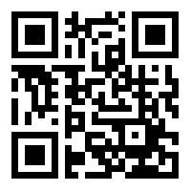
GET IN TOUCH
For additional details regarding ALCD’s consulting services, a mock survey, or questions about today’s presentation.
Website:
www.ALCDenver.com
Contact Number:
303.475.6346
Email Address:
info@alcdenver.com

Slide 34
References
§§ 25-27-101, Colorado Revised Statutes, et seq.
Assisted Living Residences -
6 CCR 1011-1, Chapter 7
General Licensure Standards -
6 CCR 1011-1, Chapter 2
Medication Administration -
6 CCR 1011-1, Chapter 24

