Slide 1
Care for Caregivers:
an Integrated Model of
Whole Person Safety
for Healthcare Workers

Slide 2
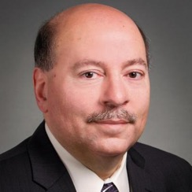
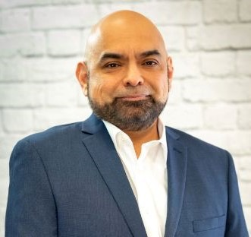
Today’s Speakers
Kevin Lombardo CEO & President
DORN
Anthony Linan Vice President of Human Resources
Christian Living Communities

Slide 3
Agenda
About DORN
Ergonomic injuries in 2022 and beyond
Total Worker Health framework
Case study
Mental health strategies
Wellness strategies
Next steps

Slide 4
We saved over $100M resulting in an annual ROI of 500% to 600% for employers, including…

Slide 5
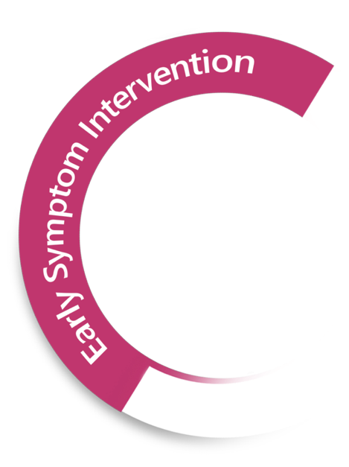
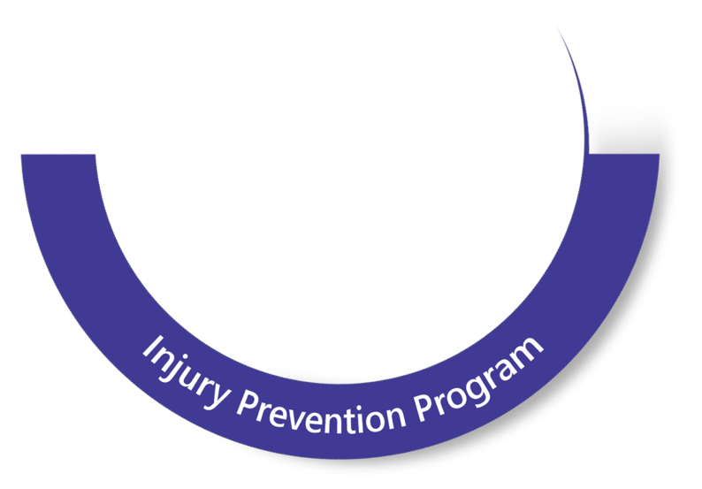
DORN’s Integrated Service Model
Early Symptom Intervention
- Therapy
- Ergonomics
- Fit-For-Work
- Training and Evaluation
- Technology
Return-to-Work
- Pain Management
- Mobility Training
- Work Hardening
Wellness
- Assessment
- Industrial Athlete Training
- Self-Care
- Biomechanics Coaching
- Ergo Eyes
- Employee Engagement Technology
Cloud-based Mobility, Conditioning & Ergonomic Technology
- HealthyWorking Ergonomics
- AlertMeter / PRISM
Injury Prevention Program
- Bio-Ergo Wearables
- Therapy
- Training and On-Site Monitoring
- Ergonomic Support
- Case Management
- Mobility and Conditioning
- DORN On-The-Go App
Empowerment through Education and Engagement

Slide 6
Current Situation

Slide 7
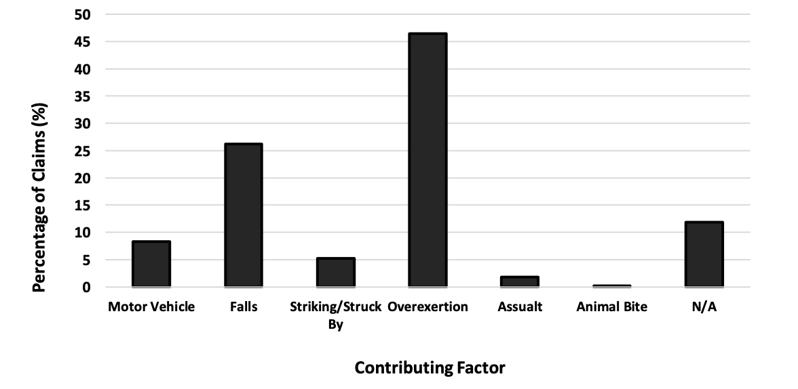
Hazards for long-term care workers that were
attributed to musculoskeletal claims in the Ohio Bureau of Workers’ Compensation System 2021
14%
86%

Slide 8
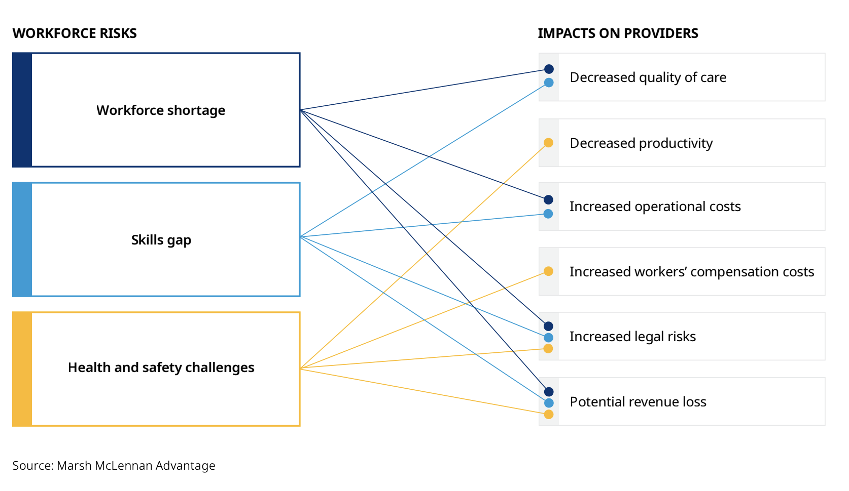

Slide 9
The Way Forward: Better Workforce Management
Ergonomic Risks
Mental Health
Wellness
Notes:
Our Agenda For Today

Slide 10
Reshaping The Employee Experience

Slide 12
Ergonomic Risks
Ergonomic Solutions:
On-Site Therapy
Body Mechanics and Conditioning
Training
Ergonomic Software
Ergonomic Assessments
Ergonomic Training – Ergo Eyes
Exoskeletons
Wearables/Virtual Ergonomics
Nursing homes are among the top 10 industries for musculoskeletal problems (Science Direct 2021).
Back injuries account for 42% of all injuries in extended care facilities (compared to 27% in
the private sector).
51% of nursing home workers suffer most
injuries when handling residents.
Physically taxing activities
Prolonged repetitive tasks
Sustained awkward or static posture
Vibration/overexertion
Outdated equipment
“Nursing home workers had one of the deadliest jobs of 2020.”
- Scientific American 2021

Slide 13
Case Study

Slide 14
CLC Partnership with DORN
2015 saw in increase in MSDs (Musculoskeletal Disorders) not related to a specific mechanism of injury for a work comp claim
Obtained leadership buy-in to reinvest our $25,000 work comp dividend into a mitigation program
2016 started at our Corporate Office to address:
General ergonomic fatigue
MSD mitigation
Team members that were miserable with pain from repetitive motion injuries
Team members that had on the job muscle injuries that impacted them at work

Slide 15
Slow Start
Team members were slow to adopt the therapy sessions
Just viewed it as a “chair massage”
Word of mouth spread quickly about how great the sessions were
Team members at the corporate office took advantage of the program

Slide 16
Case Study
One team member indicated how her wrists and elbows hurt every day
A therapist identified that it wasn’t her wrist or elbows, but treated her shoulders and back, addressing posture at her workstation as well
Within 6 sessions (once per week) she reported amazing improvement, and “graduated” from the program about 12 weeks reporting her pain from an “7/8” (on a scale of 10) to no pain at all!
She did have a “tune-up” about a year later of 4 sessions just to keep her going

Slide 17
Case Study
This team member indicated she was very close to filing a work comp claim
We estimate that the claim could have reached over $8,000 - $10,000 (the average MSD claim without surgery)
We spent about $1,500 on this one team member to mitigate MSD exposure!

Slide 18
Case Study
SUCCESS!
Provided the team member with pain relief
The team member admitted that she had called in sick previously due to muscle fatigue/discomfort/pain
Saved Money $$
Saved our policy a work comp claim
Saved points towards our NCCI Mod Rate
Other indirect benefits
Morale at the office about the program
Really gave team members the sense that we cared
Provided team members with an affordable benefit that at the same time
reduced injury risk

Slide 19
Mental Health Solutions:
Increase emphasis on self-care support
Mental health programs & telemedicine
Free counseling services and employee assistance programs
Real-time communication tools including 24/7 helplines
Free online and mobile mindfulness and
meditation apps
Manager training to better identify behavioral and mental health issues
Mental Health
45% of nursing home employees reported PTSD symptoms
during third Covid wave (Conan Brady 2021).
More than 2,000 people have left the industry across the
state since COVID-19 arrived (The Denver Post 2022).
The average 2021 turnover rate was 128%, with some
facilities experiencing a 300% turnover (New York Times 2021).
Depression and chronic pain frequently coexist, with up to
60% of chronic pain patients presenting with depression
(National Library of Medicine 2016).
Nearly 60% of adults with a mental illness didn’t receive
mental health services in the previous year (Nami.org 2021).

Slide 20
Indirect Benefits Of Self-care
Enhanced morale of team members
Provides team members with “permission” for self care
We in healthcare often take care of ourselves last
Self-care such as this has added mental health support benefits
Allows for a work environment where team members start talking about their muscle fatigue and their common injuries
Eventually created a culture of self-care up until 2020

Slide 21
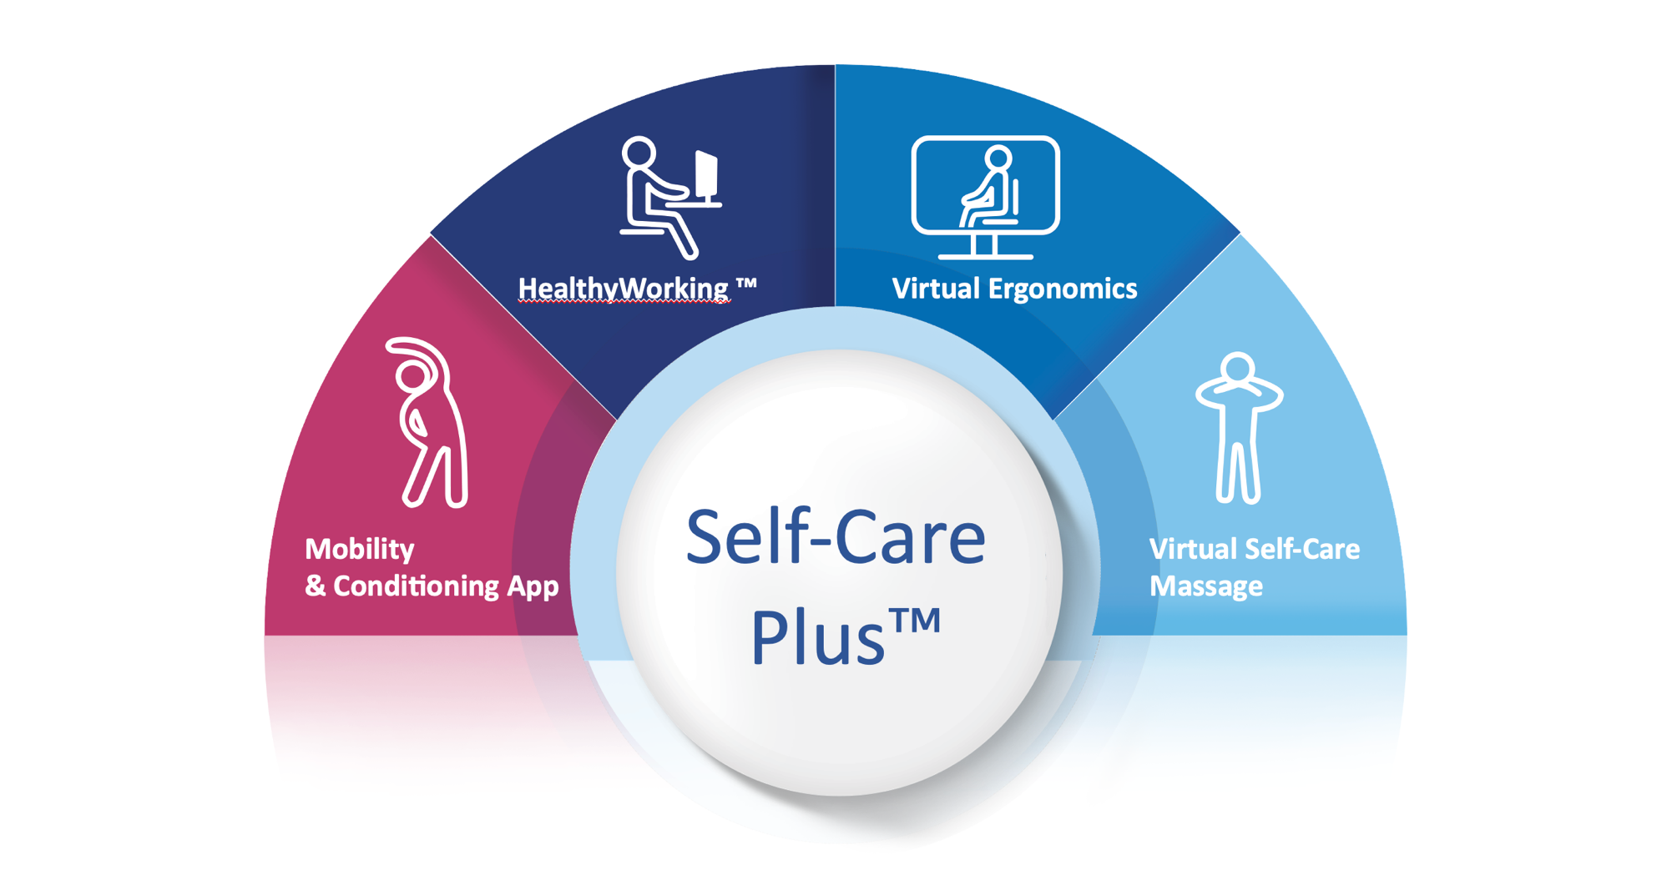
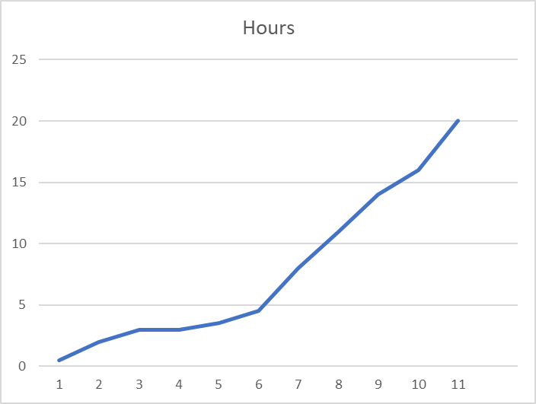
Virtual Self-Care Massage Success
Actual Client Data 2021

Slide 22
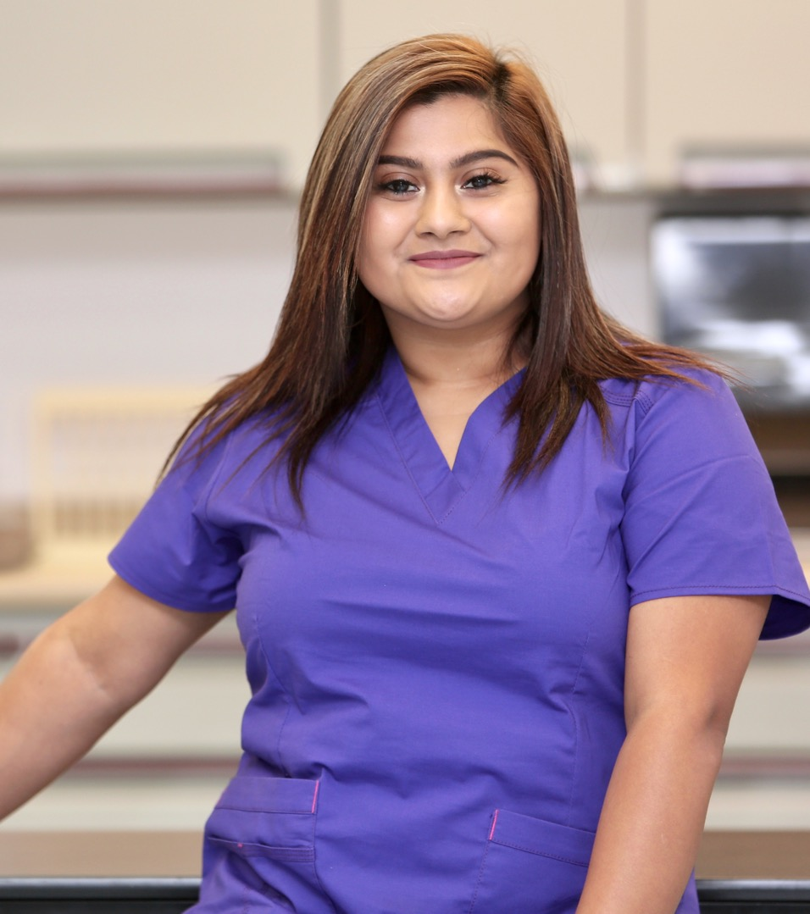
Wellness Solutions:
Leadership focused on employee well-being
Preventative benefits
Virtual on-demand and live self-care programs
Fatigue management programs
Personalized health, meal, and fitness plans
Access to wellness coaches
Stress management and resilience programs
Financial wellness programs
Employee Wellness
Majority of adults (61%) experienced undesired weight
changes since 2020, an average gain of 29+ pounds
(New York Times).
Diet and exercise are on the wane with 20% of
respondents admitting to an increase in alcohol
consumption, while a 33% are eating a less healthy diet,
and over 60% acknowledging that they are exercising less.
Inadequate pay and lack of benefits.
Stressful, complex, and high-risk work environments.
A lack of opportunities for career advancement,
promotions or raises.
Excessive caseloads and understaffing in skilled
nursing facilities.

Slide 23
Combining Culture, Operations, Safety, HR & Benefits
Collaborating between all the functions in our industry
Lending to job analysis:
Evaluating closely the needs of the person and how they match with the job
No two workers are alike!
Providing direct 1:1 coaching for safe work practices and how to work smarter with tools and equipment
Focusing on an open and honest feedback about tasks and job duties that can be improved with other processes
Getting input from team members about how they want the jobs changed, and how they improve systems
Ultimately leads to a culture of trust that we are all here for one another

Slide 24
Types of Programs
Utilize on-site support for direct care education
Provide off-site isokinetic evaluations for pre-employment job fit
Typical EAP services for mental, emotional and professional help
Work/Life Balance with retreat experiences for caregivers
Provide enriched Paid Time Off, and Unlimited PTO plans to exempt team members
On-demand pay “PayActiv” and other services for financial health
1:1 Benefit Concierge to walk through benefit enrollments and map out family specific coverage/costs
Critical needs funding – emergency access to $$

Slide 25
A Holistic Approach To Healthcare Workforce Health And Wellness
Ergonomic Risks
Mental Health
Wellness

Slide 26
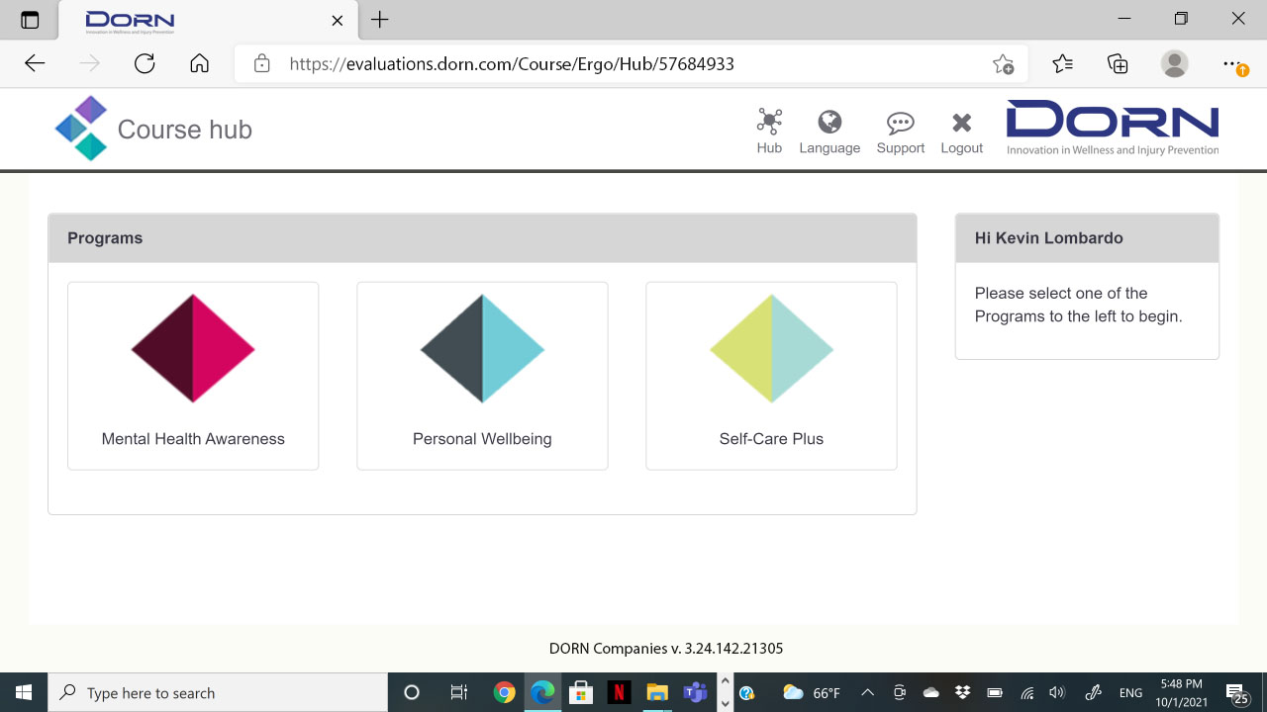

Slide 27
Safe Resident Handling And Mobility Program
Site risk assessment/needs assessment & investigation of SPHM accidents
Establish a safe patient resident committee
Provide written policy & implementation plan
Implement a multi-factor program with the right equipment and ergonomic training
On-site and online training and engagement, including manual therapy, biomechanics training, and reinforcement of best practices
Rollout to units and departments, throughout facilities

Slide 28
Strategies For Establishing A Holistic Program
Value people
Listen – all avenues available
Consistency in approach; but not one size fits all
Do the “right” thing
Empower leaders; empower teammates
Empowerment through Education and Engagement

Slide 29
“Good health IS good business.” – Paul Drechsler, Chairman/CEO, Wates Group Limited

Slide 30
Thank you!
kevin@DORNcompanies.com alinan@clcliving.org

