Slide 1
The Key Components of a Premier Workplace Culture

Slide 2
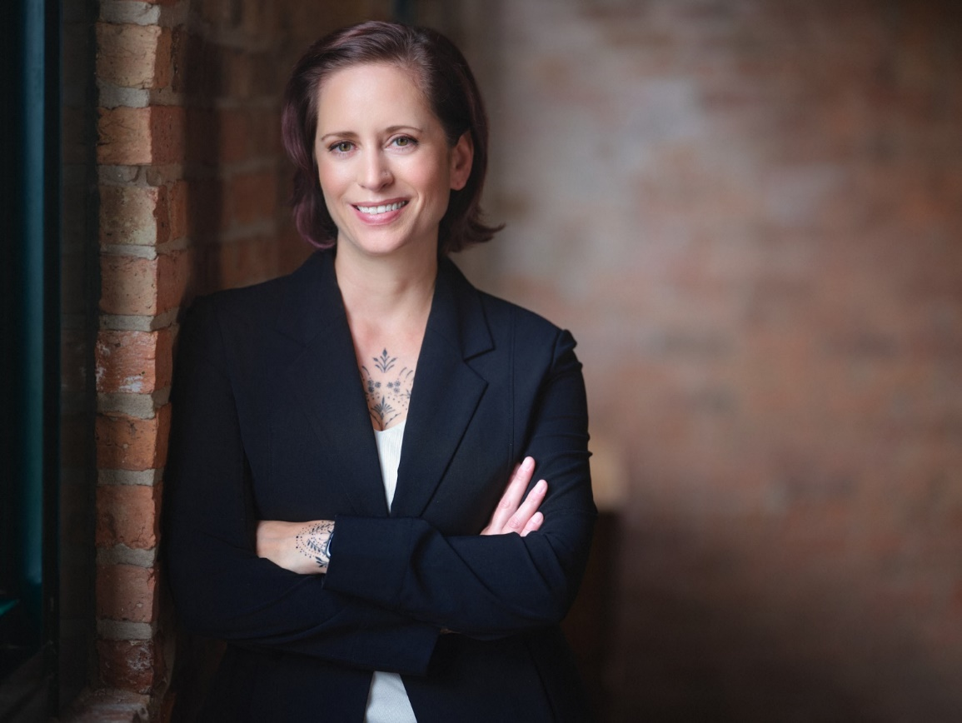
Amber Bardon
Founded Parasol Alliance based on a vision to transform senior living technology culture.
Possesses over a decade of experience in senior living technology and strategic planning.
Built a 100% virtual company with a multi-state workforce and client-base.
Contributing member & presenter for Leading Age National, VA, MD, DC, MO, IN, TN, WI, IL, Mennonite Health Assembly & Channel Futures MSP 501.

Slide 3
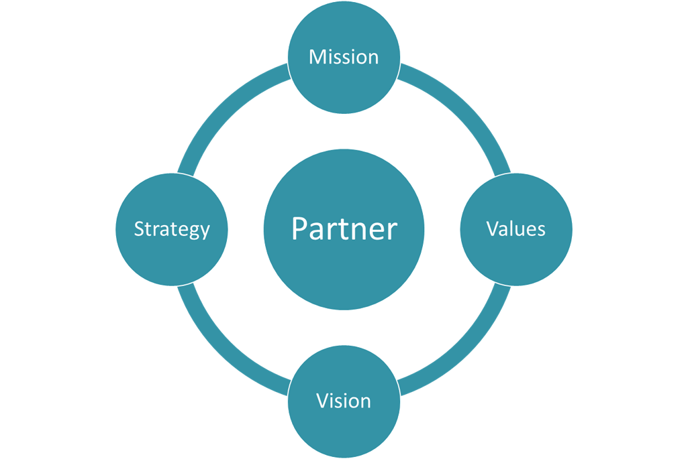
What is Parasol Alliance?
We specialize in strategic planning, project management and IT operations to help our clients effectively leverage technology and achieve their long-range goals.
Serving more than 40 communities
Decades of senior living expertise on our team
Executed more than 82 strategic plans
Completed over 500 projects
Supporting over 10,000 end users
Our Vision: Transform Technology Culture in Senior Living

Slide 4
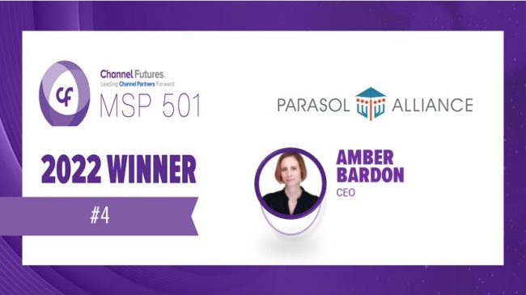
Multi-Year Workplace Awards & #4 MSP in the World in 2022

Slide 5
How Did We Win Our Awards?
Build a framework
Technology
Accountability
EOS

Slide 6
It Starts Before Hiring
Mission, Vision, Values
Job Description
Behavioral Assessment
Skills Evaluation

Slide 7
Welcoming your New Hire
Personalized Welcome Gift
Mentorship
30-Day & 60-Day Metrics
Standardized Onboarding
New Employee Handbook
Company Swag Gift
New Employee Social
Quarterly Review Process with Metrics

Slide 8
Communication
Townhall meetings/Listening Sessions
Quarterly Strategic Initiatives Updates
Weekly Team & 1-on-1 Meetings
Monthly Staff Meetings

Slide 9
Engagement
Weekly Pulse Surveys
Executive Lunch
Wellness App
Quarterly Engagement Surveys
Anniversary Gifts
Stay Interviews

Slide 10
Measurement
Everyone has a Number
Metrics

Slide 11
Development & Growth
Career Development
Mentorship
Training & Certification
Job Standards

Slide 12
Technology
Employee Management Systems
Employee Communication
Establish Use Policies
Streamline Systems

Slide 13
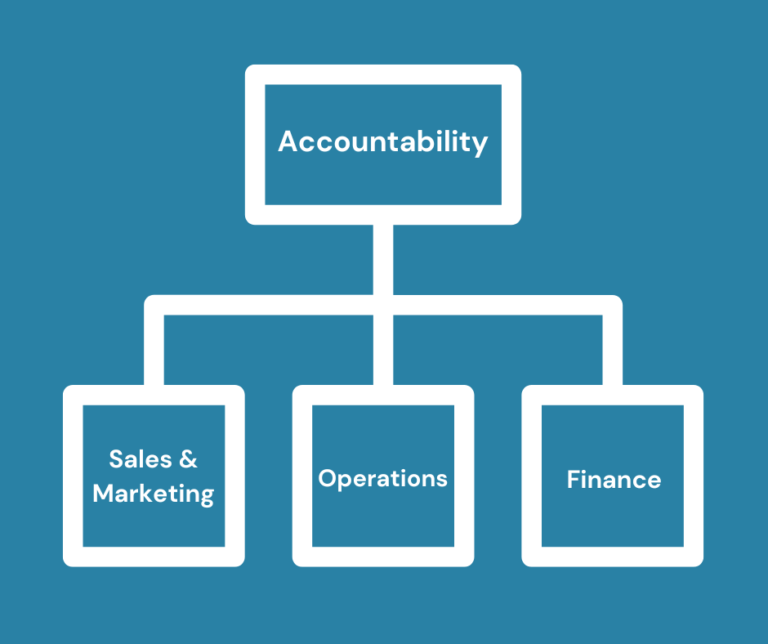
EOS
Accountability Chart
Level 10 Meetings
Everyone has a Number
Tracking log
Rocks

Slide 14
Resources

Slide 15
Additional tips for Remote or Hybrid
Camera Policy
In-Person Events
Connection Outside of Work
Committees

Slide 16
Quiet Quitting
Daily purpose
BHAG
Listening & Follow Up with Actionable Items
Values
Lead by Example
Humanize Leadership

Slide 17
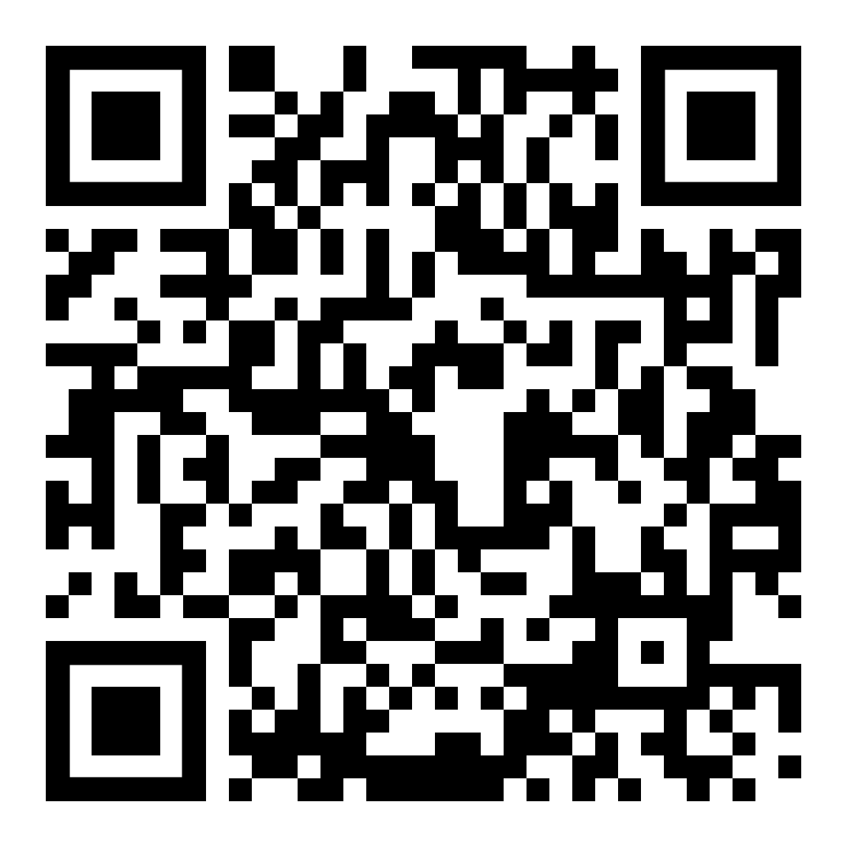
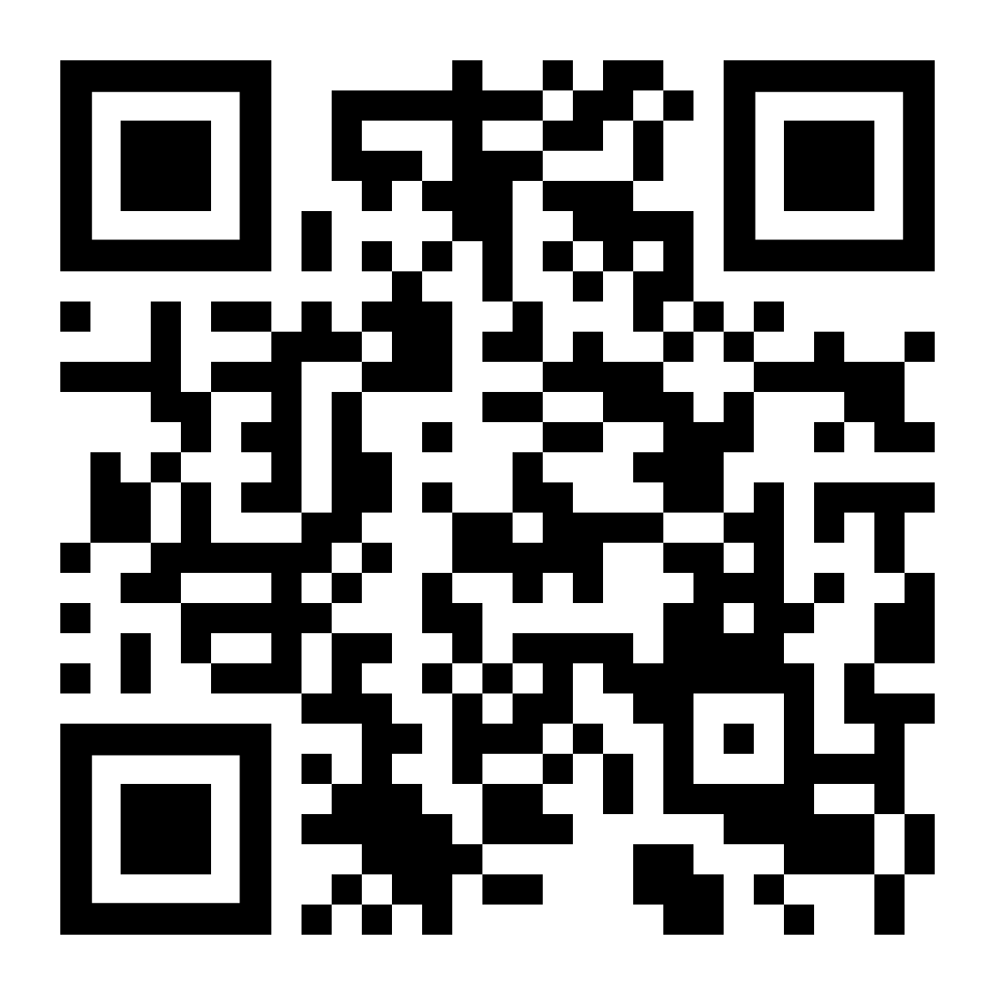
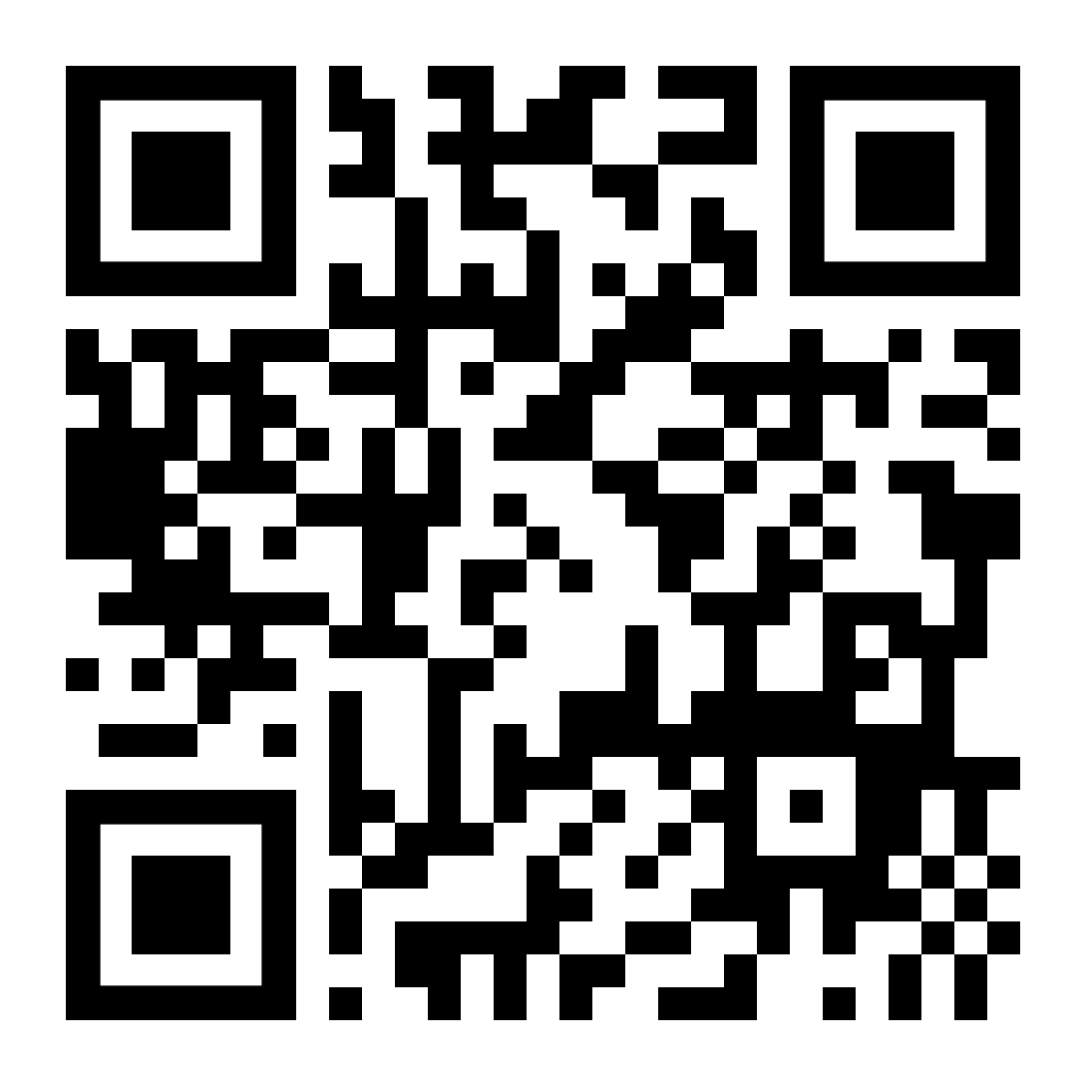
Contact Us
www.ParasolAlliance.com
amber.bardon@parasolalliance.com

