Slide 1


Governance &
Strategic Foresight
LeadingAge Colorado / May 2022 / Vail
May 17, 2022
© 2021 Dixon Hughes Goodman LLP. All rights reserved.
DHG is registered in the U.S. Patent and Trademark Office to
Dixon Hughes Goodman LLP.

Slide 2
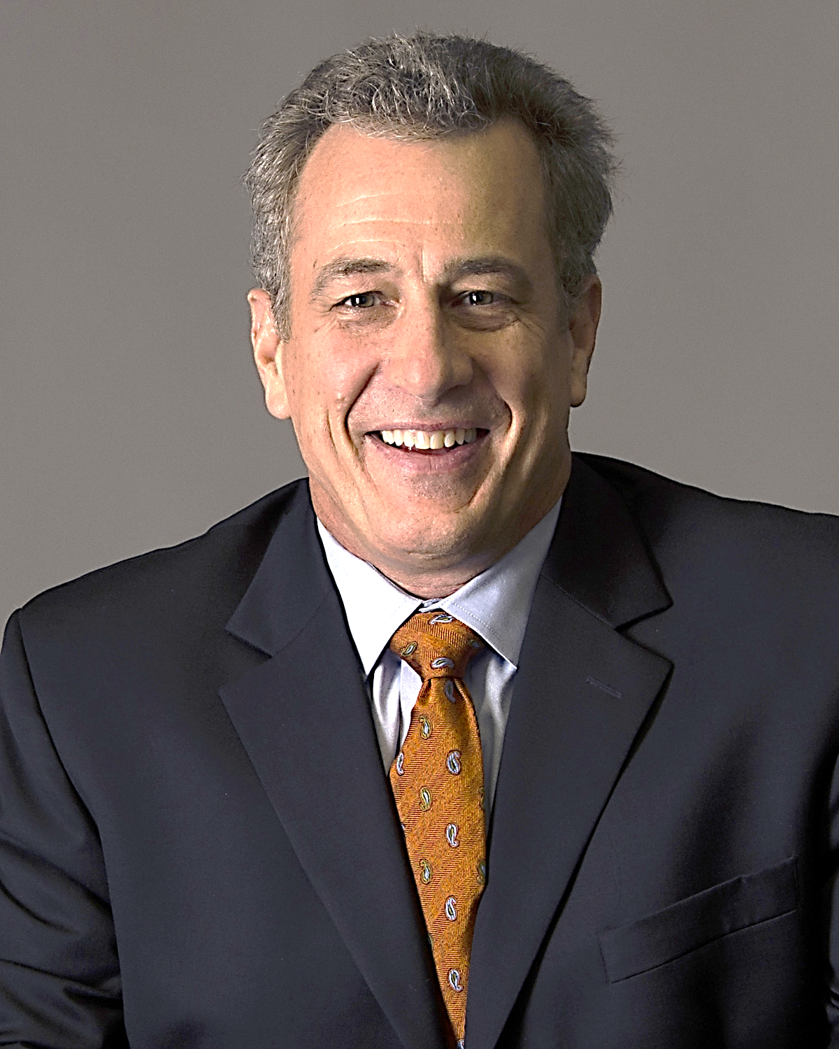
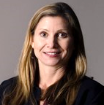
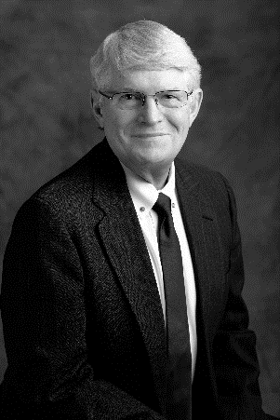
MEET YOUR SPEAKERS
Keith Seeloff, CPA
Partner / DHG
Meredith Benedict, CPA
Senior Manager / DHG
David Slack
Chief Strategy Officer / Frasier Meadows

Slide 3
GOVERNANCE AS LEADERSHIP

Slide 4






ROLES OF BOARDS
Fiduciary: Oversight
Strategic: Foresight
Generative: Insight
Financial health
Resident safety
Workforce – recruitment, development, retention
Board is the captain steering the ship; Leadership is the First Mate
    Sit down and stop rocking the boat
Forward thinking
Predictive model
“Plan your work, work your plan”
Dynamic execution
Changing for the next generation
Fiduciary
Generative
Strategic

Slide 5
TRADITIONAL RESPONSIBILITIES OF THE NONPROFIT SECTOR
“ ”
“Change Lives.”
– Peter Drucker
“ ”
4 Duties – Lester Salamon
  Guardian of values
  Meet unmet need, often difficult and unprofitable
  Advocate, especially for those without a voice
  Create social capital, a.k.a. community

Slide 6

THE LEAN BOARD
9-15
80-20
4-6
Number of Members
Visioning vs. Reflection
Meeting Frequency

Slide 7
KEYS TO BOARD DEVELOPMENT
Tactical recruitment
Written expectations and guidelines
Orientation & onboarding
Ongoing education
“Walk the walk”

Slide 8
REFLECTIVE QUESTIONS
What stands out to you about potential “potholes” for boards?
How well does your organization’s leadership and board manage various aspects of governance?
How do these topics fit into your board orientation and onboarding, board manual or board education plans?
What might you or your board do differently as you move forward?

Slide 9
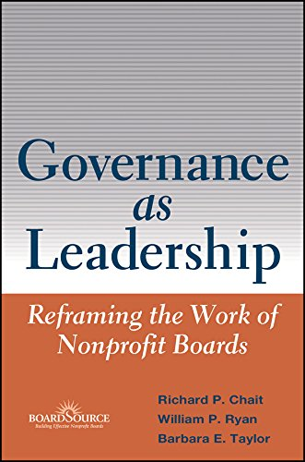
ADD TO YOUR BOARD TOOLKIT:

Slide 10
STRATEGIC FORESIGHT

Slide 11
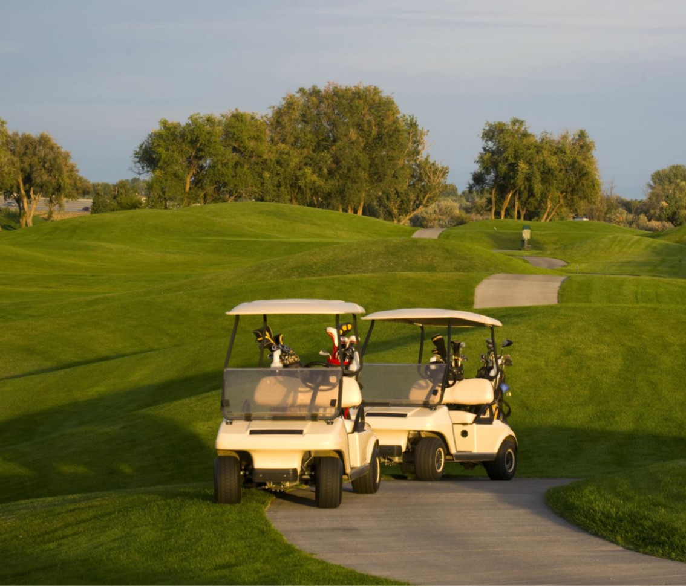
“Fore” or Foresight?
© 2021 Dixon Hughes Goodman LLP. All rights reserved. DHG is registered in the U.S. Patent and Trademark Office to Dixon Hughes Goodman LLP.

Slide 12
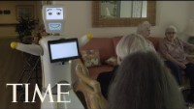
ANTICIPATING CHANGE

Slide 13
ANTICIPATING CHANGE
Tools to meet needs of emerging growing older population:
AI/robotics
Mental health interventions
Blanket vaccines
Personal monitoring devices (i.e., watches, necklaces, etc.)
Brain health interventions
Social connection opportunities
Notes:
Image of robot in SL comm.

Slide 14
HUMAN + TECHNOLOGICAL WORKFORCE
Key approaches to leveraging human and technological resources:
Hiring, educating and training workforce in-house
Workforce cooperatives
Public subsidies for family caregiving
Human caring replacement technology
Incentives and programming – partnering with academic institutions
  Tuition reimbursement; class credit

Slide 15

STRATEGIC GROWTH PLANNING
14
© 2021 Dixon Hughes Goodman LLP. All rights reserved. DHG is registered in the U.S. Patent and Trademark Office to Dixon Hughes Goodman LLP.

Slide 16
IMAGINING AND ADVANCING
Vision-driven strategic planning approaches
  “Who do we want to be when we grow up?”
  “Portrait of the future”
When visioning doesn’t work, use anti-visioning to drive momentum
The “Why”?
Who do you not want to be in 3-5 years?
Why are you stagnant?
Why are your plans not coming to fruition?
Why are you not succeeding?
Why is having a vison not motivating anymore?
Anti-Visioning
How did you arrive at your anti-vision?
Enact the changes necessary to prevent your anti-vision from coming to fruition.
Notes:
Increase font/add picture – “What do we want to be when we grow up?”

Slide 17
EFFECTIVE IMPLEMENTATION
Dynamic execution
Deadlines, deadlines, deadlines
Systemic, thoughtful, financially prudent
Clearly defined measures of success
Demonstrating thought leadership – in your local marketplace and across industry

Slide 18

EXECUTIVE & BOARD LEADERSHIP TRANSITIONS
17
© 2021 Dixon Hughes Goodman LLP. All rights reserved. DHG is registered in the U.S. Patent and Trademark Office to Dixon Hughes Goodman LLP.

Slide 19
SUCCESSION PLANNING
Leadership
Board
  Some succession planning comes through grooming, while others come out of mergers, acquisitions, affiliations, and partnerships:
  Those that come through grooming, leave your legacy
  Those that come through MAAP, share on your non- negotiables and vision for the future
  Term limits – Institutionalizing experiences at board level to maintain visioning and accountability
  Proactive v. reactive – Back to the 80/20 rule
  Attrition to rightsizing

Slide 20


Now Introducing:
© 2021 Dixon Hughes Goodman LLP. All rights reserved. DHG is registered in the U.S. Patent and Trademark Office to Dixon Hughes Goodman LLP.

