Slide 1

Disclosure: Having the Difficult Conversation Following an Adverse Event
LeadingAge Colorado
May 16, 2023

Slide 2
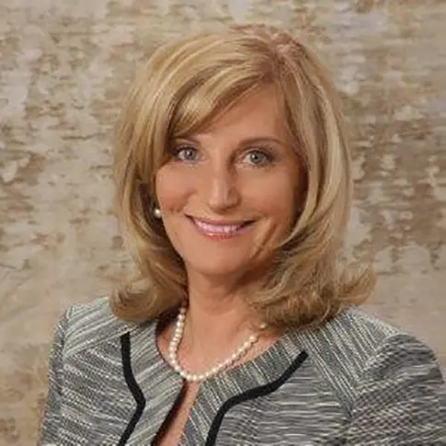


Speakers
Rhonda DeMeno
Mandy Hampton
Director of Clinical Risk Services –
Senior Living Center of Excellence,
WTW
CEO
The Ridge Senior Living
Rhonda.DeMeno@wtwco.com
MHampton@TheRidgeSeniorLiving.com
Diane Macheers
Vice President of Corporate Communications,
The Ridge Senior Living
DMacheers@TheRidgeSeniorLiving.com

Slide 3
Objectives
At the conclusion of this session, the participant will:
Describe the purpose of a communication resolution program
Identify the importance of disclosure communication and transparency with Residents
and family.
Outline the elements of a best practice disclosure conversation and the necessary documentation in the medical record that follows the discussion.
1.
2.
3.

Slide 4
The Unintended Consequence
“For every medical intervention there is an expected outcome. But there’s also the possibility for unintended consequences. While it’s comforting to believe modern science can perform miracles, the reality is that human bodies often react in unpredictable ways – even when the treatment is standardized, and evidence based.”
      Healing Words – the power of apology in medicine, 2004, Doctors in Touch.
  - Michael Woods

Slide 5

Value to the Resident
    Apology
    Expression of remorse
    Acknowledgement of the event
    Engagement
    Compassion
    Sincerity

Slide 6

Not every adverse outcome involves error, but every unexpected outcome warrants an explanation.

Slide 7
A Time for Caution: The Immediate Aftermath
You may not know if an error was involved
You will likely not know the exact cause of the error if one was made
You may not know what, if any, injuries are a direct result of an error
Honesty with the resident often involves saying you don’t know all the answers yet, but as information becomes available, you will discuss it with them.

Slide 8
The Unexpected
Not planned for; source of disappointment
May or may not be a result of error
May have been discussed as a possible outcome during the informed consent process
May be difficult to determine exact cause
ALWAYS warrants a discussion with the resident/family

Slide 9
Unexpected Outcome — No Error
Explain what may have occurred if known
Differentiate between complications and error
Discuss next steps in care of the resident

Slide 10
Unanticipated Outcome —Salon Incident

Slide 11

Case Study — A Resident’s Fall and Death
A story to which we can all relate…and hate.
The background
The process
The response
The follow-up
Notes:
Mandy

Slide 12
The Process
Make sure the resident is stable
Express empathy
Conduct risk management and leadership interviews and investigation
Gather the basic facts available at the time.
Disclose the error to the resident, his or her family, or both.
Let the resident know that your goal is to make sure that he or she gets the very best care possible.
Express a desire to continue providing care and hope that the resident can trust you and your team to do so.
Write a note in the medical record documenting what happened, the impact on the resident, treatment provided, and results.
Notes:
Mandy

Slide 13
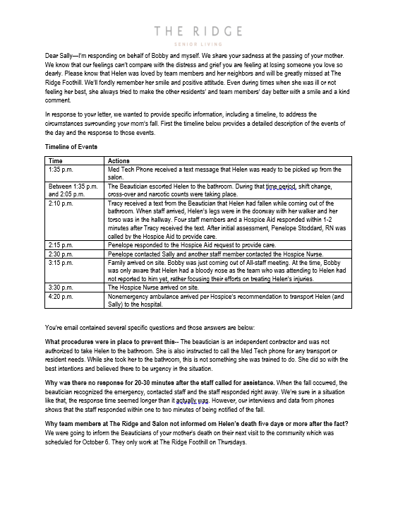
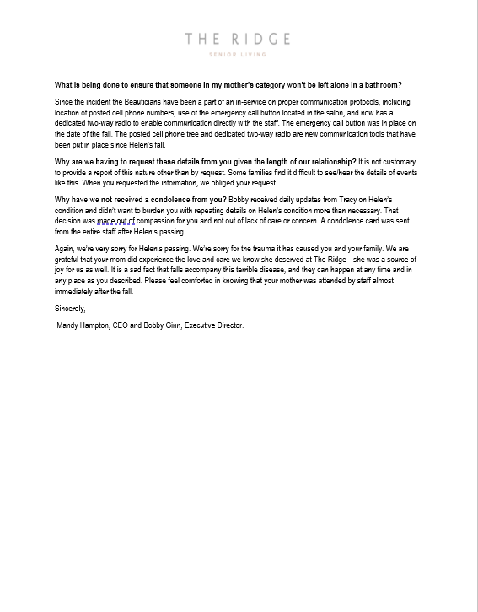
Case Study — Anatomy of a Response
Advise team to communicate verbally, rather than in writing,
in the immediate aftermath of the event
Do your research
Create a timeline and present the facts
Be humble
Be truthful
Ensure you answer all questions
None of this works without previously
establishing a foundation of trust!
Notes:
Diane

Slide 14

Disclose the error to the resident, his or her family, or both. State the facts without blame or conjecture.
That is, give an account of what happened, the consequences, what treatments are being given to correct the error, and the results of treatment.
Let them know that you will update them as you learn more.
AMA Journal of Ethics
Notes:
Diane

Slide 15
The First Discussion
Disclosure is not a one-time discussion
Express Empathy
  “I’m so sorry this happened to you.”
Be honest, but DON’T speculate
  “We don’t know all the answers yet, but we will be investigating.”
Keep communication lines open
Provide a contact date and reliable phone number where you may be reached
Document the conversation objectively
  Don’t use words such as “errors”, “mistakes”
  Don’t refer to incident reports, QA, risk management, or contact with insurer
Be prepared for anger
  Defer conversation to a later time
  Empathize with anger and focus on the next step
Make no
alterations in
the chart and
avoid defensive,
self-serving addendums
Notes:
Diane

Slide 16

Silence is not always golden
Residents frequently describe the experience of previously friendly and forthcoming care team members suddenly backing away after a bad outcome.
They may find this confusing and distressing and may turn to a lawyer for answers
Notes:
Diane

Slide 17
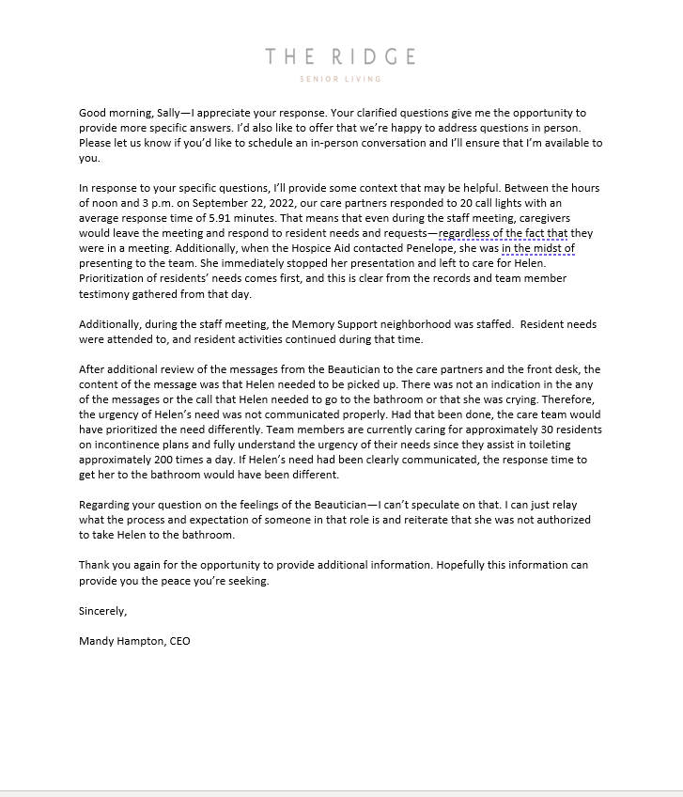
Case Study — Plan for Follow up Conversations
Just like in any conversation, don’t be surprised by follow-up questions.
Do additional research as needed
Always offer to meet in person
Provide benchmarks as needed to establish normalcy
Notes:
Diane and Mandy

Slide 18
The Colorado Apology Law, C.R.S.A. § 13-25-135, reads:
In any civil action brought by an alleged victim of an unanticipated outcome of medical care, or in any arbitration proceeding related to such civil action, any and all statements, affirmations, gestures, or conduct expressing apology, fault, sympathy, commiseration, condolence, compassion, or general sense of benevolence which are made by a health care provider or an employee of a health care provider to the alleged victim, a relative of the alleged victim, or a representative of the alleged victim and which relate to the discomfort, pain, suffering, injury, or death of the alleged victim as a result of the unanticipated outcome of medical care shall be inadmissible as evidence of an admission of liability or as evidence of an admission against interest.
Notes:
Rhonda

Slide 19
The Apology Law
In general, apology statutes restrict the admissibility of statements of benevolence, sympathy, commiseration, condolence, or compassion made by a health care provider to a resident or resident’s representative after an unanticipated outcome of medical care or treatment.
Not all apology laws are created equal.
When and Where to Say I’m Sorry
Notes:
Rhonda

Slide 20
What do Apology Laws Do?
Some states offer total protection of an apology made by a health care provider
Apology laws allow a medical provider to make a statement of sympathy to an injured resident without the fear that the statement will be used later against him in court.
Thirty-six states have “apology laws” which prohibit certain statements, expressions, or other evidence related to disclosure from being admissible in a lawsuit.
Arizona
Colorado
Connecticut
Washington, D.C.
Georgia
Iowa
Louisiana
Montana
North Carolina
North Dakota
Ohio
Oklahoma
Oregon
South Carolina
Vermont
West Virginia
Wisconsin
Wyoming
Resource: When and Where to Say I’m Sorry
Notes:
It is reasonable that many states want to avoid such a broad protection that a full admission of liability would be excluded from evidence. However, much of the aim of these laws is to promote open communication between a health care provider and the injured party. If a health care provider is expressing sympathy while tiptoeing around the fault restrictions of the statute, he is more likely to produce an apology that appears insincere or suspicious—potentially raising more questions from the injured party.

Slide 21
Barriers to Disclosure

Slide 22
Barriers to Disclosure
Fear of blame and malpractice suits often suppresses error reporting and disclosure and drives it underground.
Concern for criminal charges
Embarrassment
Job security
1.
2.
3.
4.

Slide 23
Staff psychological barriers to disclosure
Fear of retribution from the recipient of the news. “Will the recipient try to punish or harm me legally or physically?”
Fear of retribution from colleagues or peers. “Will I be ostracized or otherwise criticized for my involvement in the unanticipated event, or for my action as part of the disclosure discussion?”
Fear of conducting the conversation poorly. “What if I upset the Resident or family if I don’t convey the information effectively? Will the hospital be angry with me for communicating ineffectively?”
Fear of having to handle the recipient’s as well as their own emotions. “What if the Resident or family member cries, becomes angry or threatens me?”
Belief that the disclosure is unnecessary. “If we didn’t tell the family, they would never know this had happened.”
Belief that disclosure is primarily a factual conversation and not a complex interpersonal conversation. “If I just state the facts, haven’t I disclosed adequately?”
Belief that the outcome is not related to action on the part of the discloser. “If I were not directly involved in the event leading to the outcome, why should I be involved in disclosing the outcome?”
Belief that the outcome would potentially have occurred without the error or intervention. “What difference would it make? The Resident might have had the outcome anyway. He/She was very old and/or sick.”

Slide 24

Community goals for disclosure
A primary goal of error disclosure is preventing future harm to residents
Resident safety is an ethical duty
Resource: When and Where to Say I’m Sorry
Notes:
It is reasonable that many states want to avoid such a broad protection that a full admission of liability would be excluded from evidence. However, much of the aim of these laws is to promote open communication between a health care provider and the injured party. If a health care provider is expressing sympathy while tiptoeing around the fault restrictions of the statute, he is more likely to produce an apology that appears insincere or suspicious—potentially raising more questions from the injured party.

Slide 25
The Disclosure Process

Slide 26
Preparing for Disclosure
Risk management to consult with the key stakeholders prior to disclosure to:
  Review the medical record
  Review the informed consent process
  Review the policy for disclosure
  Discuss the approach to be taken in the disclosure
  Identify participates
  Identify where, how and when
  Determine lead communicator
  Outline post disclosure activities
Notes:
Rhonda

Slide 27

Communication
Keeping the Resident and Family in the loop
    Designate one leader/corporate representative local – determine escalation responsibilities
    Establish a primary contact person for Resident/family
    Inform other members of the care team
    Resident centered communication
    Promptly address concerns of family and resident
    Ensure that communications are culturally and linguistically appropriate
    Demonstrate Empathy
    Provide factual details – what happened, what the resident service plan is and next steps
Notes:
All

Slide 28




Disclosure
    The Joint Commission mandates that Residents be informed of unanticipated outcomes of care.
    Develop written disclosure policies and outline an organizational training program.
    Policies often set the basis for activation of disclosure at “when the Resident is substantially harmed.”
    The disclosure of investigation outcomes should be factual
    and broad.
Notes:
Show empathy
ALLOW the Resident to express his/her emotions.
ACKNOWLEDGE the Resident's emotions.
VALIDATE the Resident's emotions by saying that their response is understandable.
Be honest
EXPLAIN the facts about the adverse event without the Resident having to do a lot of probing.
GIVE direct answers to the Resident's questions.
If you do not know the answer to the Resident's questions, state this directly and explain your plan to learn more and keep them updated.
Utilize effective communication strategies
SHOW sincere interest in the Resident's questions and concerns.
USE good non-verbal expression (e.g., eye contact).
AVOID medical jargon.
CHECK for the Resident's understanding of the information throughout the conversation.
BE yourself!

Slide 29
Documentation
Objectively document what was discussed with whom along with an assessment of the resident’s or family members expressed understanding of the discussion
Document the questions asked and the responses given. Include the amount of time spent with the resident or family in the documentation
“I can understand your concerns regarding the future. Let’s focus on getting you better right now. When we complete the review, I can provide you with more answers to your questions. Then we can more fully discuss your financial questions.”
Notes:
Rhonda

Slide 30
In summary….
All unexpected outcomes warrant a discussion
Expressions of genuine empathy are helpful
Honesty is always appropriate
Apologies may be warranted
Focus on future care of resident
Involve your insurer as soon as practical
Express willingness to investigate and be fair, but do not take ownership of injuries until an investigation is complete and you have worked with your insurer
Notes:
Reputation value All

Slide 31

Items that should not be disclosed or documented in the clinical record include names of individuals or disciplinary actions taken, results of critical events or peer reviews, and consultations with attorneys or insurers.
AMA Journal of Ethics

Slide 32
Risk Management’s Role
For the Caregiver/Provider:
Consultative
Preparatory
Supportive
For the organization:
Post event debrief
Audit of process
For the resident/family:
Key contact post disclosure
Risk Manager to follow-up with resident/representative post RCA
Notes:
Mandy and Rhonda

Slide 33
Caregiver/Provider and Wellness Director Role
Perform disclosure
Answer resident and families' questions
Outline expected clinical outcome of the event
Future needed care
Documentation of the event in the medical record
Diffuse departmental concerns
Communicate to senior leadership
Notes:
All

Slide 34
The Process of Disclosure
Disclosure is not a one-time discussion
It needs to be meaningful:
  One study reported in resident Education and Counseling 2011
  showed resident perception of less than truthful disclosure actually
  increased the likelihood of distrust and pursuit of litigation
There may be other parties involved:
  Facilities such as hospitals
  Third party vendor
  Other physicians and caregivers
  Coordination is a MUST
Notes:
Mandy

Slide 35
A demand is made
What’s next? Your role as leader.
1
Be survey ready
2
Assist senior leadership in gathering the facts
3
Be supportive of staff
4
Assist the claims team with correspondence, securing health records and other needed documents
5
Attend to any legal meetings
6
Keep senior leaders updated
7
Review current practices, policies and procedures
Notes:
Mandy fact finding mission.

Slide 36

The Next Steps
Discuss future conversations with resident/family- “the facts only”
Work with other involved parties to coordinate discussions
Follow through on statements made to resident/family
Continue to keep lines of communication open
Notify your insurer as soon as practical
Notes:
Mandy Trust your gut

Slide 37
Types of damages
Noneconomic damages | Economic damages | Punitive damages
Pain Suffering Loss of consortium Emotional distress | Loss wages Medical Bills | Negligent behavior Damages exceeding simple compensation Awarded to the plaintiff to punish the actions of the defendant
Notes:
Rhonda and Mandy

Slide 38
Proactive Risk Mitigation

Slide 39
Proactive Risk Mitigation
Simple steps that can mitigate risk — and reduce issues when something does happen.
Staff training on the regulations
The expectation of transparency
Clinical focus groups
Disclosure
Resident Culture Commitment
Notes:
Diane and Mandy

Slide 40
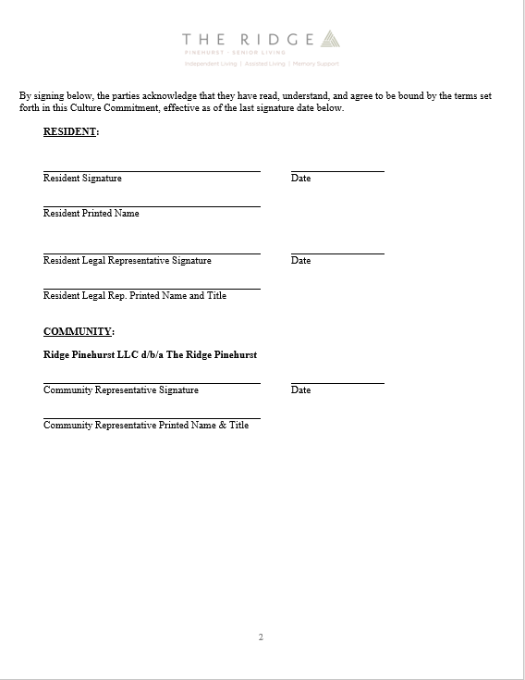
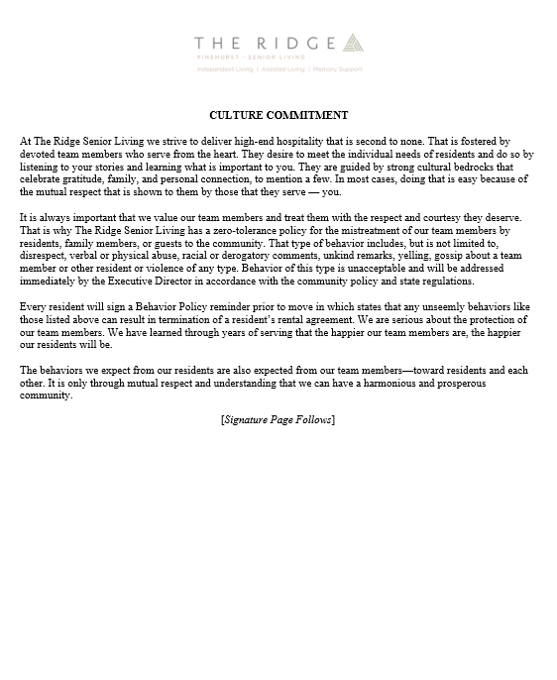
Culture Commitment
Under contract to be kind.
Protecting our team members is a priority
Contract extends to families and other guests
Founded in our culture
Zero-tolerance policy
Commitment is reciprocal
Next steps: Change in behavior or a
Behavioral Contract and eviction.
Notes:
How this came about—focus groups

Slide 41
Successful disclosures
Many organizations have linked lack of seeking compensation or retribution as “success” while the pursuit of litigation or compensation is seen by many as lack of success
    The Resident and family do not sue
    The Resident and family understand that mistakes happen and do not get angry
    The Resident and family don’t go to the press
    The press praises the caregivers’ action and honesty
    The disclosure enables the Resident and family to understand what happened and the ramifications of the event as well as have sufficient information to make future decisions.
Notes:
All

Slide 42

…

Slide 43
Disclaimer
Willis Towers Watson hopes you found the general information provided in this publication informative and helpful. The information contained herein is not intended to constitute legal or other professional advice and should not be relied upon in lieu of consultation with your own legal advisors. In the event you would like more information regarding your insurance coverage, please do not hesitate to reach out to us. In North America, Willis Towers Watson offers insurance products through licensed entities, including Willis Towers Watson Northeast, Inc. (in the United States) and Willis Canada Inc. (in Canada).

Slide 44
Appendix

Slide 45
Important Considerations
Immediate Reporting of the Event
Stop gap activation
Notification of risk management
Investigation and RCA
Filing an incident report
Preparation for the disclosure
Completion of disclosure
Disclosure documentation requirements and solutions
Follow-up with impacted residents and their families
Performance Improvement

