Slide 1
Arthritis Exercise Integration &
Let’s FACE It Together™
Facial Exercise & Rehabilitation
Christine M. Conti. M.Ed.
New Jersey

Slide 2
I am a Chronic Disease Warrior
“Your MISSION in life is to find your gift.
Your PURPOSE in life is to give it away!”

Slide 3
Christine Conti
Arthritis Fitness Specialist
Chronic Disease Fitness Specialist
Creator of Let’s FACE It Together™ Facial Exercise and Rehabilitation
Co-founder of FallPROOF, Fall Prevention
Eating Disorder Fitness Specialist
Best-Selling Author: SPLIT-SECOND COURAGE
Podcast Host: Two Fit Crazies
Master’s Degree in Curriculum and Instruction

Slide 4
Objectives
Many professionals lack the knowledge to safely and effectively design fitness programs that specifically meet the needs of clients with chronic diseases.
Understanding types of chronic diseases and symptoms that stem from various diseases, and mastering methods to improve muscle strength, range of motion, and flexibility, is paramount when working with this population.
As the yearly number of people diagnosed with one or more types of chronic diseases increases, so does the demand for fitness professionals who have the skills and education to deliver quality and individualized fitness programming.

Slide 5
Outcomes
This session is designed to provide fitness professionals an introduction to the tools needed to safely and effectively design and implement arthritis and facial exercise programs for those suffering from chronic diseases.
Gain understanding of various types, symptoms, and causes of chronic diseases, as well as how it affects muscles, joints and organs in the body.
Examine exercises to create safe and effective fitness programs that will improve range of motion, flexibility and strength, to expand the overall health and wellness for your clients.
Improve communication skills to build trust and empathy with those suffering with chronic pain.

Slide 6
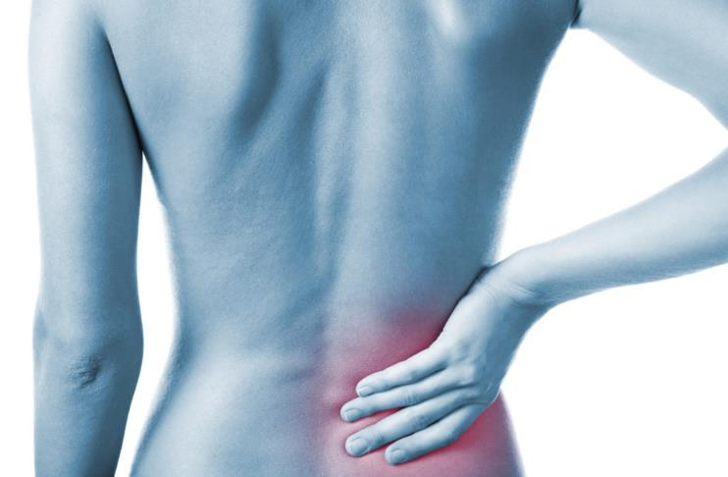
Chronic Disease
Are you one of the 25 million people in the United States living with chronic diseases and pain?

Slide 7
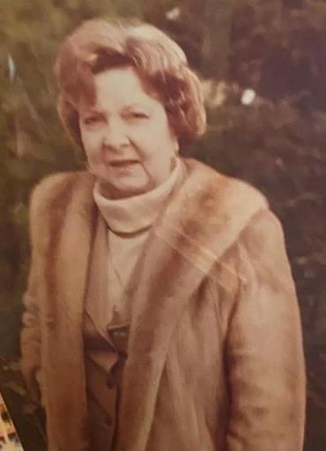
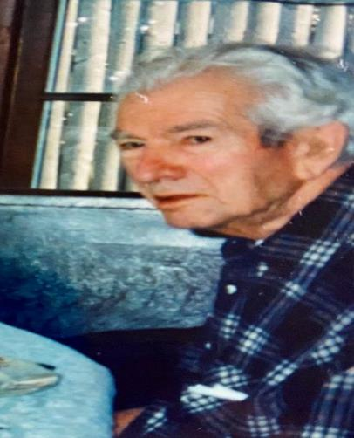
Leading with
Empathy & Compassion
Who do you know that is affected by a chronic disease?
Grandma Jeanne
1974
&
Grandpa Charles
1995

Slide 8
“By the year 2040, an estimated 78.4 million (25.9% of the projected total adult population) adults aged 18 years and older will have doctor-diagnosed arthritis”
(Hootman JM, Helmick CG, Barbour KE, Theis KA, Boring MA)

Slide 9
TYPES OF ARTHRITIS
Osteoarthritis (Degenerative Arthritis)
Inflammatory Arthritis
Rheumatoid
Psoriatic
Gout
Lupus
Juvenile Arthritis
Ankylosing Spondylitis
Septic Arthritis

Slide 10
OSTEOARTHRITIS
Osteoarthritis, also known as degenerative arthritis, is the most common type of arthritis. When the cartilage – the slick, cushioning surface on the ends of bones – wears away, bone rubs against bone, causing pain, swelling and stiffness.
Over time, joints can lose strength and pain may become chronic. Risk factors include excess weight, family history, age and previous injury (i.e., an anterior cruciate ligament, or ACL tear).

Slide 11
INFLAMMATORY ARTHRITIS
A healthy immune system is protective. It generates internal inflammation to get rid of infection and prevent disease. But with inflammatory types of arthritis, the immune system doesn’t work properly and mistakenly attacks the joints with uncontrolled inflammation, potentially causing joint erosion.
The synovium, the tissue lining around a joint that produces a fluid to help the joint move smoothly becomes inflamed and gets thicker. This makes the joint area feel painful and tender, look red and swollen and moving the joint may be difficult.
Most inflammatory arthritis sufferers may experience:
Joint pain, tenderness, swelling or stiffness that lasts for six weeks or longer.
Morning stiffness that lasts for 30 minutes or longer.
More than one joint is affected.
Small joints (wrists, certain joints in the hands and feet) typically affected first.
The same joints on both sides of the body are affected.
Skin rashes on various parts of the body
Internal organs affected: lungs, intestines, heart, etc…

Slide 12
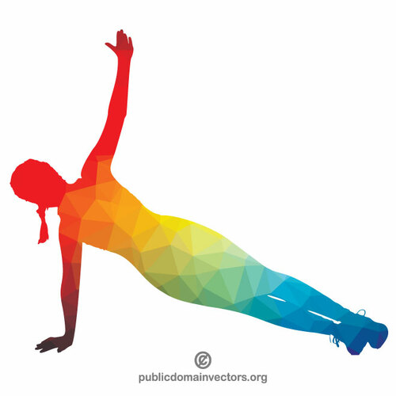
Is Exercise Medicine?
It may not be medicine, but……
EXERCISE IS KEY!
Repetitive and exaggerated movements activate and build muscle
Valuable in restoring function/ prolonging effects of diseases
Improve Neural Pathways, Muscle Memory, Neuroplasticity & Mood

Slide 13
Exercise Instruction 101
Implementing: ALL foundational patterns. 1. Squat 2. Hinge 3. Lunge 4. Push 5. Pull 6. Carry
Each movement will be clearly defined to promote:
1. Range of Motion 2. Balance, Stability and Flexibility 3. Endurance, Strength or Agility 4. Breath and Mindfulness

Slide 14
Let’s not forget…
INDEPENDENCE!

Slide 15
Let’s try it!
5 Minute Arthritis Exercise Integration Practice
Deep Breaths
Head/Neck/Shoulders
Elbows/Wrists/Hands/Fingers
Back/Hips
Knees/Ankles/Feet/Toes
Deep Breaths

Slide 16
The problem: What about the 43 muscles
in your face?
The solution: Let’s FACE It Together™
Facial
Activation
Controlled
Exercise

Slide 17
Let’s FACE It Together™
Facial Exercise & Rehabilitation
The story of Grandma Jeanne….
A 2003 love affair with plastic surgery…
A newspaper article…
Conference presentations…
The medical fitness industry…
World-wide LFIT Instructors
LeadingAge Colorado 2022

Slide 18
Let’s FACE It Together™
Facial Exercise & Rehabilitation
Specific movements increase muscle strength and
function in your body
The same concept applies to the muscles in your face
Targeted Repetitive Movements of the face and neck
Improve range of motion and mobility.
Decrease muscle tightness and immobility caused from
chronic disease

Slide 19
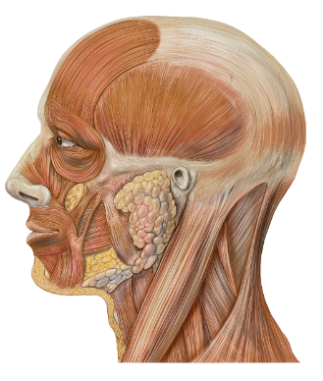
Did you know you have 43 muscles
in the face alone?
For Example:
“For people with Parkinson’s(PWP), those muscles are affected and may experience reduced blinking, neither happy or sad expressions which can lead individuals unfamiliar with PD to think the PWP is upset with them or doesn't care. That couldn't be further from the truth! They do care but have zero awareness that they are not expressing themselves. Facial exercises should definitely be a part of your routine.”
(Bridges, 2020)

Slide 20
Let’s FACE It Together™ For Parkinson’s, Alzheimer’s, ALS, MS, Bell’s Palsy, Stroke, Injury, etc…
Reduced blinking or eye movements
Limited smile and facial expression
May appear angry or no affect
Limited eyebrow movement
Difficulty chewing and swallowing or an increase in drooling

Slide 21
“Let’s FACE It Together!”
Helloooo Daaaahhhling
Smile/Frown, Unilateral Smiles, Fish, Blowfish Patterns
Palpation: The Elvis
Nose Wiggle/Sniffs
Surprise Eyes, Eyebrows, Look Around-the-World
Mouthwash, Chipmunk Cheeks
Jaw Slides Lateral/Front/Back/Rhythms
Turtleneck, Lizards, Say “Ahh”
Lists, fast/slow, add hand gestures

Slide 22
“You have two choices in life.
Do something, or do nothing.
Always choose SOMETHING!”
-Wonder Woman

Slide 23
Learn More
www.ContiFit.com
Arthritis Exercise Integration
Let’s FACE It Together™
FallPROOF™ Fall Prevention & Trivia
WORDS MATTER: Opening Dialogues About Eating Disorders
SPLIT-SECOND COURAGE: What if your fears were the key to your dreams?

Slide 24
