Slide 1
GO FOR THE
GOLD
Embracing Change in 2024
Cecile Morris, PhD, JD, MBA,SPHR, SHRM-SCP
Adjunct Faculty
CMM Consulting-Management and HR Training and Consulting

Slide 2
Empowering through Coaching and Mentoring in the Era of
Artificial Intelligence (AI)
What is the significance of reskilling and AI in the current business landscape?

Slide 3
“The average half-life of skills is less than 5 years, and in some tech fields it’s as low as 2.5 years. For millions of workers upskilling won’t be enough” Tomayo, J. ,Doumi, L., Goel,S., Ondrejkovic, O., & Sadum, R., (2023). Reskilling in the age of AI. HBR-Sept-Oct 2024, 59.

Slide 4
Agenda
Understanding Reskilling
The Role of Coaching and Mentoring
Navigating the AI Landscape
Integrating AI in Coaching and Mentoring
Successful Reskilling Initiatives
Challenges and Solutions
Outlook
Q&A

Slide 5
SHOSHIN

Slide 6
What is Reskilling?
Reskilling is the process of:
acquiring new skills or
updating existing ones
to adapt to changes in the job market, technological advancements, or evolving business requirements.

Slide 7
The Role of Coaching and Mentoring
Coaches and mentors provide guidance, support, and constructive feedback to employees, helping them enhance their skills, overcome challenges, and achieve professional goals.

Slide 8
How many of you presently have mentors?
ⓘ Start presenting to display the poll results on this slide.

Slide 9
Will anyone share how well it is working?

Slide 10
Navigating the AI Landscape
Overview
Implications
Impact

Slide 11
How many of you presently use AI?
ⓘ Start presenting to display the poll results on this slide.

Slide 12
Overview and Implications
Artificial Intelligence (AI) is a branch of computer science that focuses on developing machines and systems capable of performing tasks that typically require human intelligence. This encompasses a wide range of activities, including problem-solving, learning, understanding natural language, speech recognition, and visual perception.
AI systems utilize algorithms and statistical models to analyze data, recognize patterns, and make decisions, mimicking cognitive functions.

Slide 13
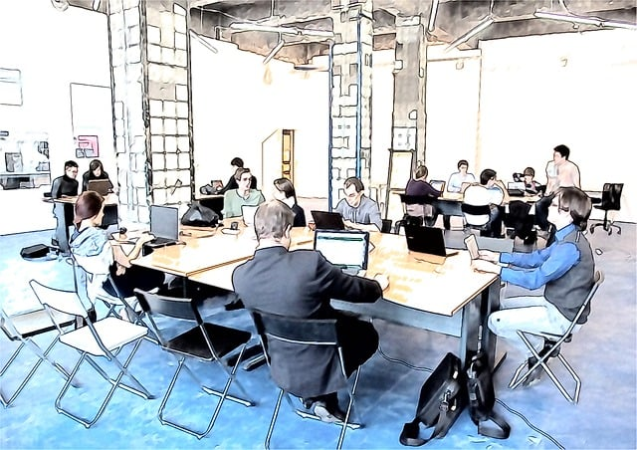
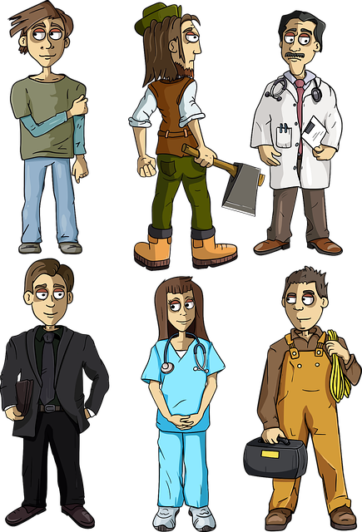
Integrating AI in Coaching and Mentoring
There are benefits of integrating AI in coaching and mentoring programs.
AI tools can be personalized learning and skill assessment.

Slide 14
Successful Reskilling Initiatives
AT&T, launched a Workforce Reskilling Initiative “Future Ready”. It’s part of the upskill America initiative.
Amazon, introduced the "Career Choice" program. Amazon's Career Choice program launched in 2012. Career Choice is now live in 14 countries
Microsoft, through its LinkedIn Learning platform, has also been actively involved in reskilling initiatives.

Slide 15
Successful Reskilling Initiatives
4. AI is being investigated to prevent dosage errors; provide personalized medicine, automatic treatment or recommendation; manage the high cost of back-office challenges and inefficiencies by eliminating time-consuming, non-patient care activities; detect claim fraud; and other applications and tasks.
(Continued)

Slide 16
Had you thought about the following?
Use AI to help:
brainstorm
gather and analyze data
verify your findings and enhance transparency
predict and then parse reviewer feedback

Slide 17
“Don’t let Gen AI limit Your team’s creativity-Treat it as a partner in a structured conversation” Gohar, K., Utley, J. (2024) HBR, Mar/April 2024, 17

Slide 18
Common challenges in reskilling and AI integration
Resistance to Change
Lack of Resources
Skill Mismatch
Fast-paced Technological Changes
Measuring ROI
Limited Access to Training
Data Privacy and Security Concerns
Cultural Shift

Slide 19
Importance of adaptability and flexibility in coaching and mentoring approaches
Adaptability and flexibility are crucial in coaching and mentoring approaches due to the dynamic and ever-changing nature of individuals, organizations, and the broader business environment.
A one-size-fits-all approach is often ineffective, as the needs, learning styles, and challenges of individuals can vary widely.

Slide 20
What’s Ahead?
Emerging trends in reskilling and AI
The evolving role of coaches and mentors in the digital age
Opportunities for continuous improvement

Slide 21
Outlook - Emerging trends
Personalized Learning Paths
Microlearning
Augmented Reality (AR) and Virtual Reality (VR)
Data-Driven Insights
AI Ethics and Responsible AI
Collaborative Learning Platform
Continuous Learning Culture

Slide 22
Outlook - Evolving role of coaches and mentors in the digital age
In the digital age, the role of coaches and mentors has evolved to become more dynamic, encompassing a range of technological and interdisciplinary skills.
Coaches and mentors now navigate not only traditional interpersonal dynamics but also the integration of digital tools, data analytics, and emerging technologies.

Slide 23
Outlook - Opportunities for continuous improvement
Ask yourself:
How does your organization approach continuous improvement?

Slide 24
“Revolutionary technology is changing the HR game. Are you equipped to make AI work for your business”? Zielinski, D. (2024). AI + HI (Human Intelligence) = ROI. HR Magazine, 34.

Slide 25
Partner with 2-3 others
Discuss: 3 minutes
What is 1 area where you could see AI as a beneficial tool that you could recommend immediately?

Slide 26
As Turner (2023) pointed out, Erik Brynjolfsson, director of the digital economy lab at Stanford University's Institute for Human-Centered, shares that the healthcare sector invests in AI more than many other industries. Turner, B. E. W. (2023). Funders remain interested in AI. Modern Healthcare, 53(7), 33

Slide 27
Questions-Thoughts-Comments

