Slide 1
Cybersecurity Threats in 2023
Case Studies in Cyber Breaches
Lessons Learned the Hard Way
May 2023

Slide 3

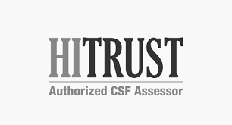
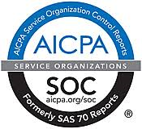
Cyber Security Services at CLA
  Information Security offered as specialized service offering for over 25 years
  Penetration Testing and Vulnerability Assessment
    Black Box, Red Team, and Collaborative Assessments
  IT/Cyber security risk assessments
  IT audit and compliance (HIPAA, GLBA/FFIEC, NIST, CMMC, CIS, etc.)
  PCI-DSS Readiness and Compliance Assessments (PCI-DSS)
  Incident response and forensics
  Independent security consulting
  Remediation assistance
  Internal audit support
*Callahan and Associates 2021 Guide to Credit Union CPA Auditors.

Slide 4
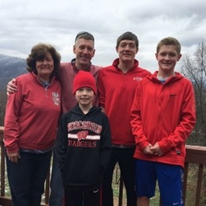
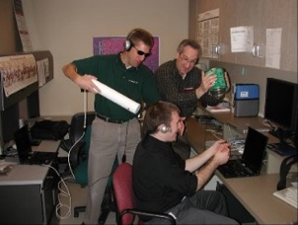
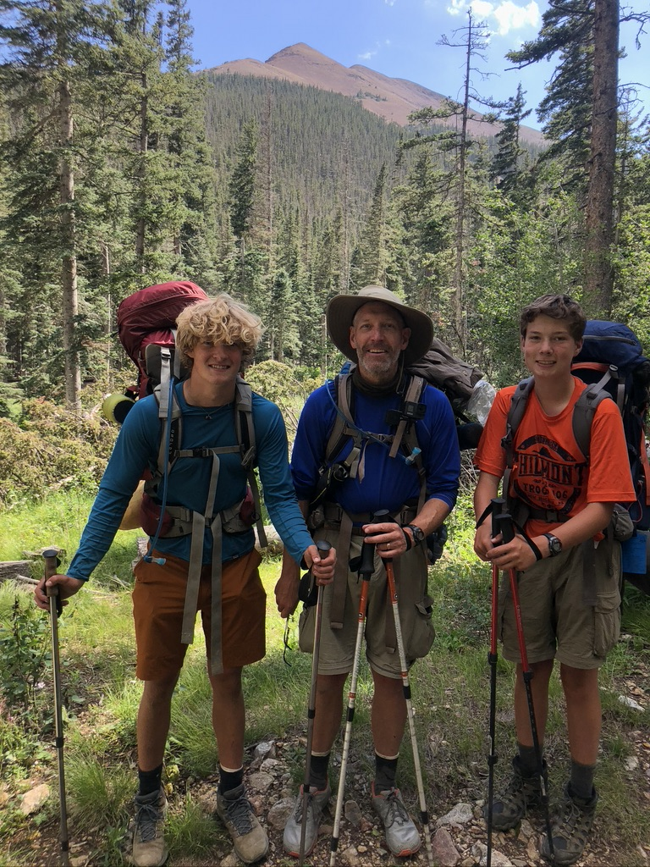
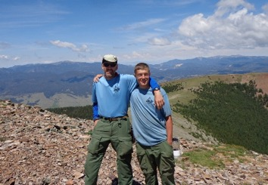
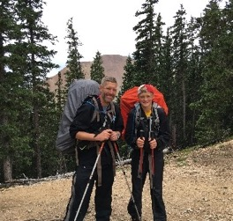
C:\whoami
> m0th_man
  “Professional Student”
  Science Teacher / Self Taught Computer Guy
  IT Consultant - Project Manager → IT Staff/Help Desk → Hacker
  Assistant Scout Master (Boy Scouts)
  Boys Scouts Motto: Be Prepared

Slide 5
Sun Tzu: “Know Your Enemy”
The Current Threat Landscape

Slide 6

Raise Your Hand if You Work for a Tech Company
Security Cameras
Motion Sensors
Logistics Tracking
Print Vendors
Smart TV Displays
Temperature and Humidity
Digital Assistance
Cloud Applications & Analytics
Bio-Medical Care & Monitoring
“Presence”
Security cameras
Garage door
Home thermostat
Cable TV remote
Smart TV
Sleep number bed
Roomba
“Hey Siri, what’s my balance?”
Apple Watch or FitBit
“Presence”
Are You Prepared?
6

Slide 7
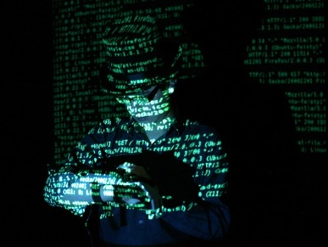
Cybercrime and Black-Market Economies
Black market economy to support cyber fraud
  Business models and specialization
  Underground Marketplace (The Dark Web)
Most common cyber fraud scenarios we see affecting our clients
  Theft of information
  Credit card information
  ePHI, PII, PFI, account profiles, etc.
  Log-in Credentials
  Ransomware and interference w/ operations
To the Hackers, we all look the same…
They will hit you with any or all of the following:
Email Spear Phishing Attacks
Password Guessing and Business Email Account Takeovers
Payment and Funds Disbursement Transfer Fraud
Ransomware
Extortion to avoid breach disclosure
7

Slide 8
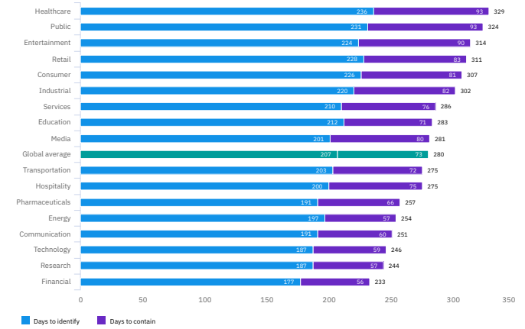
Average Days to Identify and Contain a Data Breach
Global average is 280 days
  207 days to identify a breach
  73 days to contain the attack
Source: IBM Security Cost of a Data Breach Report 2021
Notes:
HC is top of list while Financial Industry is about bottom. Talk about FI regulations.
Hackers can do a lot in and to your network in 231 days (public average)
Learn everything about your CU
Find you crown jewels and take them
Disable backups and security systems
Create numerous back doors
Plant Ransomware (AFTER they are done with everything else…)
Labeling ransomware as the top threat creates a false narrative
Ransomware is usually coupled with other acts and just the most visible part of the attack
These days, ransomware is coupled with data exfiltration
Resuming operations is just the first step
Legal and business ramifications of a data breach can persist

Slide 9
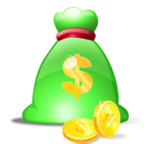
Behind the statistics
What are they doing while they are inside???
  Learn everything about your institution
  Find your crown jewels and take them
  Disable backups and security systems
  Create numerous back doors
Public portrayal of ransomware creates a false sense of security
  Ransomware is usually coupled with other acts – Ransomware is simply the most visible part of the attack – it is usually “the last act”
  Current ransomware attacks are coupled with data exfiltration
  Resuming operations is just the first step
  Legal and business ramifications of a data breach can persist

Slide 10
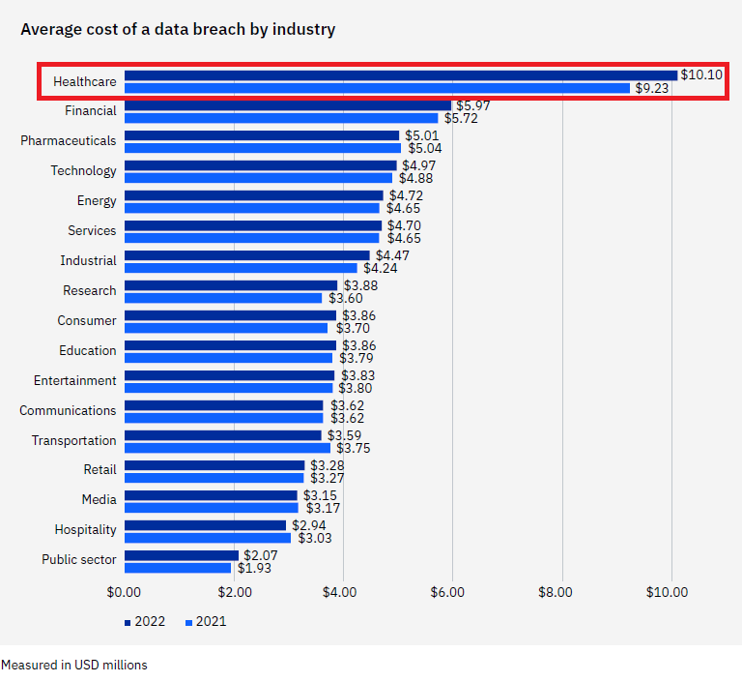
2022 IBM Data Breach Study:
What does a breach cost?
Source: IBM Security Cost of a Data Breach Report 2022

Slide 11
Email Spear Phishing
The Root Cause For More Than 85% of Breaches

Slide 12
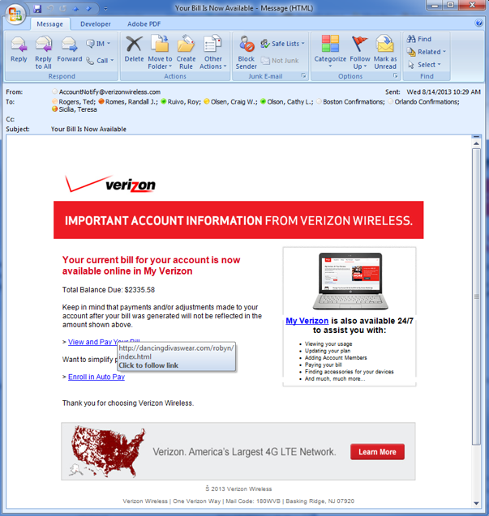

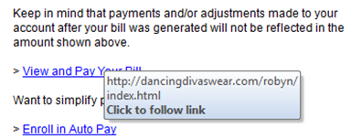
Spear Phishing

Slide 13
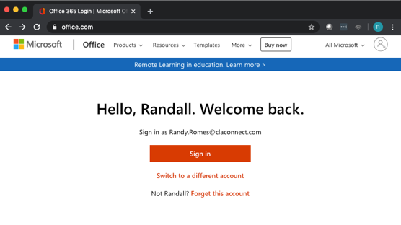
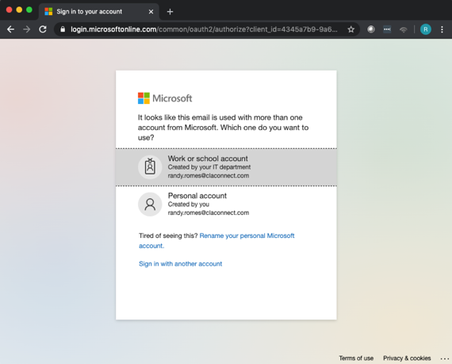
Credential Harvesting and Password Guessing:
Attacks on Office365
Password guessing attacks
Phishing that harvests credentials

Slide 14
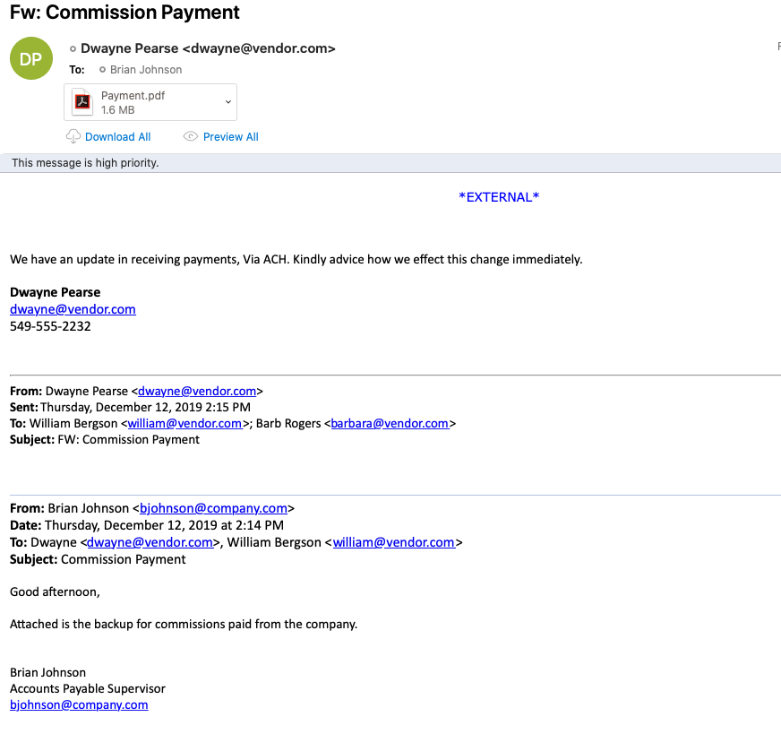
Business Email Compromise
Fraudsters impersonate employees, service providers, or vendors via email in an attempt to…
  EXAMPLE
  Finance person phished
  …gift cards…
  IT staff “investigated…”
  IT staff “shut it down”
  We are good (right?)

Slide 15
Business Email Compromise - Examples
RECENT EXAMPLES in the last 4 weeks…
Finance person’s email account is compromised.…
  Finance person phished
  …gift cards…
  IT staff “investigated…”
  IT staff “shut it down”
  We are good (right?)
Issues
  Retention time and data storage limits
  IT is not equipped to perform incident response
Notes:
IT admin:
Standard/general Domain user account NOT DA
HOWEVER, standard/general Domain user is Admin in Cloud (O365)
E5 License

Slide 16
Does Your Organization Already Use a Phishing Service?
“We already use _______”
  “IT tests our people every ___”
  ”Click through rate is ___”
  “Failures are required to take training…”
  “We report results to the board quarterly…”
These are important…
These services are best categorized as training and training effectiveness measurement tools.
They are NOT penetration testing…
There is a “so what factor” that you may be missing…

Slide 17
The Supply Chain Exposing Us
Embedded / Open-source Software
Log4j and Other Imbedded Software Components

Slide 18
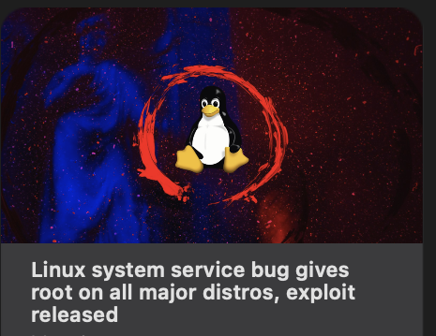
Software Vendor/Supply Chain Risk Management
Recent Significant Issues:
  Common software components with exploitable vulnerabilities.
  Recent examples include
  “Log4j” Java vulnerabilities…
  Pkexec - CVE-2021-4034 (PwnKit)
  Python – CVE-2007-4559
  September 2022
  15-Year-Old Python Flaw Slithers into software worldwide
  An unpatched flaw in more than 350,000 unique open source repositories leaves software applications vulnerable to exploit.
Google:
Log4j vulnerabilities

Slide 19
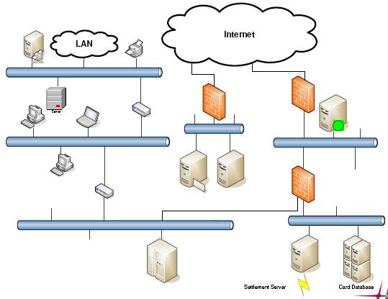
Java Software and Log4j
Java in Firewall(s)
Java in
Multifunction device
Java in
Printer
Linux appliance
Where else?
Java in web server

Slide 20
Software Vendor/Supply Chain Risk Management
Inventory
Controlled use of Administrative Access
Secure Standard Builds
Vulnerability Management
Logging, Monitoring and Alerting
Vulnerable API Interfaces and Web Services
Notes:
All software products have bugs/vulnerabilities…
In-house development: what (open source) code repositories are we using
What are we doing to assure they are “clean”
Vendor supplied software development: what (open source) code repositories are THEY using
What are THEY doing to assure they are “clean”
What are WE doing to assure THEY are “clean”
What impact does this software have on the institution…
Do we have an accurate “inventory”?
If it is hacked/breached?
If it is down for… 2 hours? 2 days? 2 weeks? 2 months?

Slide 21
Interference With Operations & Extortion
Ransomware is not going away…

Slide 22
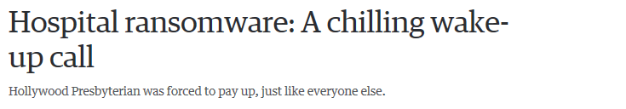
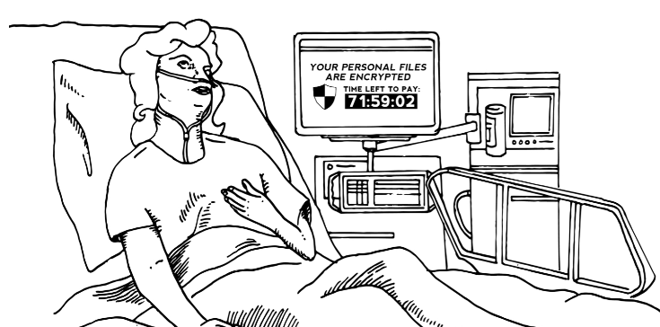
Ransomware
Ransomware bursts on the scene more than eight years ago…
Notes:
Describe Imperial County.
- Ransomeware demand of $1.2M
Estimate to recover on own and fix was over $3M
WOULD NEED TO DO THIS ANYWAY…
Did NOT pay
More than 8 months later… still not done fixing and cost has soared past $3M

Slide 23
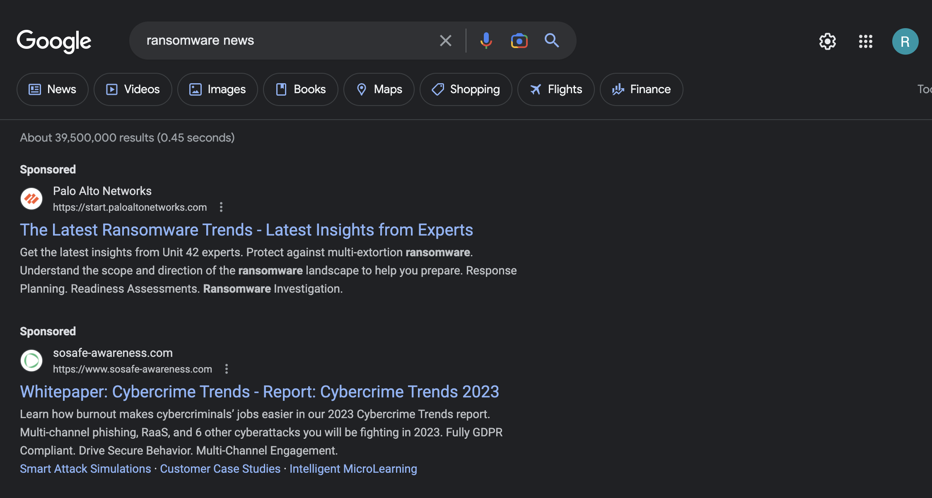
Ransomware

Slide 24
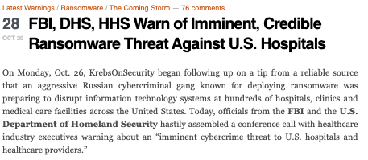
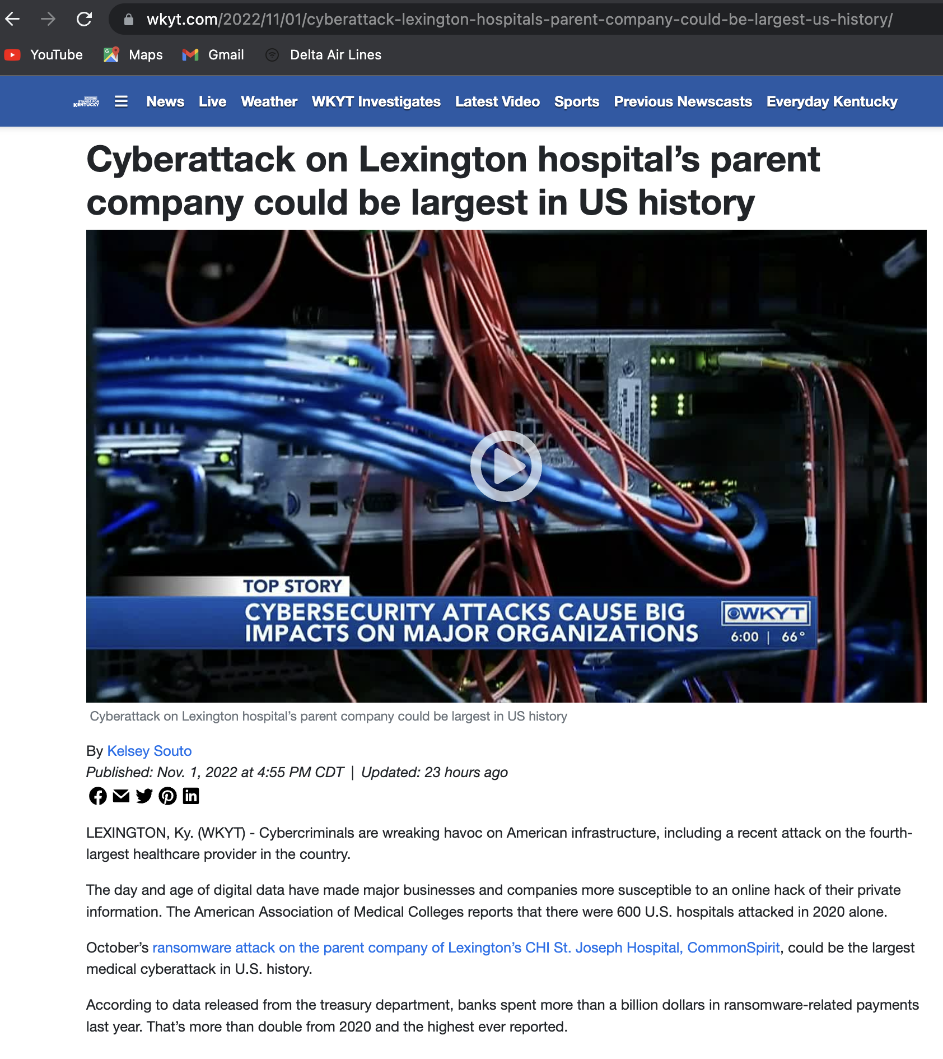
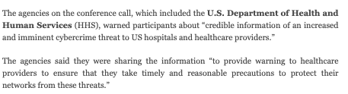

Late Last Year…
https://krebsonsecurity.com/2020/10/fbi-dhs-hhs-warn-of-imminent-credible-ransomware-threat-against-u-s-hospitals/
Notes:
Describe Imperial County.
- Ransomeware demand of $1.2M
Estimate to recover on own and fix was over $3M
WOULD NEED TO DO THIS ANYWAY…
Did NOT pay
More than 8 months later… still not done fixing and cost has soared past $3M

Slide 25

Ransomware Attacks Continue to Evolve
Earliest versions attack consumer availability
2nd generation attacked business availability & confidentiality
Newest versions
  Successful against all operating systems
  Include Internet banking trojans (Zeus Sphinx Trojan)
  Search for and encrypt back ups first
  FINISH with threat of data disclosure (DR is not enough…)
If you have not tested your susceptibility to Ransomware…???
If you have not tested your recovery capabilities, from bare metal up…???
Ransomware

Slide 26
Standards Based Operations
“People, Rules, and Tools”

Slide 27
Reliance - It Starts with Policies and Standards
Security is not a product
People, Rules and Tools
  What do we expect to occur?
  How do we conduct business?
  Who is responsible for what?
Standards based operations from a governance or compliance framework:
  HIPAA, GLBA, (State Laws?) ----- Regulatory
  PCI – DSS, CMMC ----- Contractual
  CIS Critical Controls, NIST ----- Operational standards

Slide 28
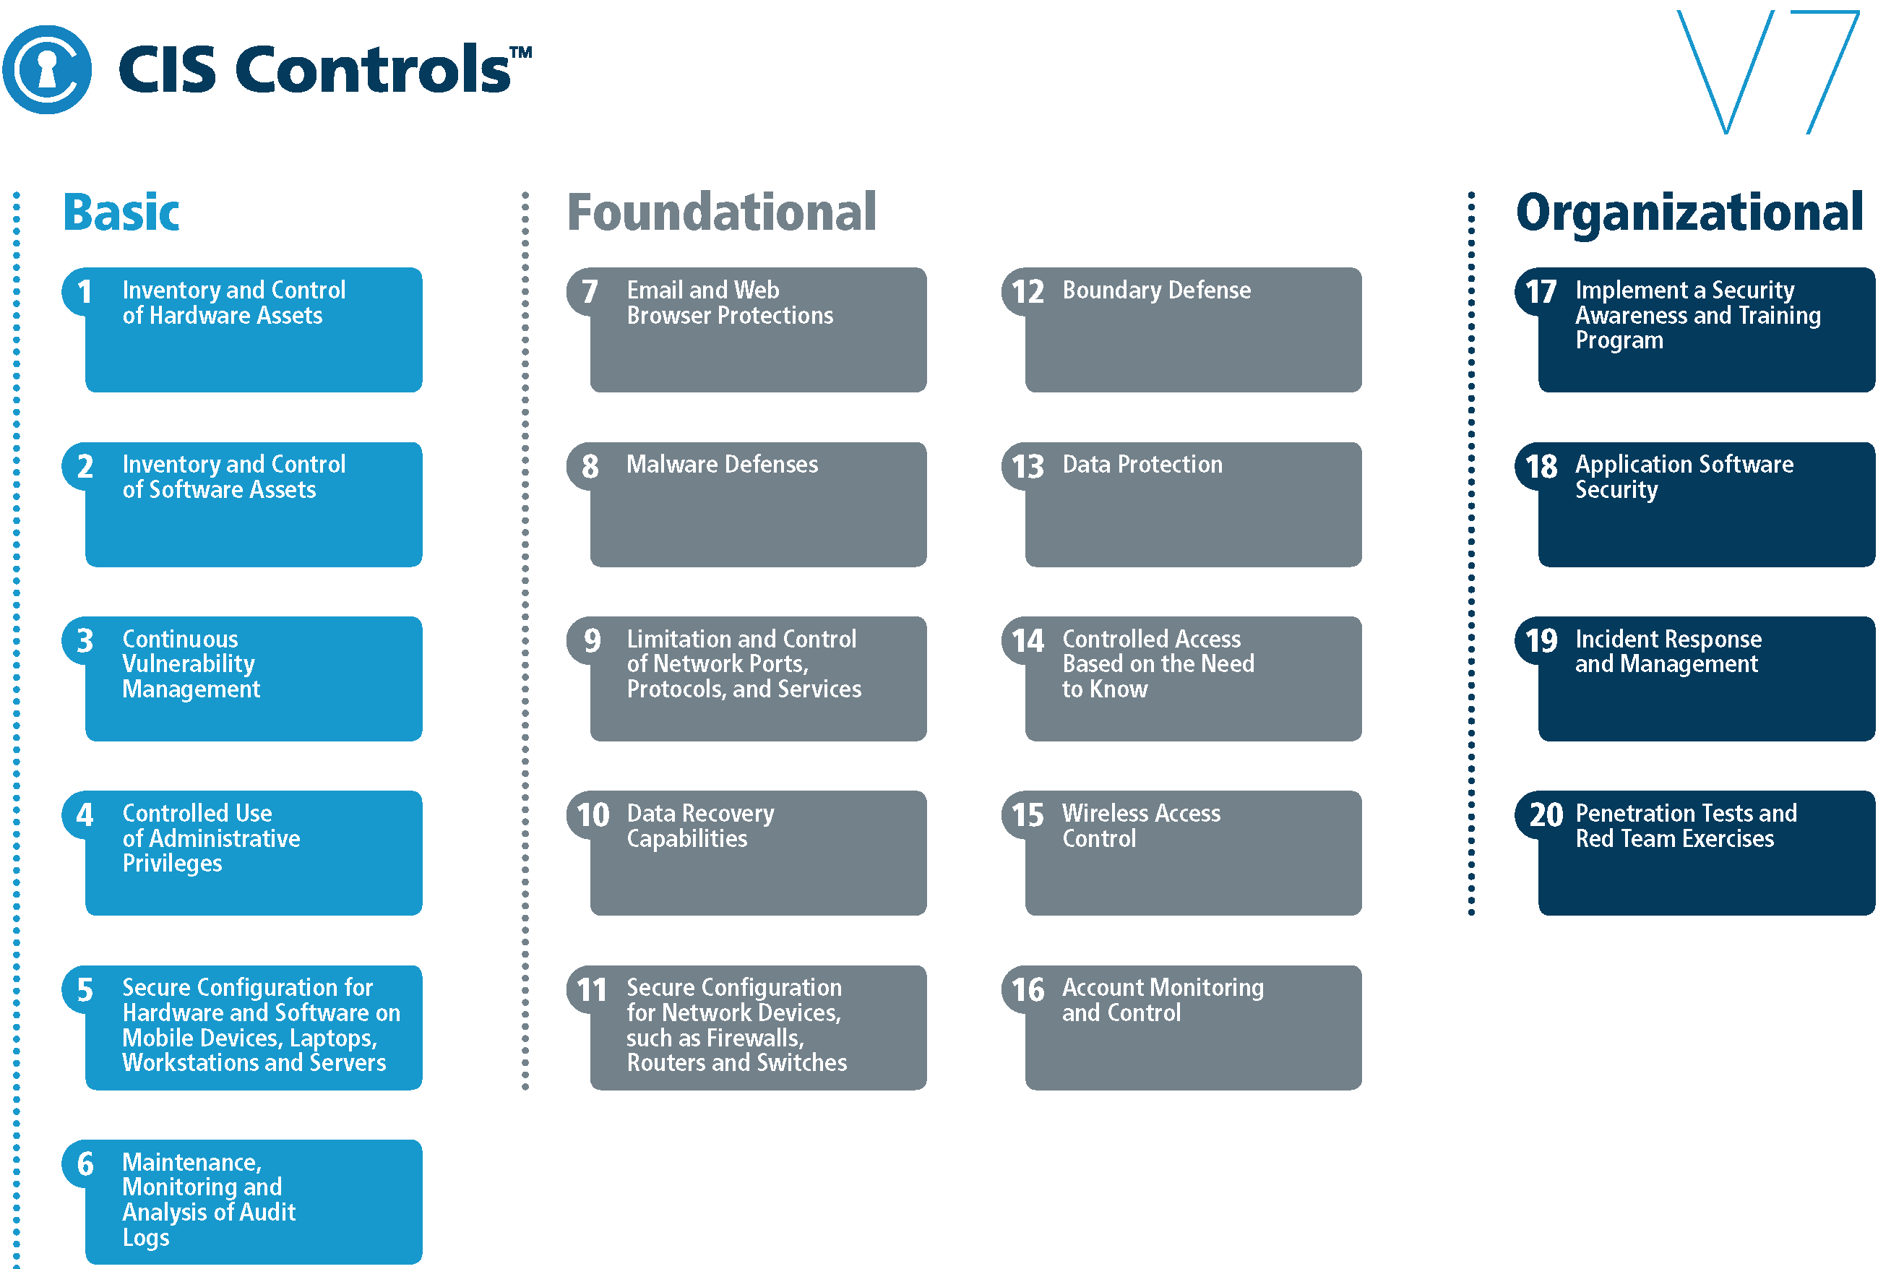
Standards Based IT and Cyber Operations
https://www.cisecurity.org/controls/
Notes:
New version has more focus and emphasis on internet based/cloud based systems and processes…
Implementation groups
CLA is licensed to use CIS tools and materials. Please check with CLA IT if you have questions.

Slide 29
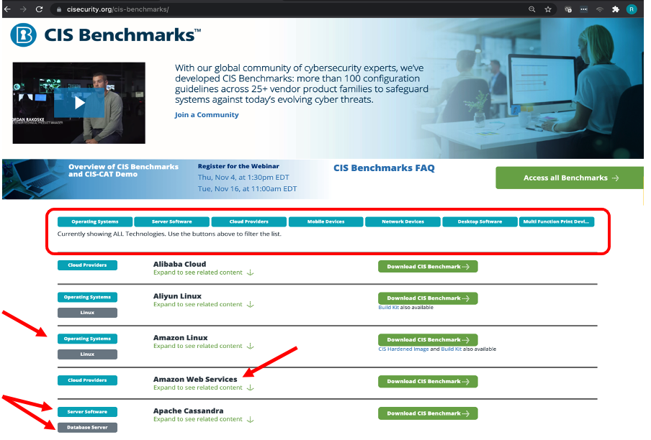
CIS Benchmarks
Checklists and How-to guides for just about everything
Operating Systems
Server Software
Network Devices
Cloud Implementations
Etc.

Slide 30
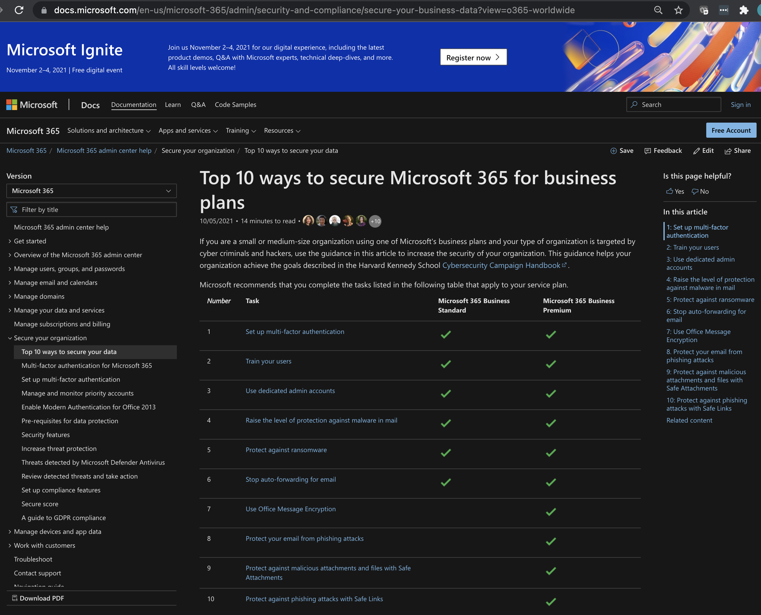
Secure Office 365
NOT fully secure by default
Needs to be secured:
Enable/Turn On security features
Harden (email) security
Fine tune logging, monitoring and alerting
Enforce retention periods
Security configurations need to be periodically assessed.
Logging is based on license level.

Slide 31

Operational Discipline
Disciplined change management
Consistent exception control
and documentation
  Should include risk evaluation
  and acceptance of risk
  Risk mitigation strategies
  Expiration and re-analysis of risk acceptance

Slide 32
Passwords
Old Rules (NIST – 2005?)
  Length (8+ characters)
  Complexity (Aa4@)
  Forced expiration (every_____)
New Guidance (NIST – 2018?)
  Loooooooong Passwords
  No expiration
  Especially important for administrative accounts (CIS 4)
Password Audit | Total
Number of passwords audited | 855
Passwords cracked | 794
Passwords that were all letters | 63
Passwords that were all numbers | 5
Passwords that were an English word | 20
Passwords that were a word with numbers appended to it | 200
Passwords that were the same as the username | 6
Passwords that do not meet Windows complexity | 584
Notes:
Exceptions… 10% / 33% failure rate… so what factor
Length more important than complexity
Pass phrase/natural language
Last Pass
KeePass
Google Authenticator
Most applications have this

Slide 33
Password Strategies:
Multi-factor authentication on ALL external systems
Password management tools
Pass Phrases – Loooooong natural language
Password21 <------------- Unforgiveable!
Summer21 <------------- Terrible
N*78fm/1 <------------- Painful
Wallet Painting lamp <-- GOOD
The Packers always beat the Bears! ← BEST
Audit your passwords
Notes:
Training and auditing

Slide 34
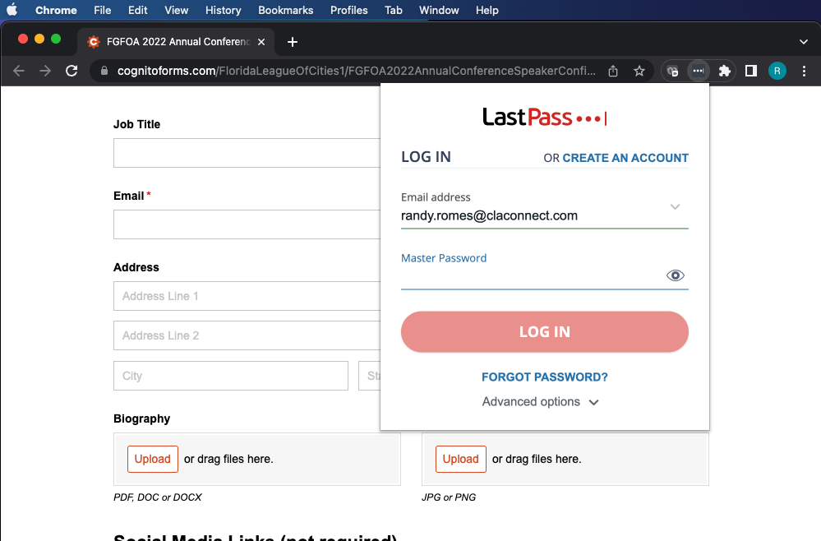
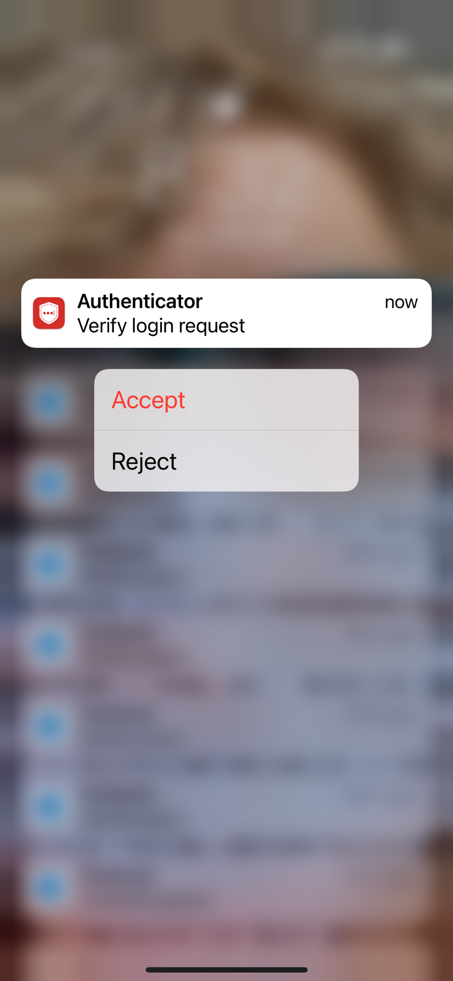
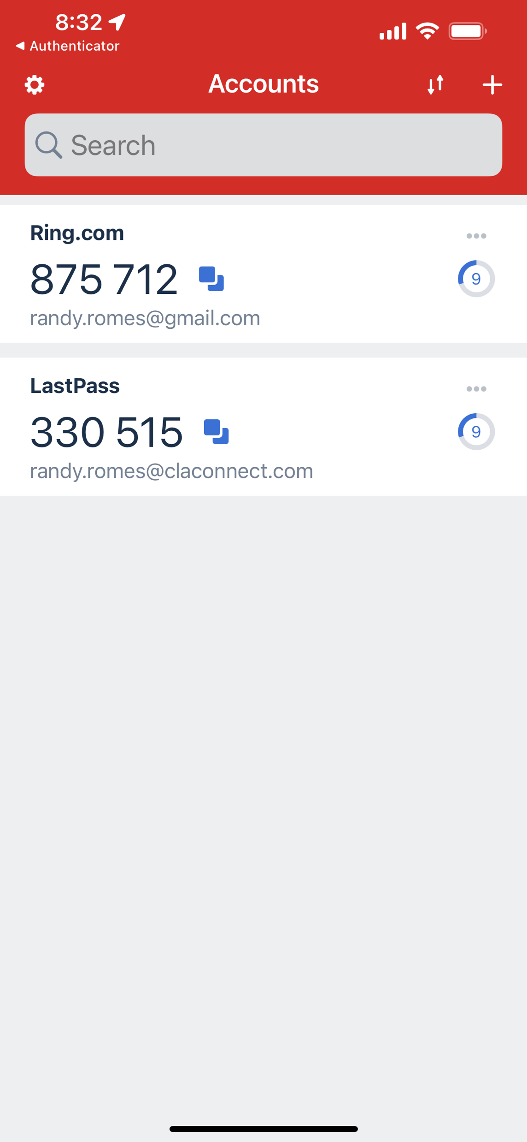
Password Strategies:
Password tools: MFA and Password Managers are needed
Notes:
Training and auditing

Slide 35
Disaster Recovery & Business Continuity
Inventory of assets and results of risk assessment are crucial
  Hardware and software
  Critical data elements (“the crown jewels”)
    Data Retention policies and standards
    Where is the data (if we know where it is, we know where to apply controls)
  Critical business processes
Business impact analysis with definition of recovery point objectives
  This is another name for a specialized type of risk assessment
  Defines priority for restoration
Disaster Recovery is periodically practiced
  Need to make sure it works the way you expect
  IT needs to PRACTICE – prove they can restore in the heat of the moment

Slide 36
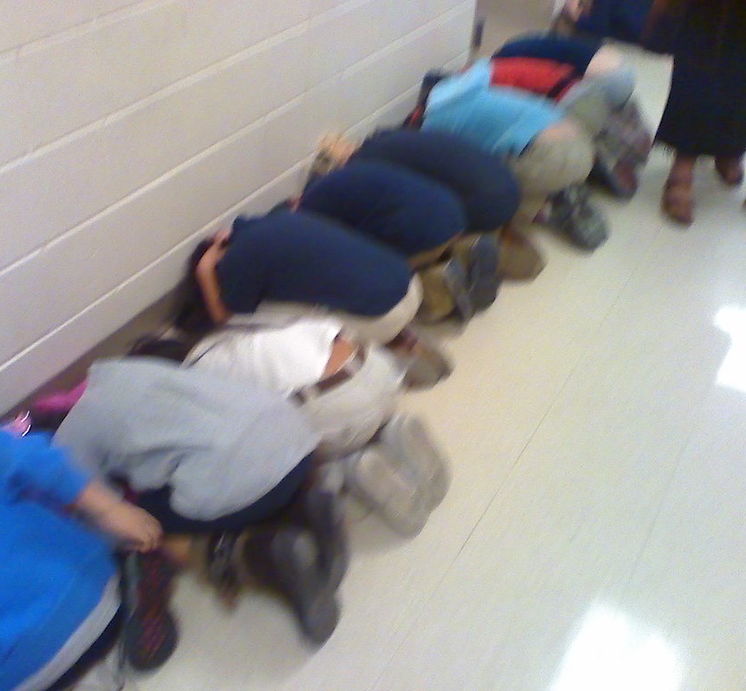
Practice the Plan
Tabletop exercises- simulations where participants walk through the incident and response procedures
Two types of tabletop exercises
  Technical
  Management
  Both types should be conducted annually
Spear phishing tests and other social engineering tests
Red team penetration testing
Notes:
Like all emergency procedures, they need to be practiced

Slide 37
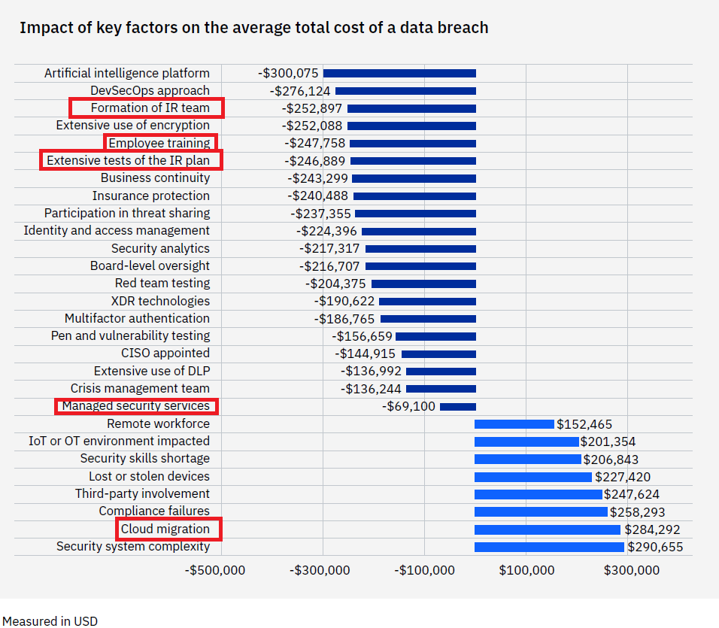

Incident Response Preparedness- Cost Savings
The impact of 28 factors on the average cost of a data breach
$4.35 Million – The average cost of a data breach in the US
Source: IBM Security Cost of a Data Breach Report 2022

Slide 38

Boy Scouts Motto: Be Prepared…
Prepare
Operate
Test
  Standards Based Operations and Exception Management
    Daily Operational DNA
  Regular/periodic risk assessment:
    Daily Business as Usual
  Monitor and fine tune:
    Continuous improvement
  Practice and Test
    Audit your operations controls (against a framework)
    Review Office 365 (O365) security (periodically)
    Schedule IR Tabletop and Disaster Recovery exercises
    Test new systems and after significant change
  Governance - PROVE IT
38

Slide 39
Randy Romes, CISSP, CRISC, CISA, MCP, PCI-QSA
Principal – Cybersecurity
612.397.3114
Randy.Romes@claconnect.com

