Slide 1
Creating Inclusive Senior Living Communities for LGBT+ Older Adults
Stormie Foust Maley, MSc | Dayspring Villa Assisted Living
Carey Candrian, PhD | University of Colorado School of Medicine
Amy Dore, DHA | Metropolitan State University of Denver

Slide 2
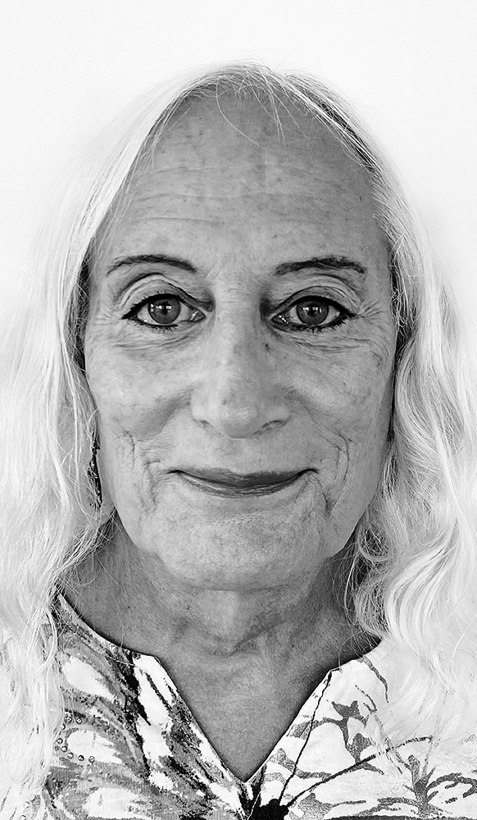
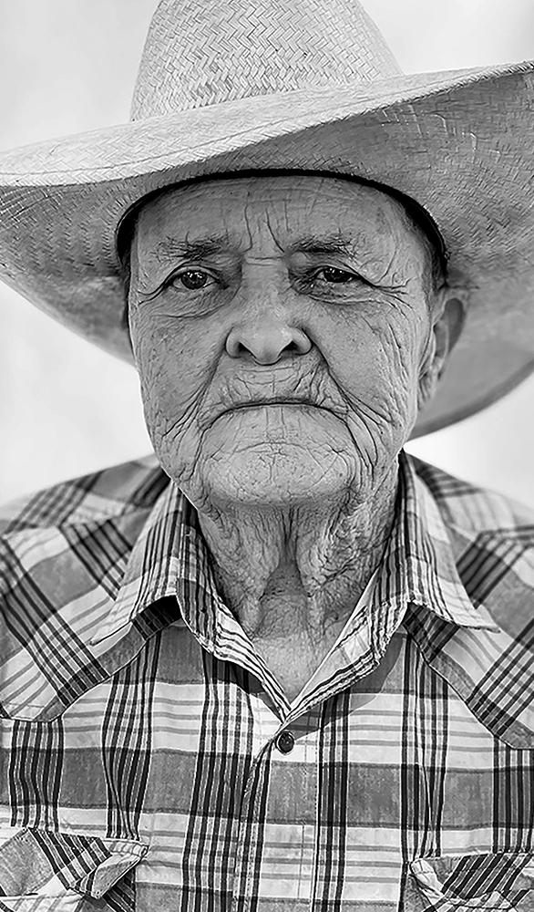
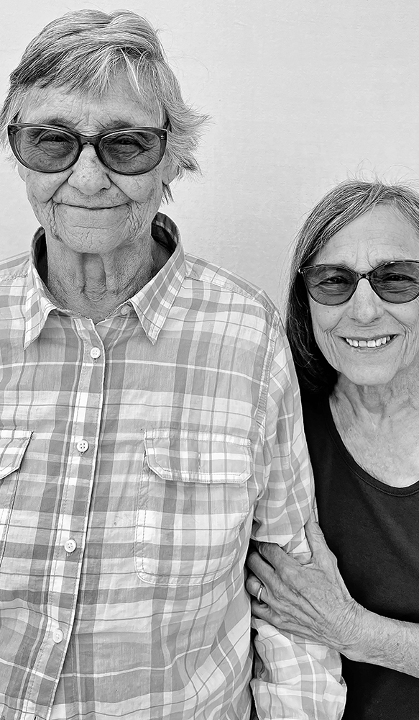

Slide 3
LGBTQ Disparities
Financial security
Family support
Stigma and discrimination
Sources: National LGBT Cancer Network & Healthy People 2020

Slide 4
Until
1973

Slide 5
Discrimination in healthcare
48% Not come out to own doctor.
56% Report experiencing discrimination.
Jumps to 70% for trans or gender non-conforming.
Sources: AARP, 2018 and American Heart Association, 2021

Slide 6
Habit of Silence

Slide 7
Silence: effects on health
75%
Go back into closet when
entering long-term care.
Source: National Senior Citizens Law Center. (2016)

Slide 8
Silence: effects on health
-12 years
Source: Harvard Medical Magazine, 2020

Slide 9
So what can we do? Community-initiated solution: LGBT+ friends group

Slide 10
Goal of project
Create more inclusive senior living communities for LGBT+ residents through video-based education/training and learning-circle facilitation.
Center and engage the voices of the residents to find creative solutions to the issues impacting their lives.

Slide 12
Staff feedback

Slide 13
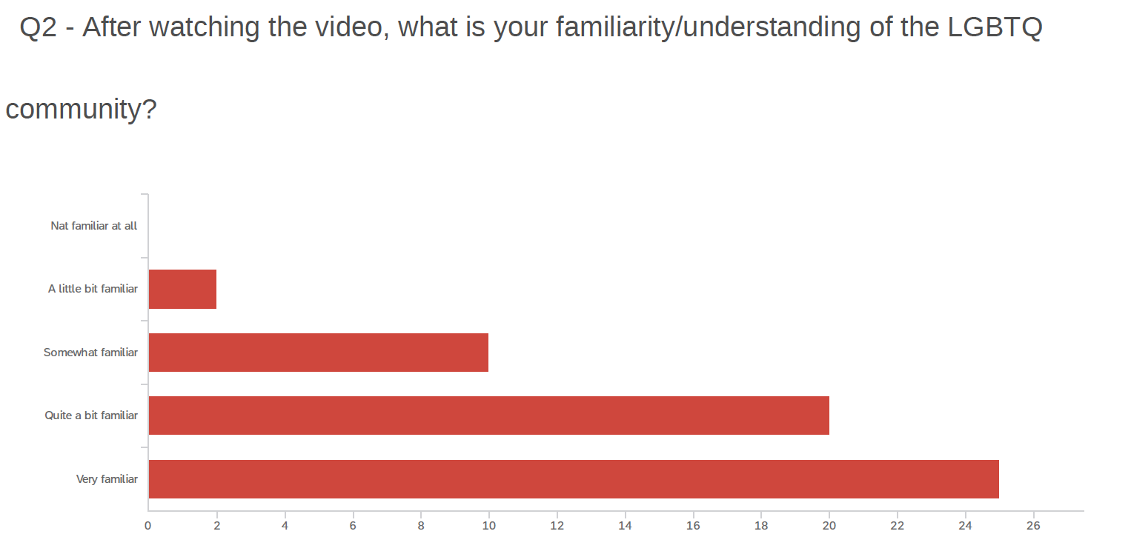

Slide 14
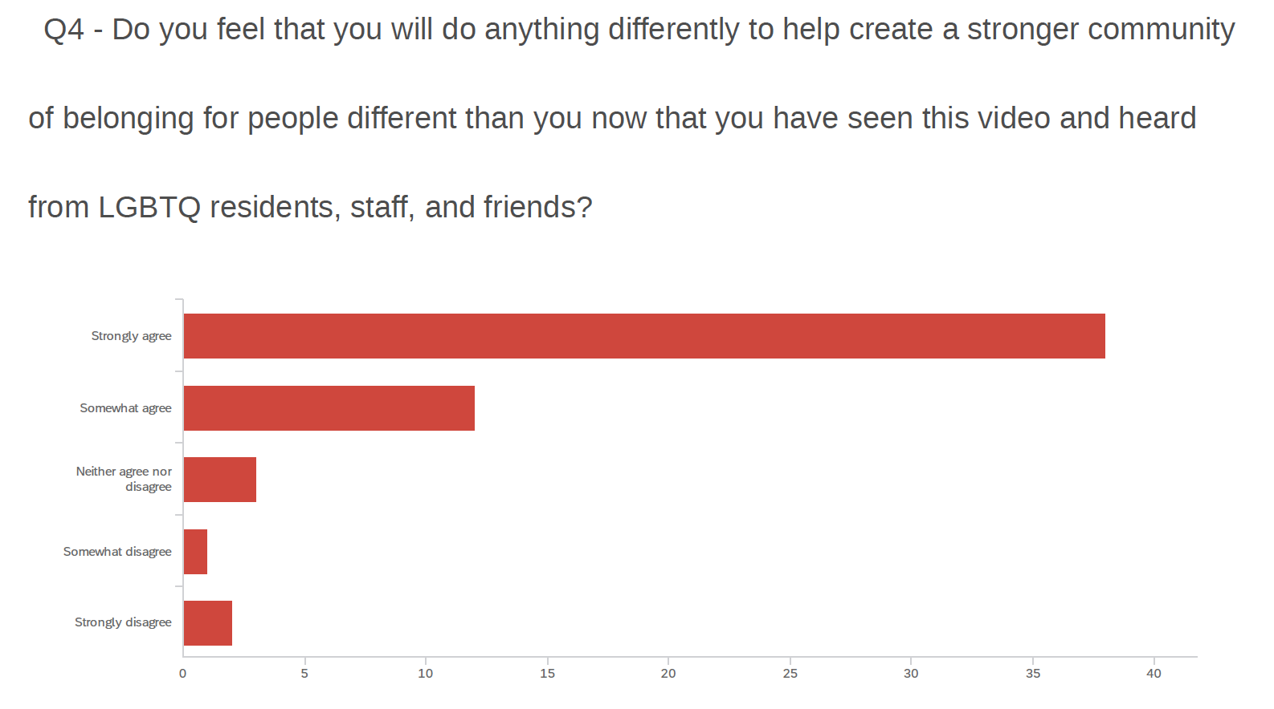

Slide 15
What things are you thinking of doing differently after seeing it…

Slide 16
Anything else you’d like to say after seeing it…

Slide 17
Challenges and Lessons Learned
Communication with stakeholders about alignment of goals
Buy-in/engagement at multiple levels of the organization
Sensitivity to different levels of familiarity
Education vs. advocacy during cultural change projects

Slide 18
Concrete strategies to improve interactions with LGBT+ residents
Language: “Who do you consider family?” “Do you have a partner?” What’s their name?”
Environment: Signs and symbols matter. Non-discrimination policy.
Programming: LGBT+ friends group, for example.

Slide 19
Thank you!! Questions and contact information: Stormie: sfoust@clcliving.org Carey: carey.candrian@cuanschutz.edu Amy: dorea@msidenver.edu

