Slide 1
BUILDING AND SUSTAINING
A RESILIENT WORKFORCE
By: Marisol Solarte-Erlacher, M.A., LPC

Slide 2
Gain the knowledge, skills, and strategies necessary to cultivate a sustainable workforce that is resilient, by building your own resilience as a leader.

Slide 3
Resilience is associated with greater job satisfaction, work happiness, organizational commitment and employee engagement.

Slide 4
In a recent systemic review on the COVID-19 pandemic and mental health and a narrative review on COVID-19 related mental health effects in the workplace concluded that COVID-19 has resulted in depression, anxiety, and poor sleep quality.

Slide 5
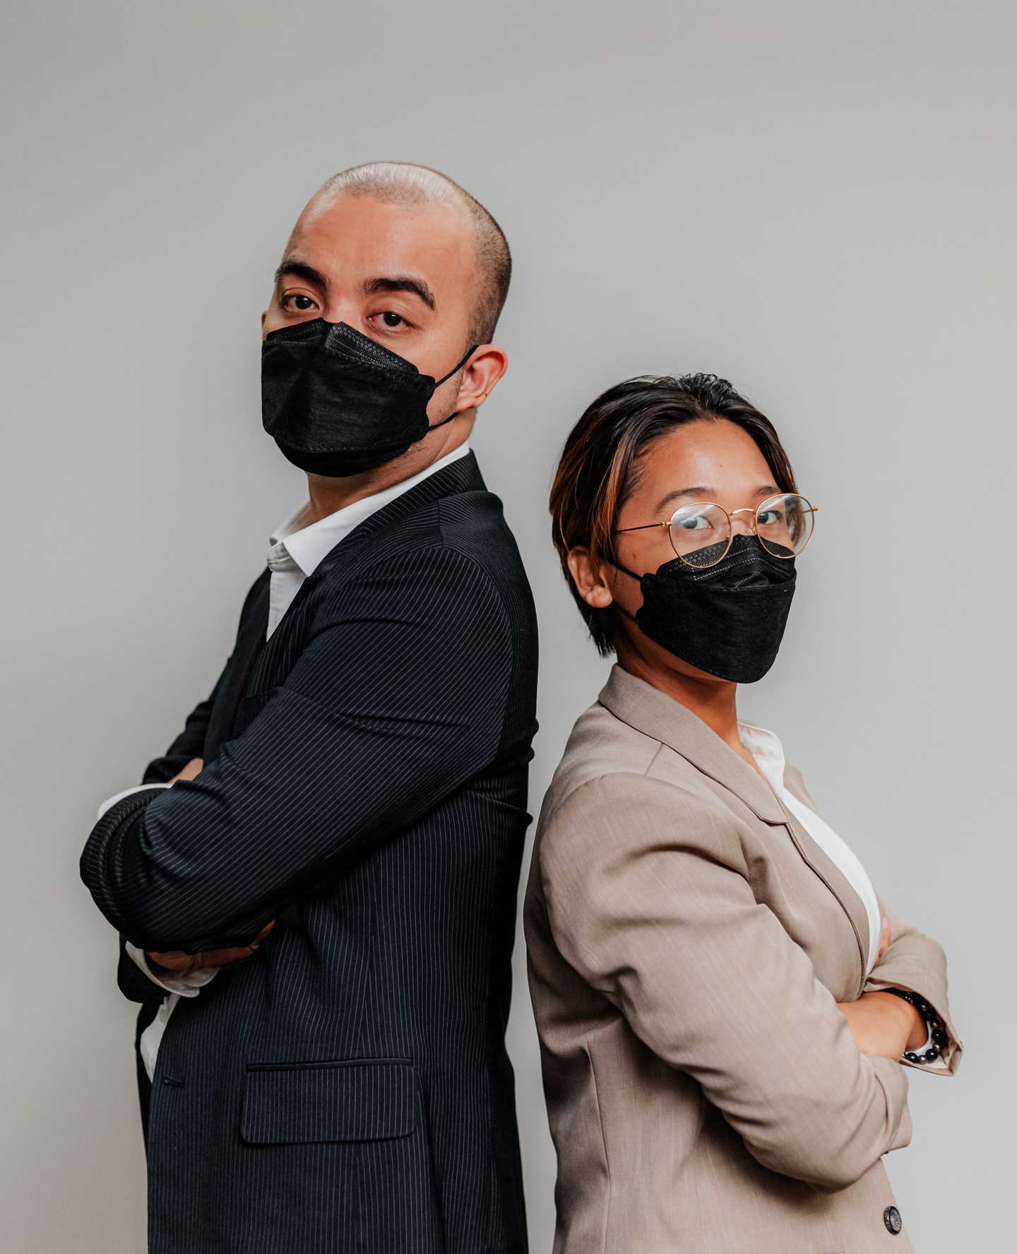
How would you describe the impact of COVID on you and your team?

Slide 6
30% of employees reported being fearful that disclosure of mental health could lead to being fired or furloughed
37.8%
44.2%
52.8%
Reported having at least 1 adverse mental or behavioral health symptom during COVID-19
White
Black
Latinx

Slide 10
1.00 - 2.99 - Low Resilience
Low resilience: Individuals with a low resilience score may struggle with a lack of personal and social competence and may find it difficult to adapt to changing circumstances and setbacks.
They may experience high levels of stress, anxiety, and hopelessness when faced with challenging situations. Low resilience scores may indicate a need for additional support or intervention to help build resilience and coping skills.
Tips to keep building:
Consider seeking out help or support from a therapist, counselor, or other mental health professional.
Practice self-compassion and positive self-talk to counteract negative self-beliefs and build confidence.
Focus on building coping skills and gradually exposing oneself to difficult situations to increase confidence and resilience over time.

Slide 11
3.00 - 4.30 - Normal Resilience
Normal resilience: Individuals with a normal resilience score generally have a moderate level of personal and social competence and are able to adapt to some degree to changing circumstances and setbacks.
They may experience some stress or anxiety in difficult situations but are generally able to cope effectively and find ways to overcome challenges. Normal resilience scores may be indicative of typical levels of resilience for the general population.
Tips to keep building:
Focus on building and maintaining strong relationships in your community to increase social support.
Develop healthy coping mechanisms, such as exercise or creative outlets, to manage stress and increase resilience.
Seek out new challenges and opportunities to learn and grow, while also acknowledging and celebrating successes along the way.

Slide 12
4.31 - 5.00 - High Resilience
High resilience: Individuals with a high resilience score tend to have a strong sense of personal and social competence and are able to adapt to changing circumstances and setbacks with relative ease.
They are often able to maintain a positive outlook and find meaning and purpose in challenging situations. High resilience scores may indicate a greater overall sense of well-being and ability to handle stress.
Tips to keep building:
Practice mindfulness and self-care regularly to maintain a positive mindset and reduce stress.
Set realistic goals and challenge yourself to try new things to continue building your confidence and competence.
Build and maintain strong social support networks through regular communication and engagement with family, friends, and community.

Slide 13
FRONTAL
LOBES
YOUR BRAIN ON STRESS
LIMBIC
SYSTEM
EMOTIONAL
MEMORY
CENTER
AMYGDALA
BRAINSTEM

Slide 14
WINDOW OF TOLERANCE
HYPERAROUSAL
HYPOAROUSAL

Slide 15
How do we know when we are
out of the window?

Slide 16
STAYING IN
THE WINDOW
MORE OFTEN

Slide 17
Emotions are information that
helps us better understand
our day to day experiences.

Slide 18
Our ability to move toward and
tolerate difficult emotions will
increase our overall well-being.

Slide 20
What are the behaviors of a
resilient employee?

Slide 21
Positive self-talk
Flexibility
Problem-solving skills
Manages time well
Emotional intelligence
Creates a support network
Has a growth mindset
Practices Self-care
Confidence

Slide 22
Calmness and willingness to improve
communication skills
Encouraging positive habits
Recognize and Reassure
Empower individuals and teams by giving them
ownership over their work
Set appropriate goals and adjust expectations
Focus on strengths
Learn mindfulness in order to build a connection
with self and others

Slide 23
Lead by Example

Slide 24
How are you doing today?
What challenges are you facing right now?
What strategies have you used in the
past to overcome similar challenges?
How can I support you in overcoming
these challenges?
What can you do to take care of
yourself during this time?

Slide 27
Thank you
Marisol Solarte-Erlacher, M.A., LPC
Trauma Expert . Consultant . Creator
marisolerlacher.com
(720) 257 - 1515
marisol@marisolerlacher.com

