Slide 1
AGELESS ACOUSTICS:
BUILDING ENVIRONMENTS THAT SPEAK VOLUMES TO OLDER ADULTS
LEADING AGE COLORADO| MAY 14 2024

Slide 2
AGELESS ACOUSTICS
Introduction
Julia Bailey
Ben Seep
Angela Gunn
OZ ARCHITECTURE
Interior Design
WAVE ENGINEERING
Acoustical Engineering
OZ ARCHITECTURE
Architecture

Slide 3
AGELESS ACOUSTICS
Importance in Older Adult Living
SOCIALIZATION
COMMUNICATION
ENRICHMENT

Slide 4
AGELESS ACOUSTICS
Importance in Older Adult Living
COMMON SYMPTOMS
Speech of others sounds mumbled or slurred.
High-pitched sounds are hard to distinguish.
“S” and “TH” are hard to distinguish.
Conversations are difficult to understand particularly when there is background noise or reverberation.
Men’s voices are easier to hear than women’s.
Tinnitus (ringing) may occur in one or both ears.
FACTORS
Family history (age-related hearing loss tends to run in families).
Repeated exposure to loud noises.
Smoking.
Certain medical conditions (ex: diabetes).
Certain medicines (ex: chemotherapy drugs).

Slide 5
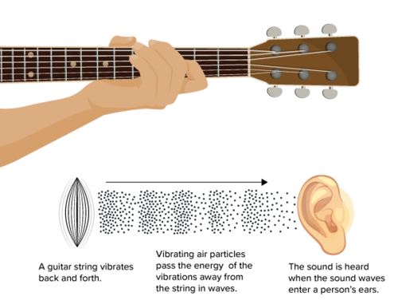
AGELESS ACOUSTICS
Sound Basics 101

Slide 6
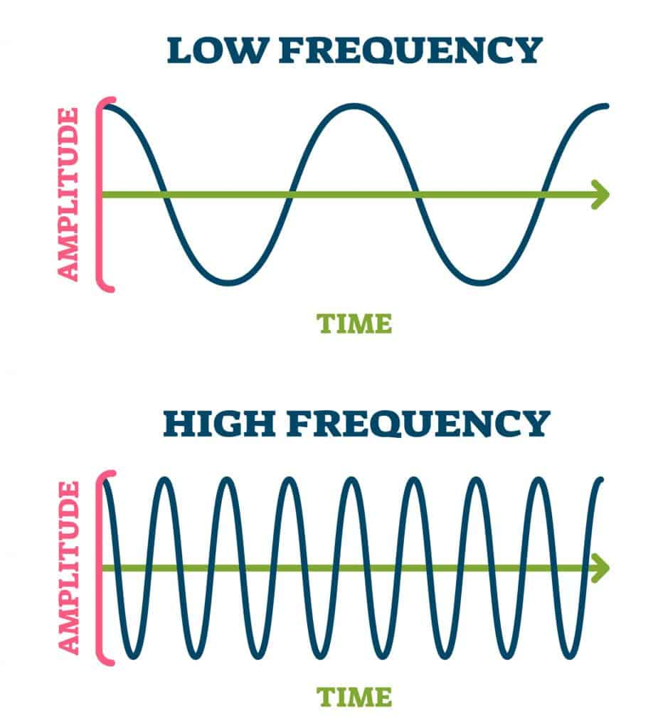
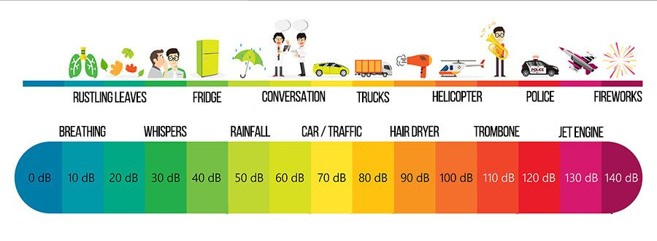
AGELESS ACOUSTICS
Sound Basics 101
Pitch is measured as frequency (Hz)
Sound level is measured in decibels (dB)

Slide 7
AGELESS ACOUSTICS
Architectural Acoustics
Architectural Acoustics is the study of:
Room Acoustics & Reverberation
Sound Isolation
Mechanical and Environmental Noise

Slide 8
ROOM ACOUSTICS & REVERBERATION

Slide 9
AGELESS ACOUSTICS
Architectural Acoustics
Acoustics of a room are primarily determined by:
Size
Shape
Surface Finishes

Slide 10
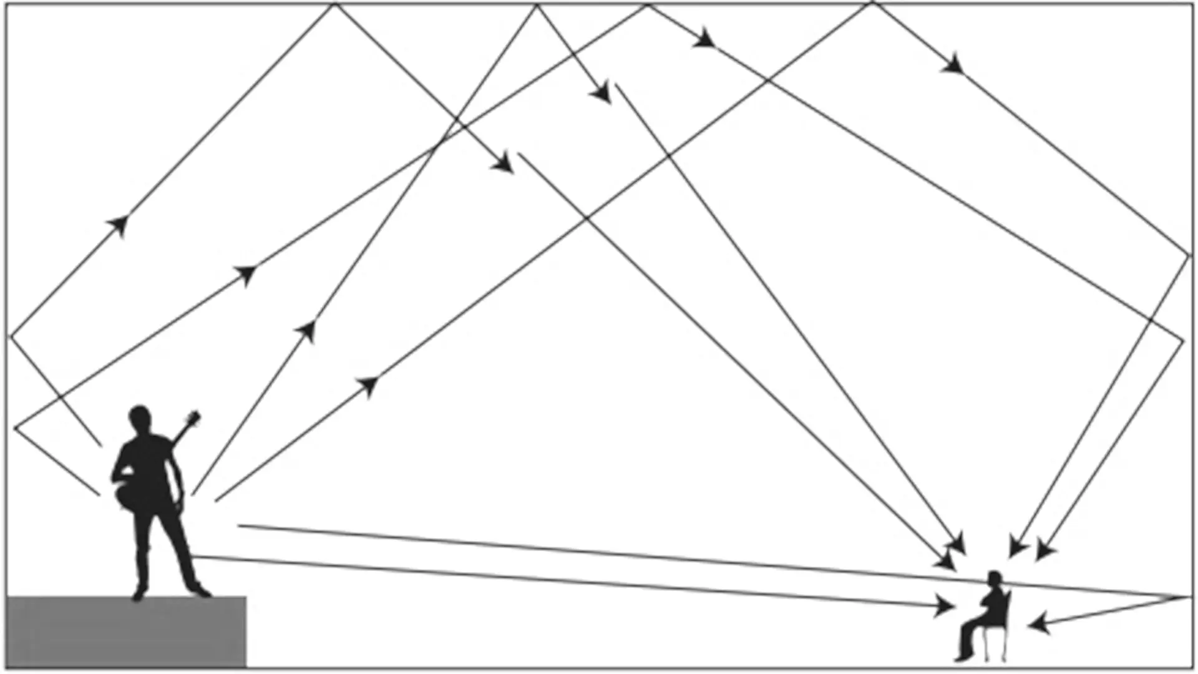
AGELESS ACOUSTICS
Room Acoustics
REVERBERATION
Reverberation is a measure of how long it takes sound to decay in a room.
A long reverberation time makes speech sound muddy and hard to understand.
A long reverberation time also increases noise buildup in the room (the loud restaurant scenario).
Large rooms and reflective surfaces increase reverb.
Hearing aids are less effective in reverberant environs.

Slide 11
AGELESS ACOUSTICS
Room Acoustics

Slide 12
AGELESS ACOUSTICS
Room Acoustics
ABSORPTION (sponge)
Soft, porous materials are better at absorbing sound.
Acoustic ceiling tiles
Fabric-wrapped fiberglass panels
Acoustic felt
Perforated or slatted wood
Carpet
REFLECTION (brick)
Hard, smooth materials reflect sound and increase reverberation.
Drywall/plaster
Concrete
Tile/Glass
Wood
Vinyl floors

Slide 13
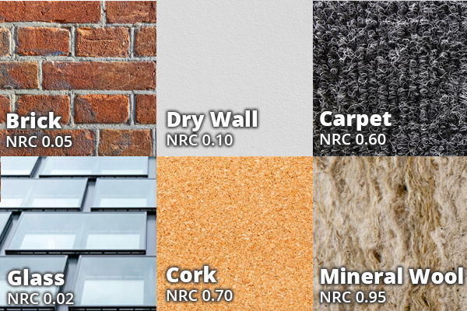
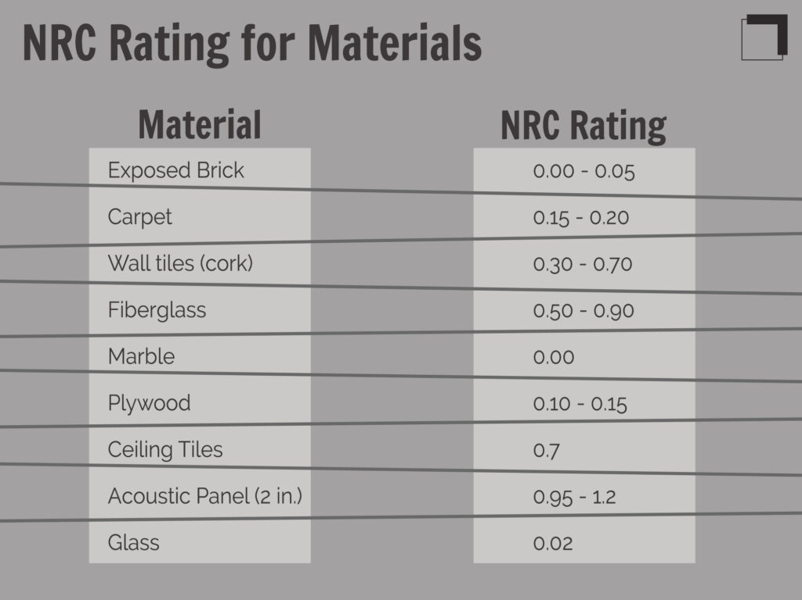
AGELESS ACOUSTICS
Room Acoustics
Acoustic performance is measured with the Noise Reduction Coefficient (NRC). Ranges from 0 to 1.0. Higher is more absorptive.

Slide 14
AGELESS ACOUSTICS
Room Acoustics
Highlands Ranch Senior Center

Slide 15
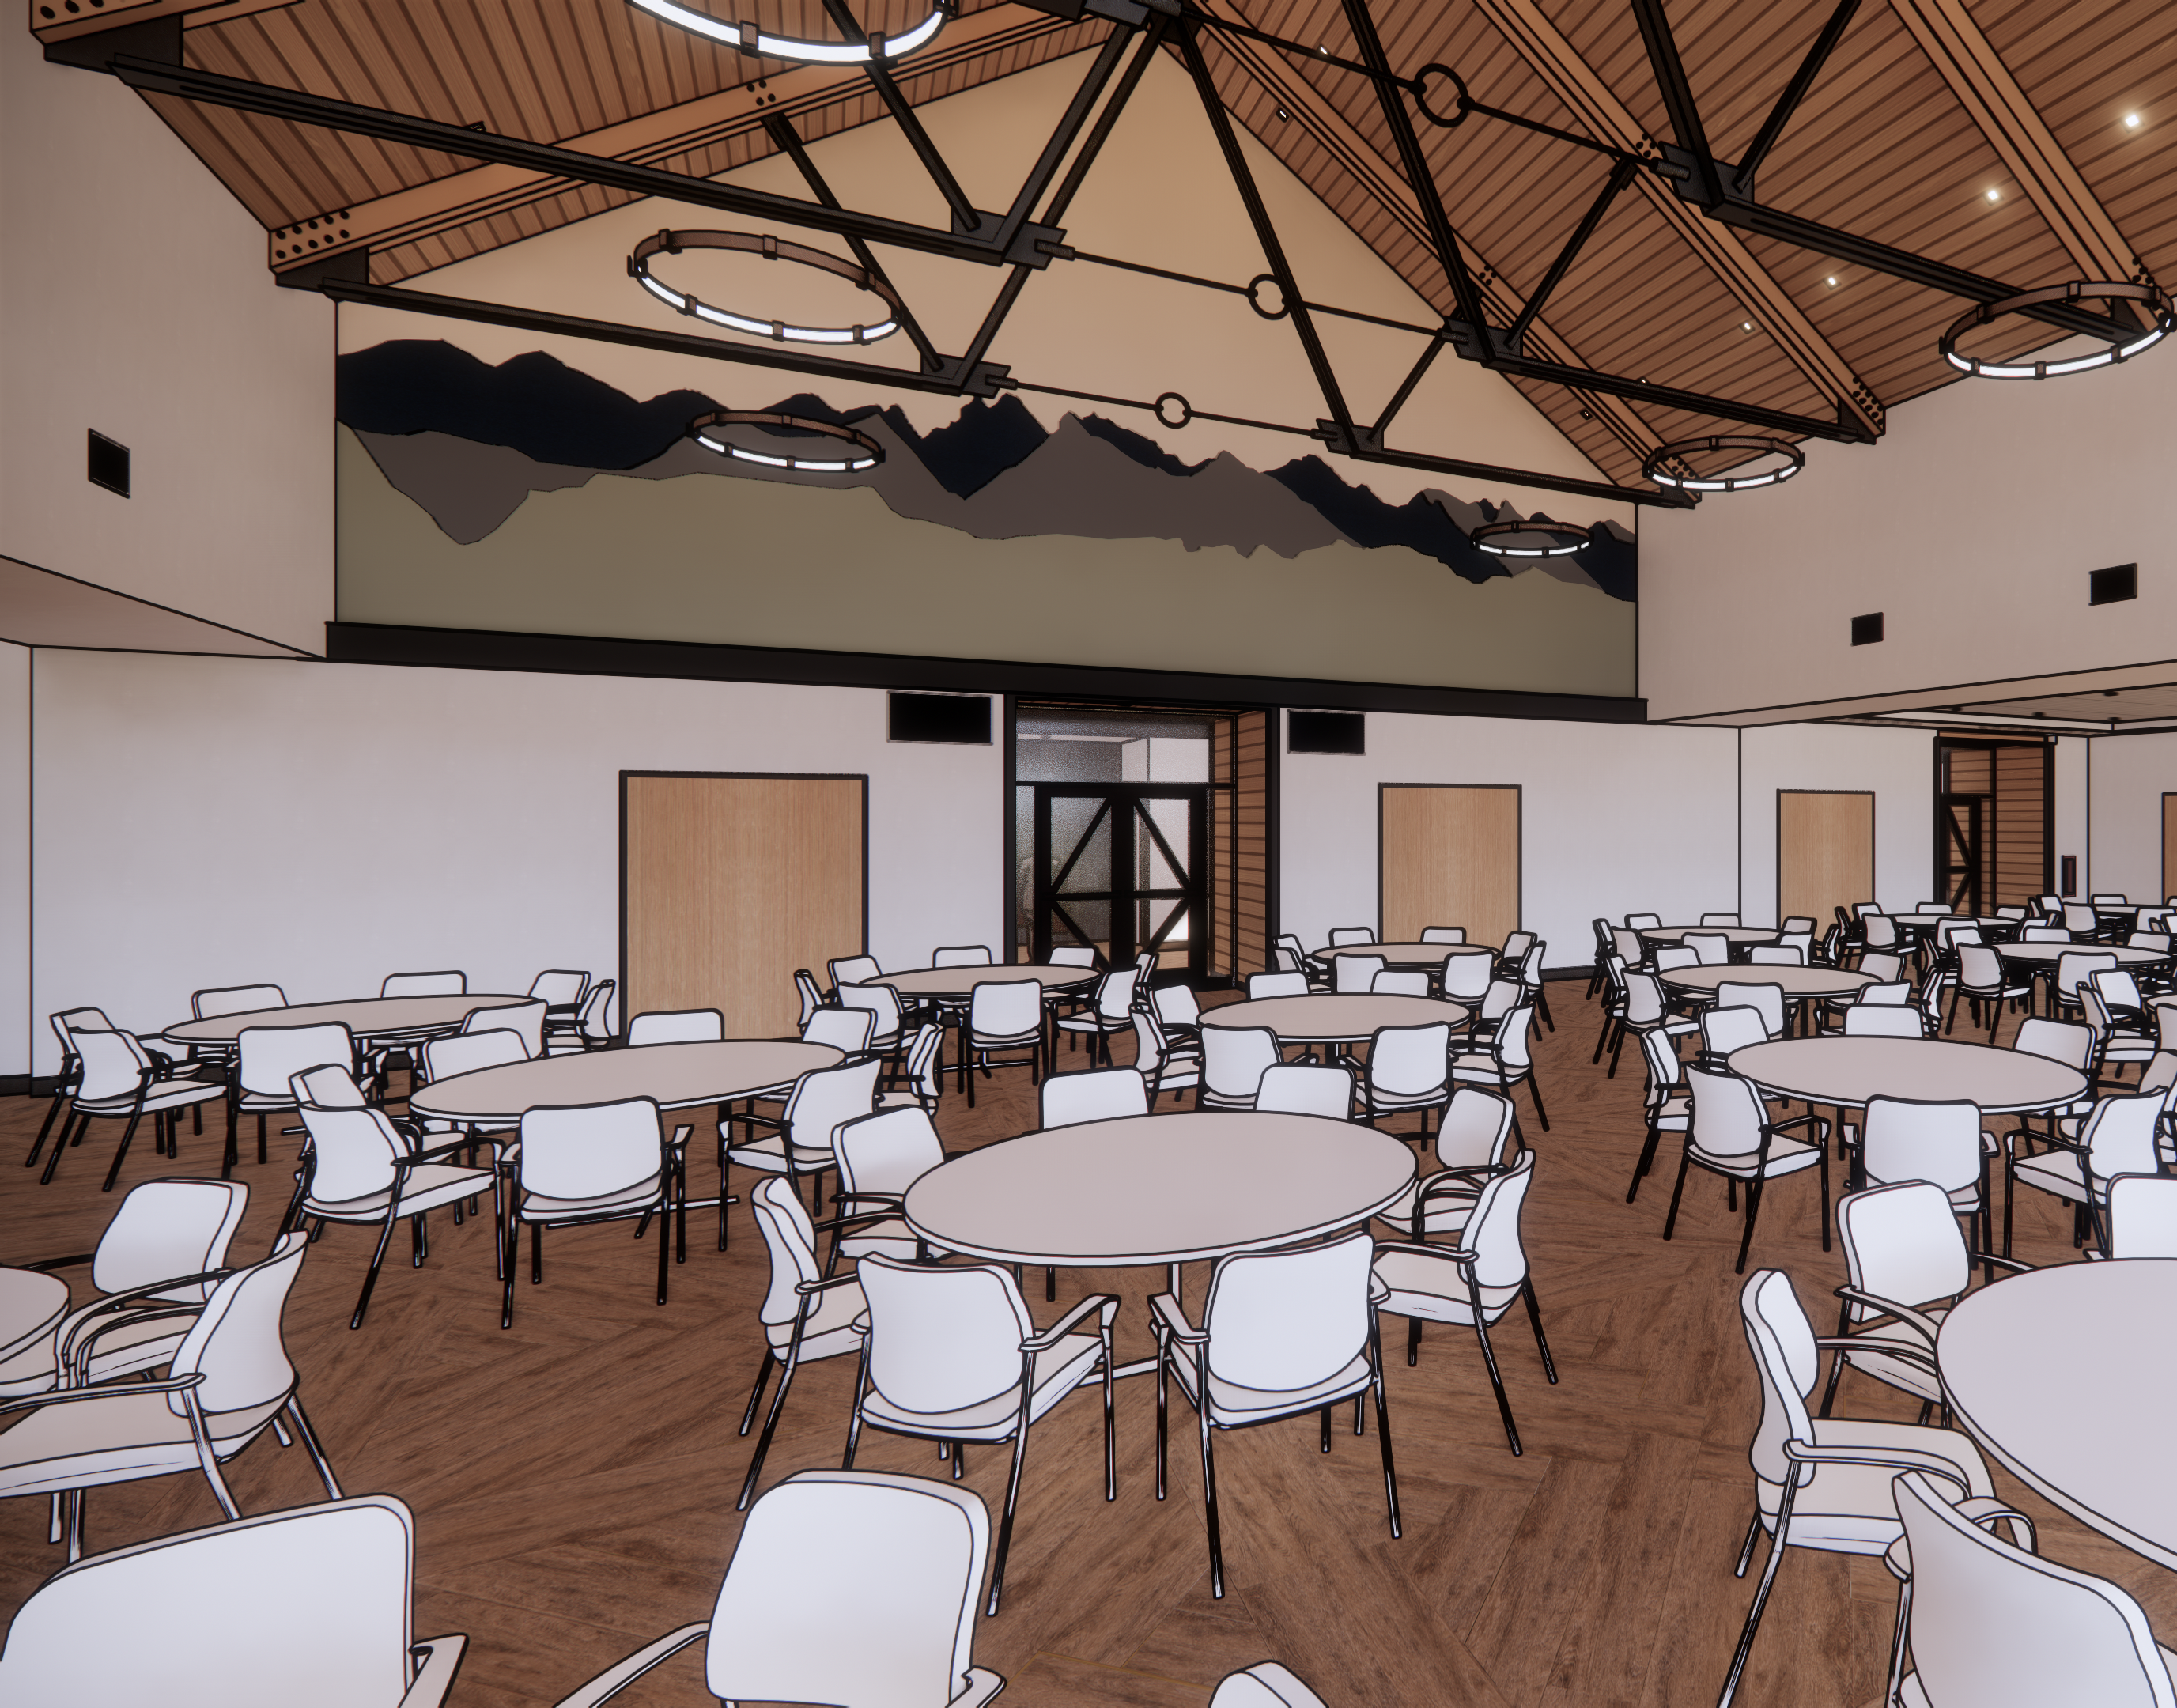
AGELESS ACOUSTICS
Room Acoustics
Highlands Ranch Senior Center

Slide 16
AGELESS ACOUSTICS
Room Acoustics
The Gallery at Broomfield

Slide 17
SOUND ISOLATION

Slide 18
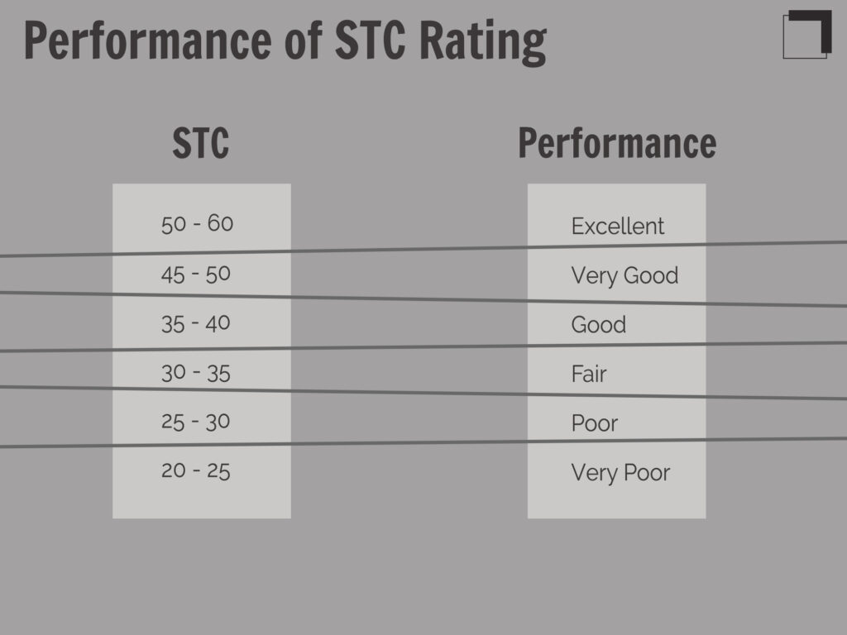
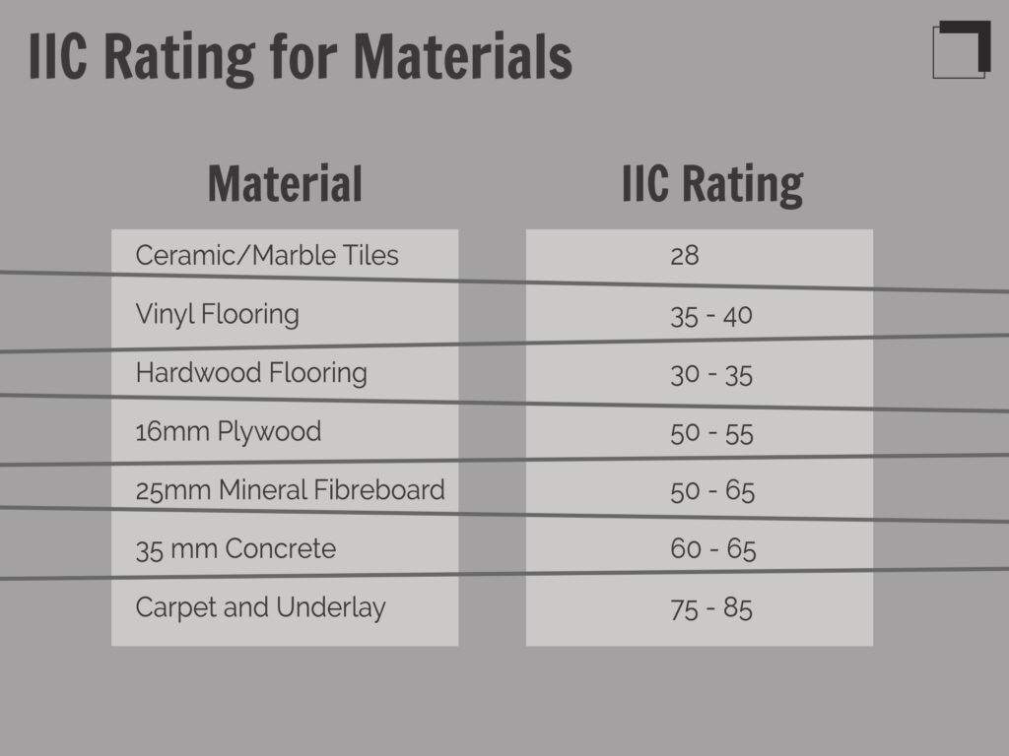
AGELESS ACOUSTICS
Sound Isolation
STC ratings
Sound Transmission Class is airborne sound. A higher number is better.
Talking
TV
Music
IIC ratings
Impact Insulation Class is for impact sound at floors. A higher number is better.
Footsteps
Chairs
Fitness

Slide 19
AGELESS ACOUSTICS
Sound Isolation

Slide 20
AGELESS ACOUSTICS
Sound Isolation
Design Considerations
Designing to higher STC and IIC levels will increase construction costs.
Specific to older adult projects:
Loud TVs
Residents moving from single family home can have less tolerance.
Not just that you can hear your neighbors but anxiety surrounding that they can hear you too!

Slide 21
AGELESS ACOUSTICS
Interior Sound Isolation
Unit to Unit Strategies
More mass is better.
Decoupling (double studs, staggered studs, resilient channels and clips, suspended ceilings).
Acoustic drywall (QuietRock, SoundBreak XP, etc.)
Resilient floor finishes (carpet is great or acoustic mats below hard flooring).
Unit to Common Area Strategies
Consider placement – locate noisy rooms away from sensitive rooms.
Don’t place fitness rooms on elevated floors. Special fitness flooring is available and equipment like treadmills can be isolated.
Avoid subwoofers in fitness rooms, theaters, etc. (difficult to isolate low frequencies).
Add sound seals to unit entry doors and door closers to avoid slamming.

Slide 22
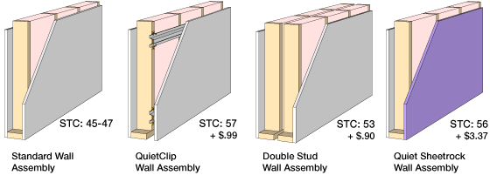
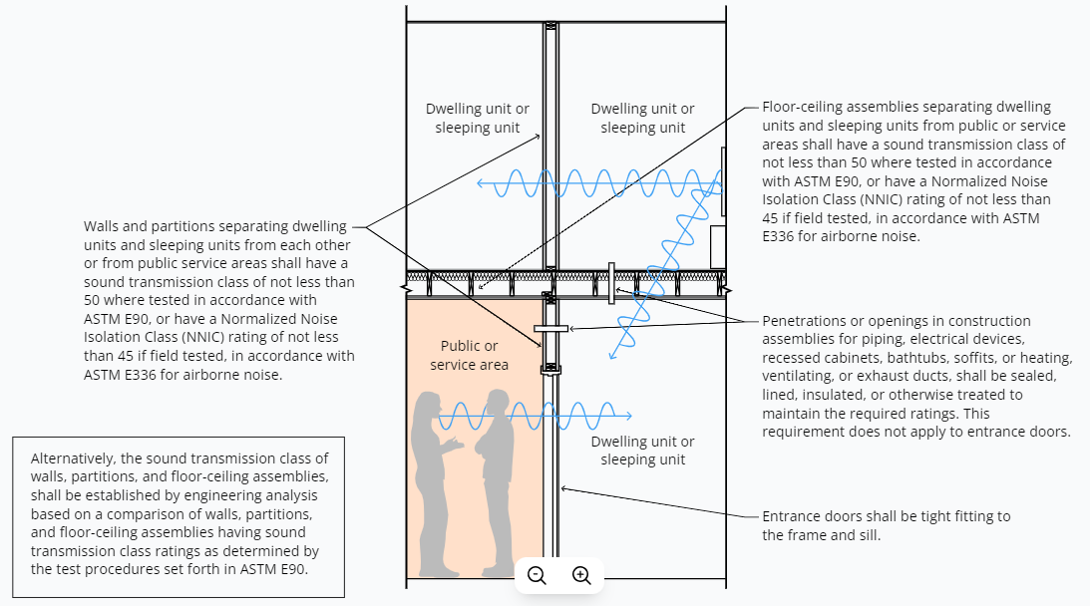
AGELESS ACOUSTICS
Sound Isolation
STC Wall Assemblies
$
$$
$$$

Slide 23
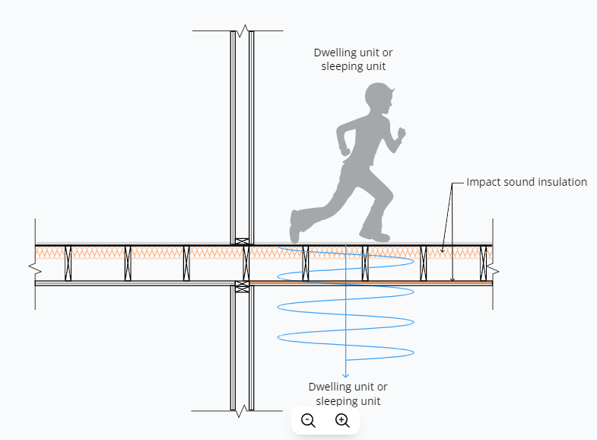
AGELESS ACOUSTICS
Interior Sound Isolation
IIC Floor Assemblies

Slide 24
MECHANICAL & ENVIRONMENTAL NOISE

Slide 25
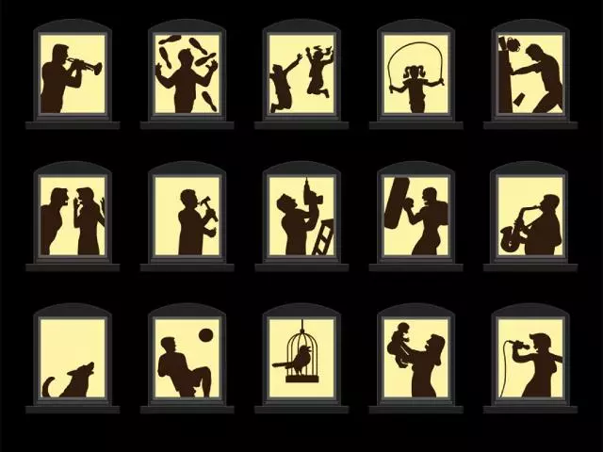
AGELESS ACOUSTICS
Mechanical & Environmental Noise
Noise
Typically measured in decibels (dBA) or Noise Criteria (NC).
Noise can be the “annoyances” that daily activities (ex: sleep).
Tonal
Repetitive
Impulsive or out of our control

Slide 26
AGELESS ACOUSTICS
Mechanical & Environmental Noise

Slide 27
AGELESS ACOUSTICS
Mechanical & Environmental Noise
Mechanical Noise
Fans
Air handlers
Rooftop units
Condensing units
Fan coil units
Heat pumps
VAV boxes
PTACs
Chillers
Pumps
Boilers
Mechanical Noise Reduction Strategies
Locate noisy equipment farther from sensitive spaces.
Avoid cheaper mechanical solutions (ex: PTAC).
Treat long duct runs w/ fiberglass duct liner or attenuators.
Isolate equipment vibration.
Reduce air velocity.
Enclose ductwork and equipment.

Slide 28
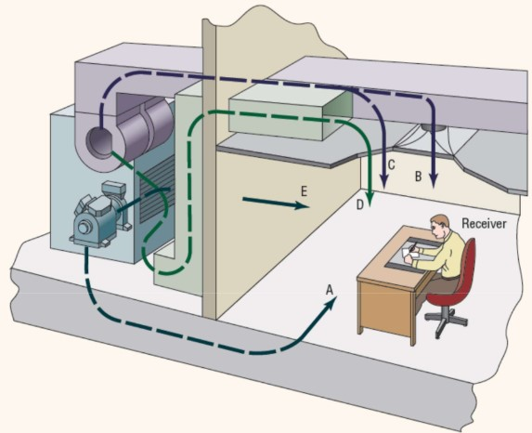
AGELESS ACOUSTICS
Mechanical & Environmental Noise
Mechanical Pathways
A. Path through floor
B. Path through supply air
C. Path from supply duct breakout
D. Path from return air
E. Path through walls

Slide 29
AGELESS ACOUSTICS
Mechanical & Environmental Noise
Environmental Noise
Traffic
Aircraft
Trains
Outdoor mechanical equipment
Pickleball
Environmental Noise Reduction Strategies
Consider site selection and building configuration.
Design for noise barriers and enclosures.
Select quieter mechanical equipment.
Consider upgrades to exterior wall assemblies (ex: laminated windows).

Slide 30
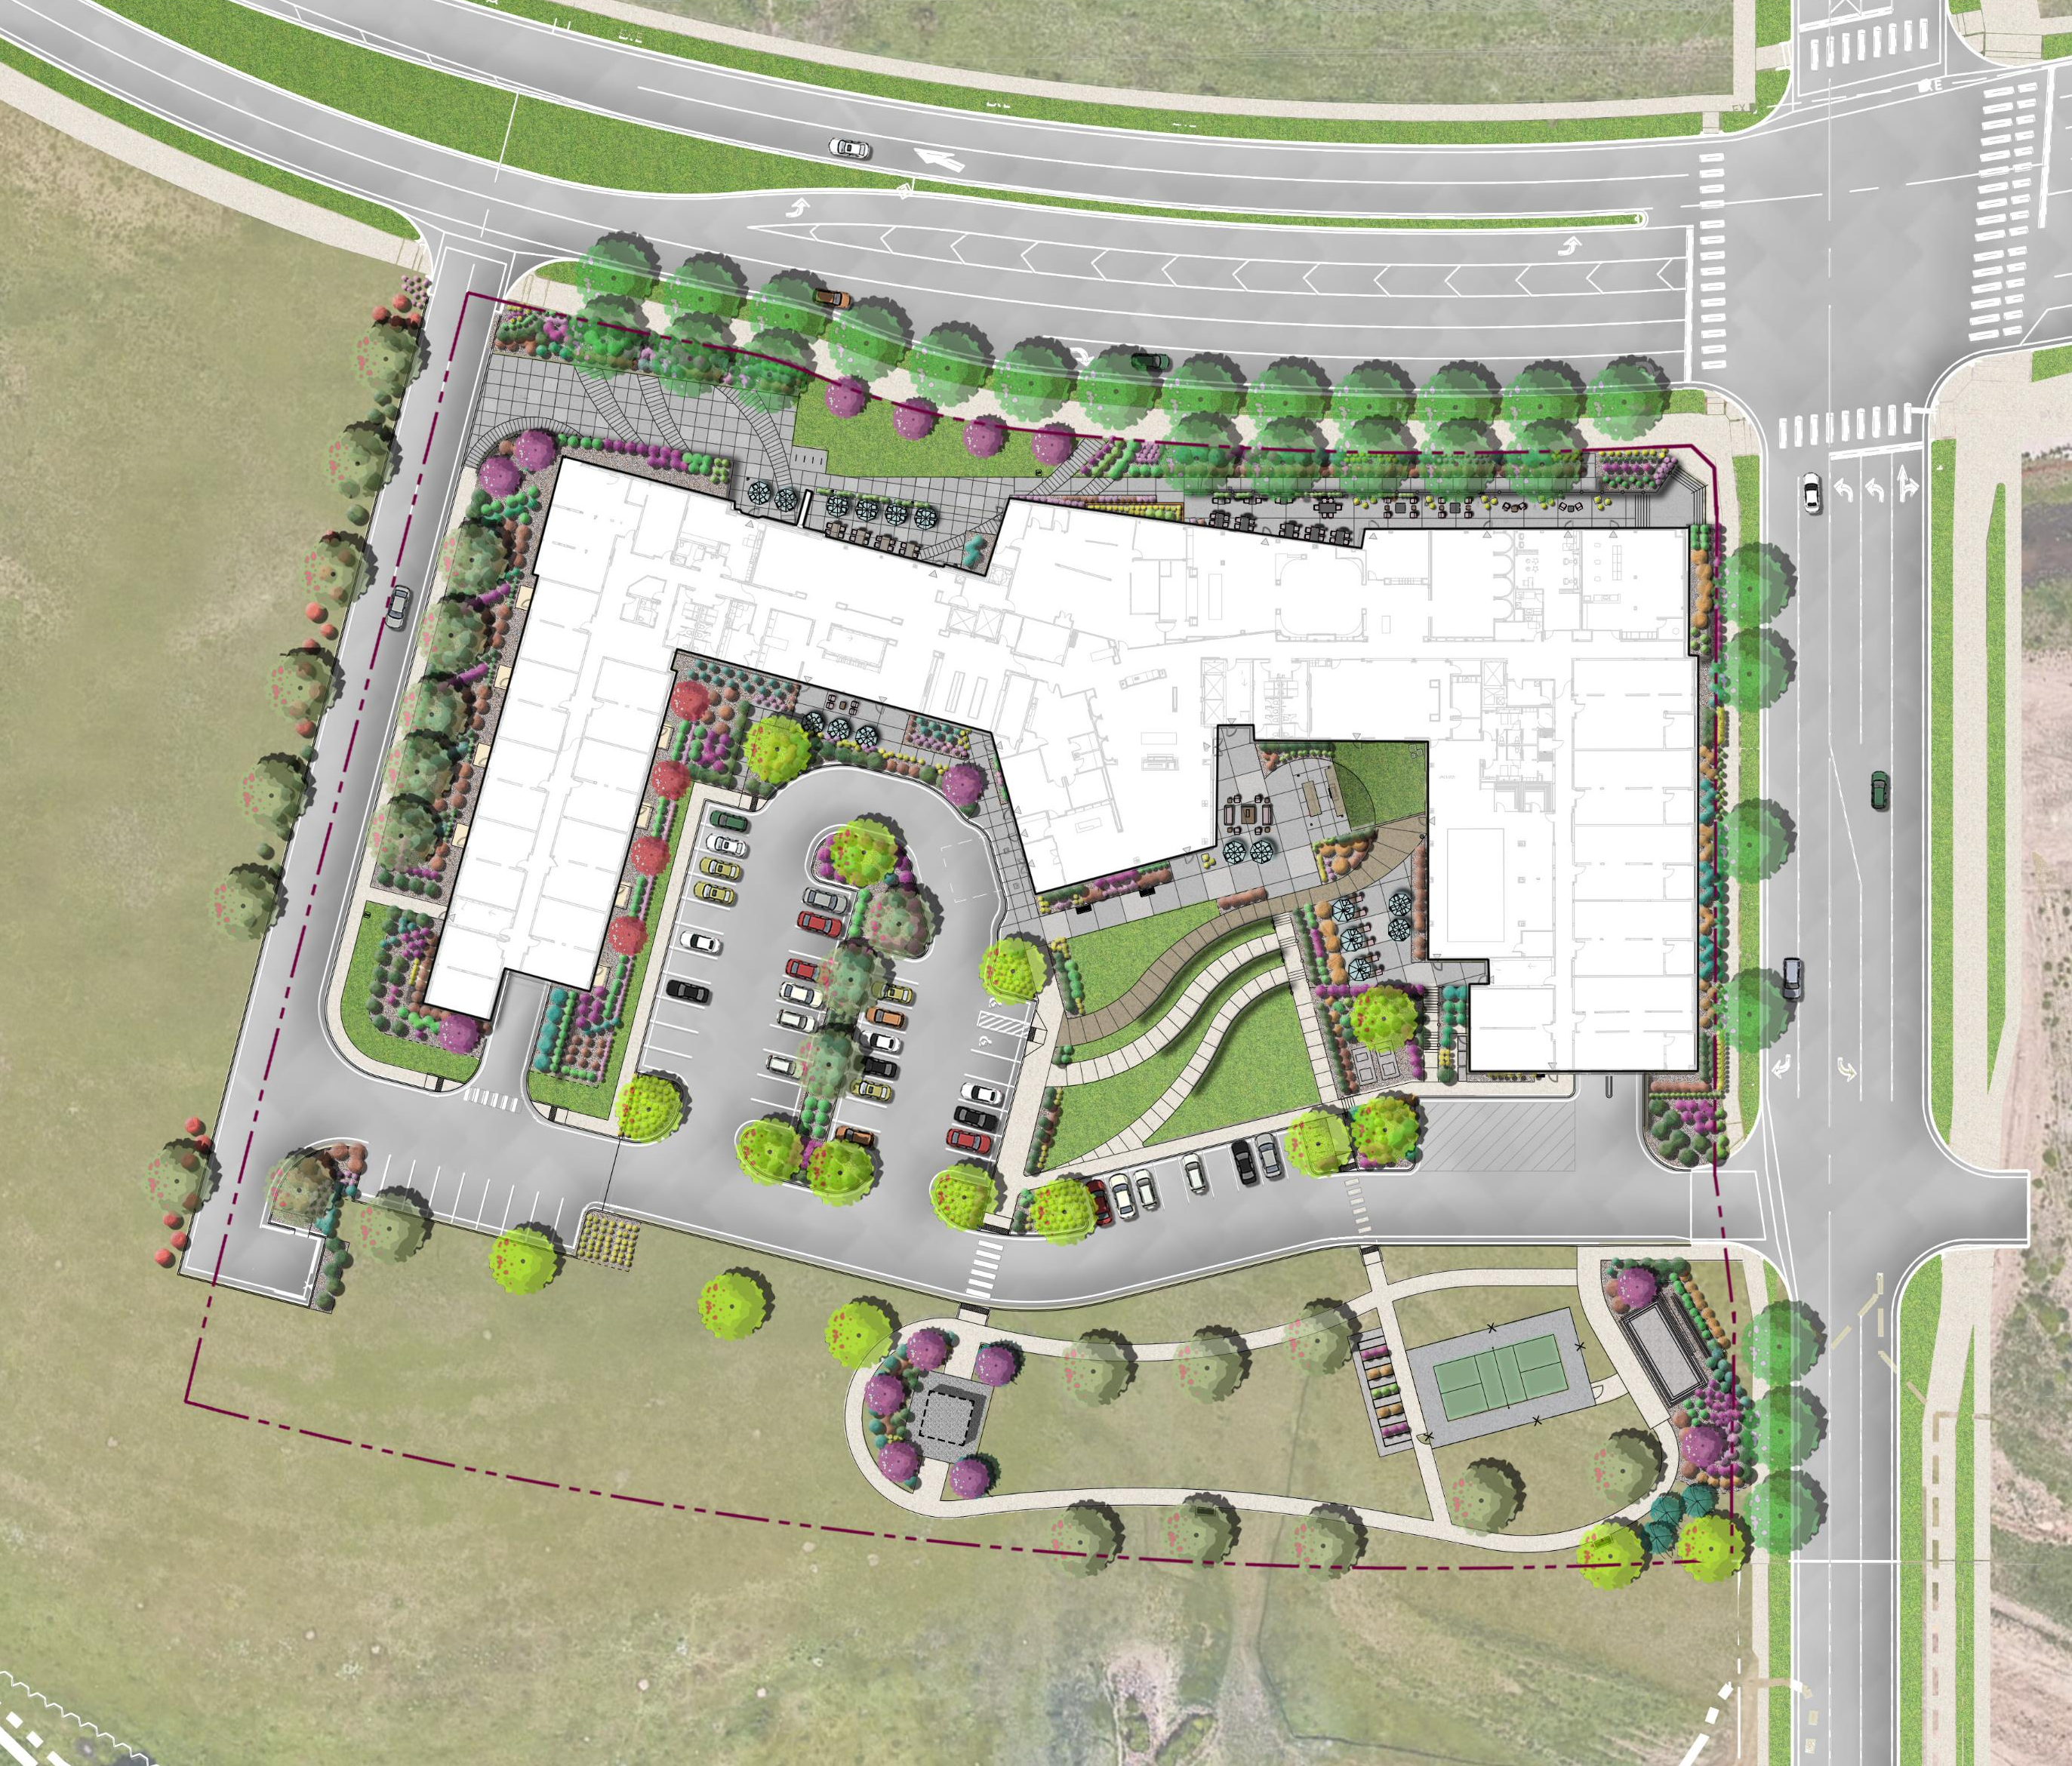
AGELESS ACOUSTICS
Mechanical & Environmental Noise
RTD Ridgegate Station
Trash
Generator
Dog Park
Pickleball Court
Regional Park
The Reserve at Lone Tree

Slide 31
TECHNOLGIES & SUMMARY

Slide 32
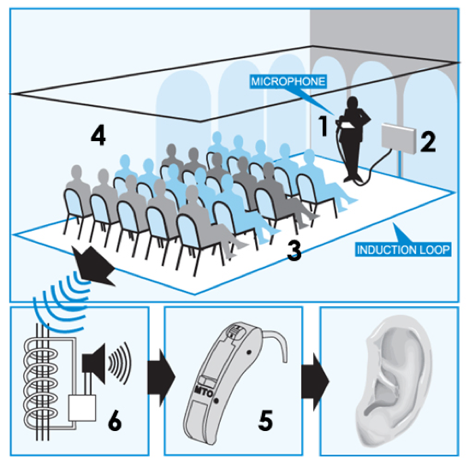
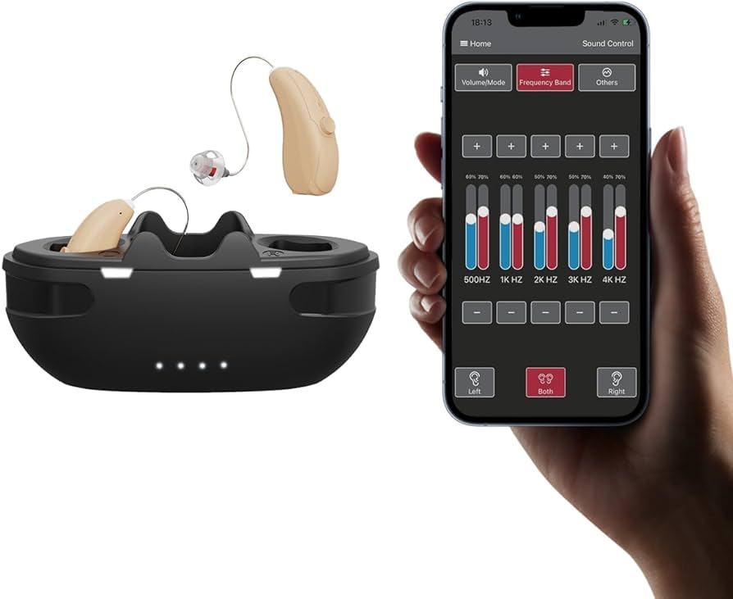
AGELESS ACOUSTICS
Sound Technology
Sound Loop
Bluetooth

Slide 33
AGELESS ACOUSTICS
Summary
Design Summaries
Is this an Absorption or Blocking issue?
Placement of program/spaces can avoid problems altogether.
Consider your materials and finishes.
Consider your mechanical options.
Hire an expert! Design solutions in the beginning can avoid throwing money at a solution later on.

Slide 34
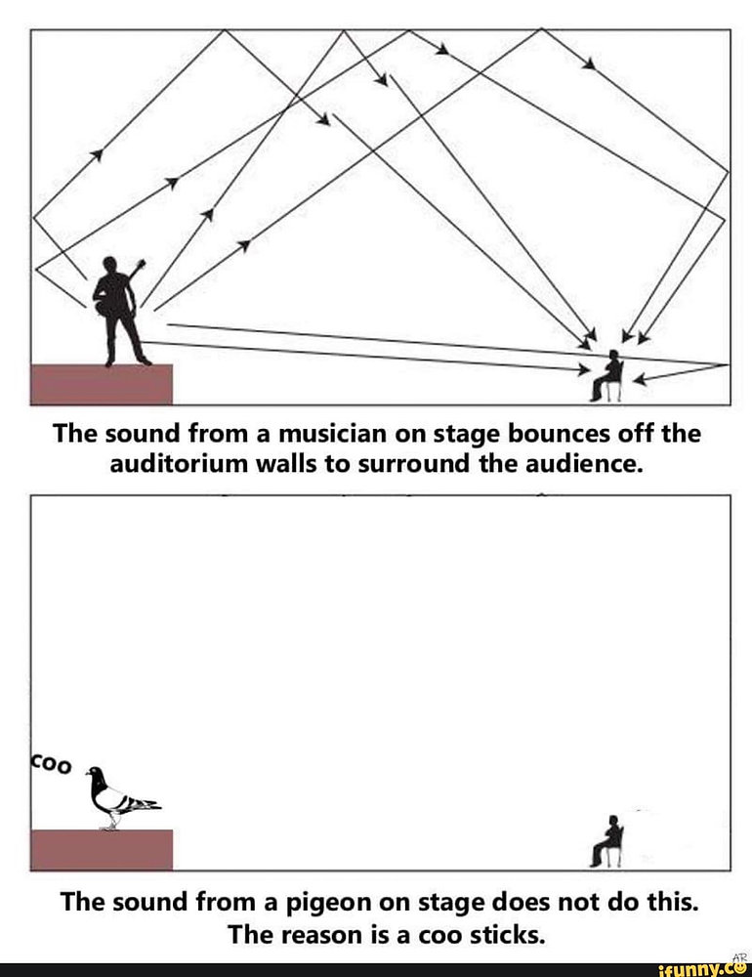
AGELESS ACOUSTICS
Summary

Slide 35
THANK YOU!

