Slide 1
2024 Regulatory & Legislative Updates
Presented by:
Peggy E. Kozal, Esq.
303.723.8406
pkozal@dickinson-wright.com

Slide 2
Agenda
New Legislation
Key Regulatory Changes
Department Enforcement
Updated General Compliance Program Guidance
Cybersecurity Initiatives

Slide 3
SB24-094 Safe Housing for Residential Tenants
Establishes and clarifies procedures regarding a tenant’s claim of breach of the warranty of habitability
Sets deadlines for communities to make repairs—i.e., 2 weeks after notice or 7 days if condition interferes with life, health or safety
Requires comparable dwelling unit/hotel while addressing uninhabitable conditions
Requires agreements to state where resident can report notice of an unsafe or uninhabitable condition

Slide 4
Safe Housing for Residential Tenants (cont’d)
Establishes procedures for when you can enter unit to address the condition and when a resident can deny entry
Clarifies certain conditions or characteristics of premises that are considered uninhabitable and rebuttable presumption that certain conditions materially interfere with life, health, or safety
Establishes legal standards and remedies/damages

Slide 5
Radon Disclosure
The Colorado Department of Public Health and Environment strongly recommends that ALL tenants have an indoor radon test performed before leasing residential real property and recommends having the radon levels mitigated if elevated radon concentrations are found. Elevated radon concentrations can be reduced by a radon mitigation professional.
Residential real property may present exposure to dangerous levels of indoor radon gas that may place the occupants at risk of developing radon-induced lung cancer. Radon, a Class A human carcinogen, is the leading cause of lung cancer in nonsmokers and the second leading cause of lung cancer overall. A landlord is required to provide the tenant with any known information on radon test results of the residential real property.

Slide 6
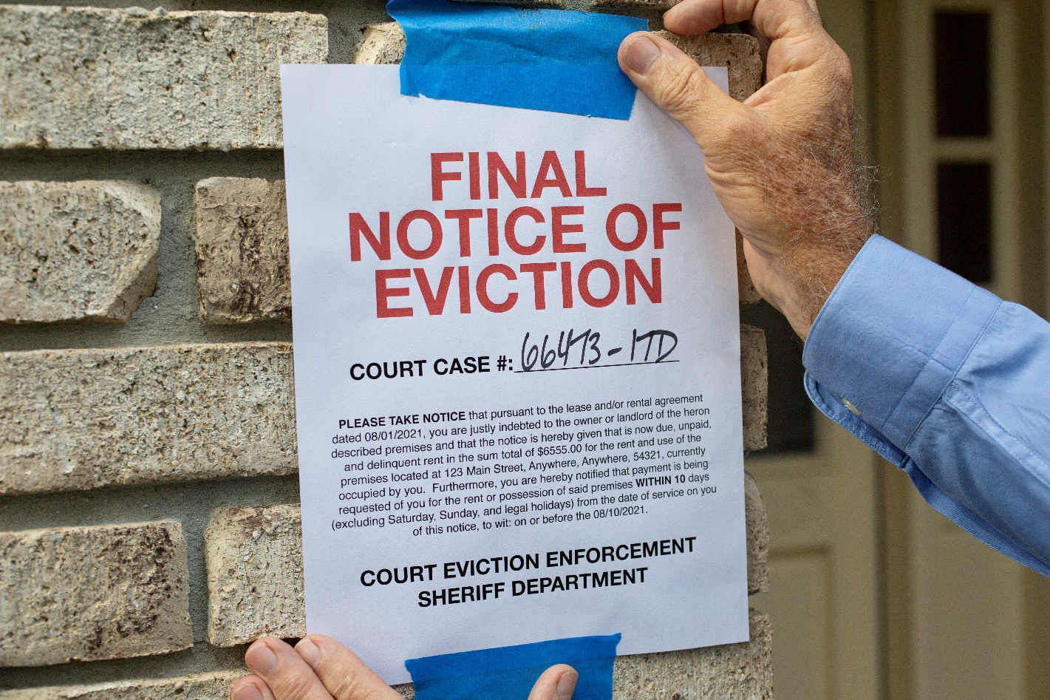
HB24-1098 For Cause Eviction Policy
LL shall not serve a notice to terminate tenancy or a demand for possession unless there is cause.
Does not apply to a residential tenant who has not been a tenant of premises for at least 12 months
Nonpayment of rent is an exception BUT rent payment qualifies as late only if it is submitted more than ten calendar days after the day it is due under the agreement and proper service of a written notice has been provided.

Slide 7
HB24-1260 Prohibition Against Certain Employee Discipline
Would prohibit against disciplining an employee for refusing to participate in employer speech
Prohibits subjecting or threatening to subject an employee to discipline, discharge, or adverse employment action on account of refusal to attend or participate in an employer-sponsored meeting concerning RELIGIOUS or POLITICAL matters
Requires distribution of notice to employees
Exempts certain religious corporations, entities, educational institutions, or societies or nonprofit faith-based health systems or nonprofit health facilities

Slide 8
HB24-1066 Prevent Workplace Violence in Healthcare Settings
Unlikely to pass this year
Hospitals, Nursing Facilities, ALRs, FQHCs would be required to:
Establish a workplace violence prevention committee to review workplace violence incidents and develop and regularly review a workplace violence prevention plan;
Adopt, implement, enforce, and update the plan;
Provide training on the plan and on workplace violence prevention;
Submit biannual workplace violence incident reports to CDPHE or BHA, as applicable; and
If a workplace violence incident occurs, offer post-incident services to affected staff.
Resource: https://www.osha.gov/hospitals/workplace-violence/

Slide 9
Other Shiny New Laws
Involuntary Discharge Grievance and Appeal process
Direct care staff must have dementia training
Fines for lack of administrator or interim administrator
Healthy Families and Workplaces Act – new reasons for leave as of 8/7/2023:
Bereavement, or financial/legal needs after a death of a family member; or
Due to inclement weather, power/heat/water loss, or other unexpected event, the employee must evacuate their residence or care for a family member whose school or place of care was closed.

Slide 10
Department Expectations Among Increase Enforcement
Culture
Celebrate successes – e.g., call light response times, reporting, completion of tasks, raffles, employees of the month
Administrator rounding and communications with staff
Check-ins and feedback
Decreased reliance on agency staffing
Staff understanding regulations
Identification of patterns or inconsistencies

Slide 11
November 2023 Updated General Compliance Program Guidance (GCPG)
Voluntary Guidance
Applicable to all but more specific ICPGs anticipated for 2024
Revises 7 elements of CP:
Written policies and procedures
Compliance leadership and oversight (previously Designated Compliance Officer and Compliance Committee)
Training and education
Effective lines of communication with the Compliance Officer and Disclosure Program
Enforcing standards: consequences and incentives
Risk assessment, auditing and monitoring
Responding to offenses and developing corrective action initiatives

Slide 12
Key Takeaways
Emphasizes need for commitment to compliance to stem from the top (e.g., Board and CEOs)
Adaptations for small and large entities
Risk Assessments
New entrants and PE
Quality and patient safety
Non-retaliation policies
Encourages participation in CPs through incentives

Slide 13
HHS Concept Paper Outlining Cybersecurity Strategy for HC Sector
Establish voluntary Cybersecurity Performance Goals
Provide resources to incentivize and implement cybersecurity practices
Implement an HHS-wide strategy to support greater enforcement and accountability
Expand and mature the “one-stop shop” within HHS for HC sector cybersecurity

Slide 14
Thank You / Questions

Slide 15
Peggy Kozal
Member | Denver, CO
303.723.8406 | pkozal@dickinsonwright.com
Peggy Kozal, based in Dickinson Wright’s Denver office, is a dedicated attorney deeply involved in the complex world of health care law. With a passion for untangling legal complexities, Peggy navigates regulatory compliance, litigation, data privacy and security matters, and strategic counsel for a diverse range of clients within the health care sector, including long-term care facilities, hospitals, physicians and physician practices.
She excels in identifying crucial legal matters and devising compliance strategies that not only reduce risks but also align with her clients’ strategic goals. Peggy brings a wealth of experience in advising on legal issues impacting health care operations for providers and other organizations within the health care industry.
Peggy’s practice extends to constructing frameworks that shield health care entities from fraud and abuse. She adeptly assists clients in managing whistleblower complaints and government investigations and also represents providers in reimbursement disputes involving state and federally funded programs.
She actively guides the day-to-day operations of health care clients, offering counsel on risk management, patient care, and emergency response programs. Peggy also regularly advises clients regarding compliance with privacy laws, including HIPAA, 42 CFR Part 2, and other state and federal data privacy and security frameworks. In today’s health care landscape, which emphasizes efficiency and quality, Peggy ensures her clients are well-prepared and compliant.
Beyond health care, Peggy leverages her legal insight in employment matters, skillfully managing high-stakes class actions and guiding health care entities in managing employment disputes. Her litigation skills cover administrative, state, and federal courts, demonstrating proficiency in enforcing arbitration agreements and advising clients on minimizing losses.
Her approach prioritizes strategic resolution, settling when it’s pragmatic and standing firm against unreasonable opposition.

