Slide 1
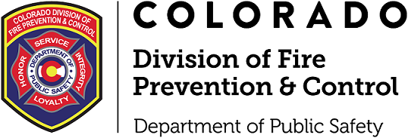
Fire & Life Safety Compliance in Health Care Facilities
Bryan Adams, Residential Health Care Unit Chief
Shannon St. Hilaire, Health Facilities Liaison
Fire & Life Safety Section
Division of Fire Prevention and Control Colorado Department of Public Safety
FR
FABRIKAM RESIDENCES

Slide 2
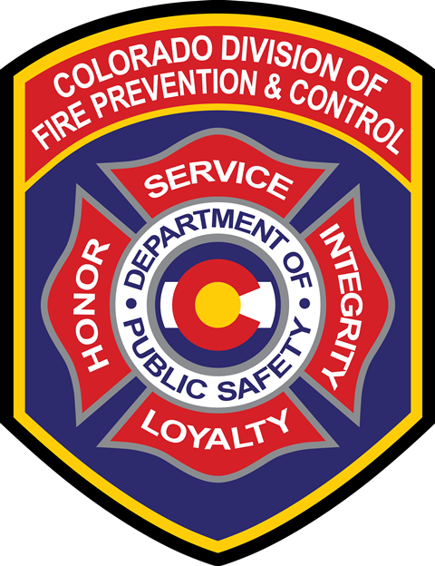
Topics of Discussion
DFPC Overview
Regulating Documents
Survey Process
License Portion
Q & A

Slide 3
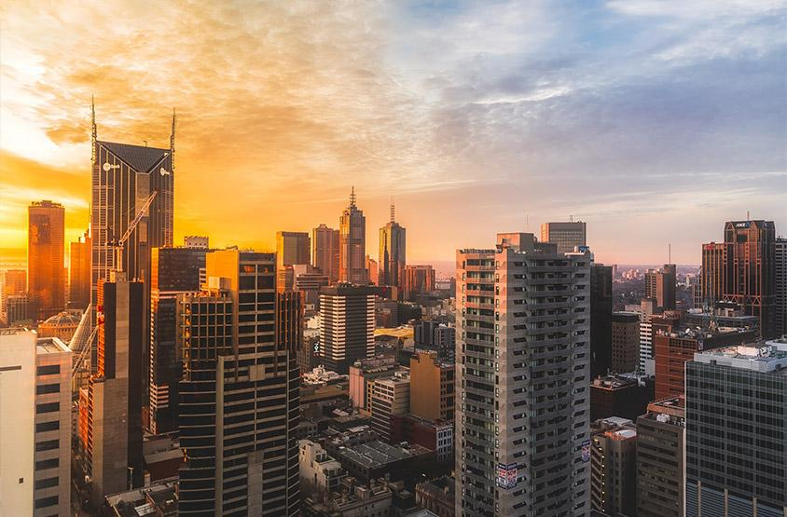
About Us
Colorado Division of Fire Prevention and Control
DFPC
4 Sections
Wildland Fire Management
Center of Excellence
Professional Qualifications & Training
Fire & Life Safety

Slide 4
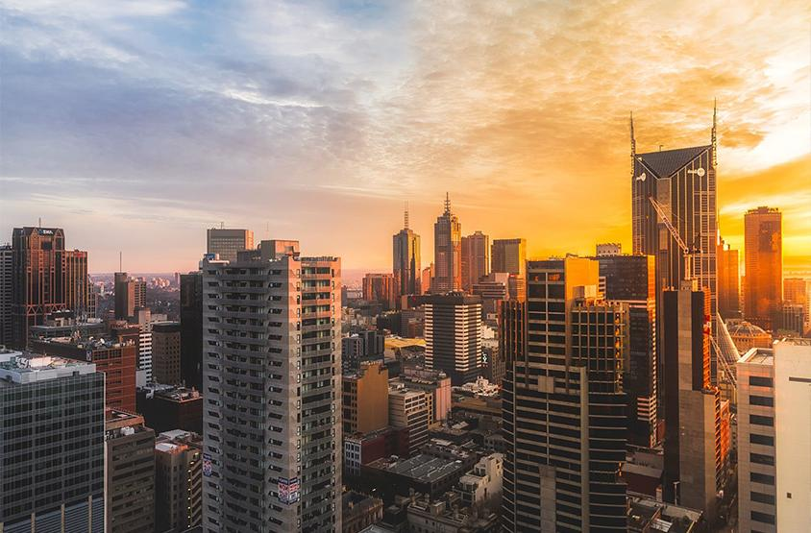
Fire & Life Safety Section
Fire Prevention Branch
Branch Chief- Chief JT McLeod
Plan Review Unit Chief- Chief Mike Garitano
Health Care Unit Chief (Acute) – Chief Pete Anderson
Health Care Unit Chief (Residential) - Chief Bryan Adams
Suppression/Schools Unit Chief – Chief Bryan Kendall

Slide 5
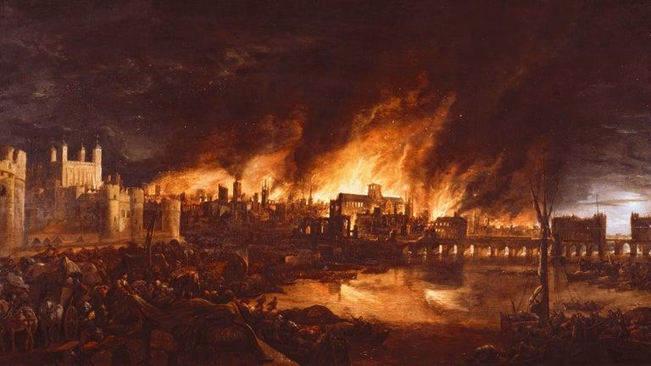
Historic Fires
Fire codes are reactive. We study why things happen and make codes retroactively.
Triangle Shirtwaist
•146 deaths, 78 injured
•Factor - locked exits
MGM Grand
•85 deaths, 600-700 injured
•Factors – penetrations, no sprinklers
Station Night Club
•100 deaths, 230 injured
•Factors – interior finishes, blocked exits, exit width
Iroquois Theatre
•602 deaths, 250 injured
•Factors – Door swing direction, interior finishes, no separations

Slide 6
Regulating Documents for DFPC Inspections
6 CCR 1011-1 Chapter 2
Part 2.
LICENSURE PROCESS
2.8 Issuance of License
2.8.1 No license shall be issued until the applicant conforms to all applicable statutes and regulations.
(A) The Department shall not issue or renew any license unless it has received a Department of Public Safety Certificate of Compliance certifying that the building or structure of the facility or agency is in conformity with the standards adopted by the Director of the Division of Fire Prevention and Control. This requirement does not apply to out-patient hospice or home care agency licenses because they do not provide services on their own premises.

Slide 7
Regulating Documents for DFPC Inspections
6 CCR 1011-1 Chapter 2
Part 3.
General Building and Fire Safety Provisions
3.2 Physical Plant Standards
3.2.2 All physical locations of a facility or agency shall be constructed in conformity with the standards adopted by the Director of the Division of Fire Prevention and Control (DFPC) at the Colorado Department of Public Safety, as applicable.
(A) An applicant or licensee that is subject to fire prevention and life safety code requirements shall not provide services in areas subject to plan review, except as approved by DFPC.
8 CCR 1507-31
BUILDING, FIRE, AND LIFE SAFETY CODE ENFORCEMENT AND CERTIFICATION OF INSPECTORS FOR HEALTH FACILITIES LICENSED BY THE STATE OF COLORADO

Slide 8
NFPA 101 2012 Edition
Adopted Edition – 2012
Effective – July 5, 2016
Applicable Chapters
Chapter 18 New Health Care Occupancies
Chapter 19 Existing Health Care Occupancies
Chapter 20 New Ambulatory Health Care Occupancies
Chapter 21 Existing Ambulatory Health Care Occupancies
Chapter 32 New Residential Board & Care Occupancies
Chapter 33 Existing Residential Board & Care Occupancies

Slide 9
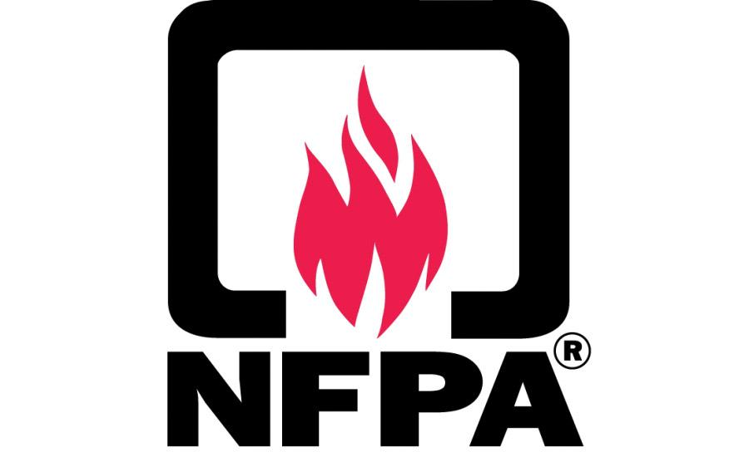
Life Safety Code
Requirements
NFPA 101-2012 (Life Safety)
NFPA 99 (Healthcare Facilities Code)
NFPA 13 (Sprinkler Code)
NFPA 25 (Inspection/Testing Maintenance)
NFPA 72 (Fire Alarms)
NFPA 14 (Standpipes & Hose)
NFPA 96 (Commercial Cooking)
NFPA 10 (Fire Extinguishers)
NFPA 80 (Fire Doors)
NFPA 105 (Smoke Doors)

Slide 10
Fire/Life Safety Basics
Definitions
Egress- the action of going out of or leaving a place.
AHJ- Authority Having Jurisdiction
Compliance- the act or process of complying with an applicable law, code, regulation, or rule
Occupancy Type – What goes on inside a building

Slide 11
Survey Process for Residential Health Care
ALR/ACF/SLP, SNF/NF/NF-Lic, ICF-IID, BHE
CMS Inspections and Certificate of Compliance Inspections
Task 1 – Offsite Survey Preparation
Task 2 - Entrance Conference/Onsite Preparatory Activities
Task 3 - Information Gathering
Task 4 - Facility Tour
Task 5 - Information Analysis and Decision Making
Task 6 - Exit Conference

Slide 12
Task 1 – Offsite Survey Preparation
The surveyor or survey team will review the facility file for:
• Recent licensure and/or certification surveys, including any deficiencies from the previous, bed capacity, change in ownership, facility waivers;
• Corrective action status (if applicable);
• Complaint investigations;
• Facility floor plans, including the location of individual rooms, exits and commons areas; and
• Correspondence to or from the state agency and the facility.

Slide 13
Task 2 – Entrance Conference/Onsite Preparatory Activities
Entrance Conference:
The objectives of this task are to explain the survey process to the facility leadership and obtain the information needed to conduct the survey.
Explains the purpose and scope of the survey (initial certification or recertification; complaint investigation; validation; revisit)
Discusses how the facility will timely provide the surveyors inspection/testing/maintenance records, and other information as needed;
Discusses the appropriate time, location, and possible attendees of any meetings to be held during the survey; and
Proposes a preliminary date and time for the exit conference.

Slide 14
Task 3 – Information Gathering
The general objectives of this task are to complete observations, interviews, and record reviews. The team’s or surveyor’s preliminary identification on potentially deficient areas that require follow-up prior to the Exit Conference.
In evaluating whether the facility is currently in compliance, the survey team must consider:
What corrective action the facility implemented for areas where noncompliance is identified;
Whether the corrective action was sufficient to address the underlying, systemic causes of the deficiency;
Whether the corrective action was evaluated for its effectiveness to sustain long term compliance; and
Whether there are any other findings from the survey indicating current noncompliance.

Slide 15
Task 4 – Facility Tour
The Facility Tour - The surveyor(s) inspect the building with facility staff (e.g., maintenance director, administrator, regional staff, others) to review:
Life safety systems (emergency lighting, fire panel, fire extinguishers)
Egress (exit doors, pathways, hallways)
General building maintenance (smoke doors, rate doors, penetrations)
Generator (if applicable)
The facility is provided with the opportunity to review and discuss concerns during the tour.

Slide 16
Task – 5 Information Analysis and Decision Making
Determining what findings are considered deficient based on observations, interviews, and record reviews
Developing an initial deficiency list to share at the Exit Conference
Determining the potential citation level of deficiencies (CMS inspections)

Slide 17
Task 6 – Exit Conference
The general objective of this task is to inform the facility management of the team’s preliminary findings.
Presentation of findings (2567 versus DFPC findings report)
Discuss a plan of correction (COHFI process versus email)
Discuss revisit type (desk versus onsite)

Slide 18
Most Common Deficiencies and
Points of Confusion
What they are and why they’re important.
Deficiencies
Confusion
Avoidable Stuff
  Missing Records
  Unprepared Staff
Small Stuff
  Loaded Sprinkler Heads
  Overloaded Power Strips
Big Stuff
  Non-functional Systems
  Exceeded Capabilities
  Blocked Egress
Codes and Definitions
Fire Drills
Resident Rating Sheets
Plan of Correction

Slide 19
Residential Healthcare
ALR, ACF, SNF, NCF, ICFIID,BHE
License Portion
  DFPC is the Life Safety Authority when it comes to your licensure.
  CDPHE is the Heath and Environment Authority when it comes to your licensure.

Slide 20
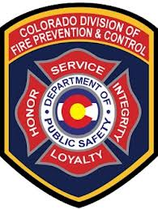
Who Completes My Inspection?
Are you ACF/SNF
Are you a Private Pay ALRONLY/NF-Lic?
Does your fire department complete inspections?

Slide 21
Who inspects ACF/SNF facilities?
  Federal and state reimbursement requirements mandate the frequency of inspections for healthcare facilities.
  Specifically, Skilled Nursing Facilities (SNFs) are inspected annually.
  Assisted Care Facilities (ACFs) and SNFs undergo inspections within a three-year timeframe.
  Local fire departments may also conduct concurrent inspections.

Slide 22
Who inspects private-pay ALR-only or NCF facilities?
  For facilities where the local fire department does not conduct an inspection, DFPC will carry out a life safety inspection at some point within a three-year cycle.
  Even if your local fire department does perform inspections, DFPC will still conduct a separate life safety inspection within the same three-year timeframe.

Slide 23
Plan Review
ALRONLY, ACF, SNF, NCF, ICF-IID,BHE
DFPC is required to conduct a plan review.
Your local building and fire departments must also conduct their own plan reviews.

Slide 24
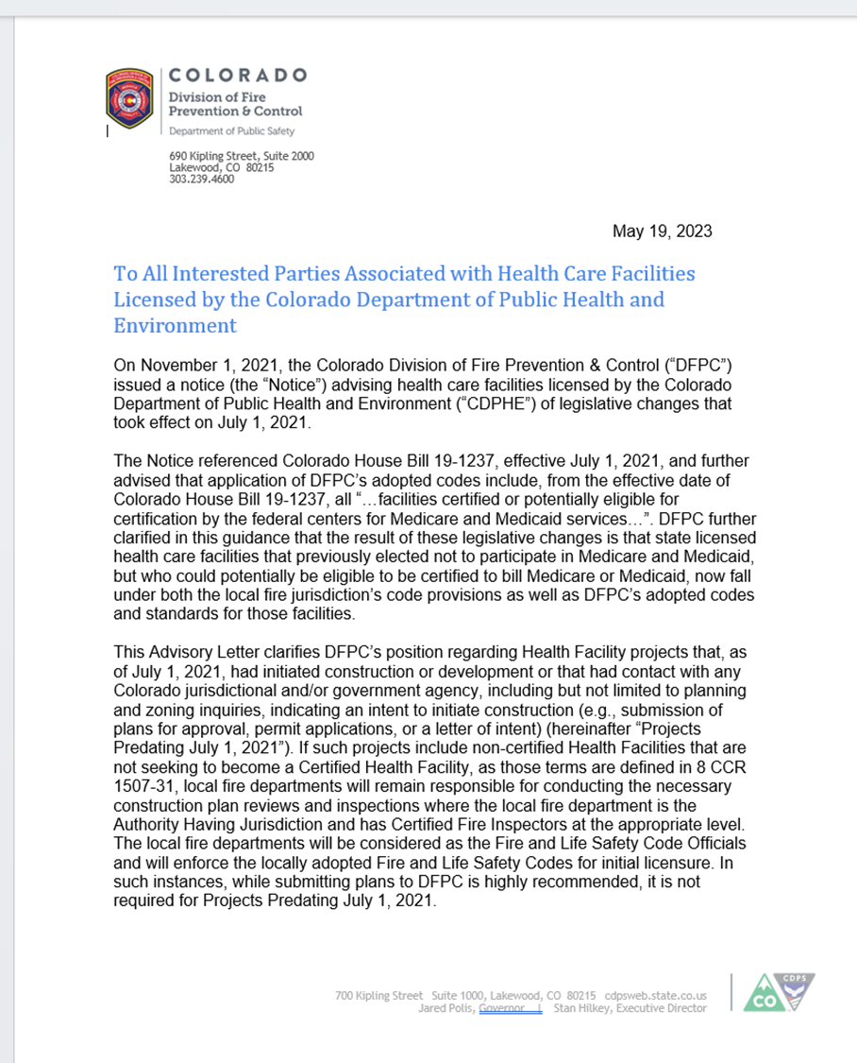

Slide 25

Common Code Issues
Different Codes
Multiple Jurisdictions
Different Surveyors/Inspectors
Conflicting Information

Slide 26
Questions?

Slide 27

Thank You.
FR
JT Mcleod
FABRIKAM RESIDENCES
303 921 0165
jt.mcleod@state.co.us
https://dfpc.colorado.gov/FLS

